Slide 1
Physical vs. Chemical: Properties and Changes in Matter

Slide 2
*What is a property?
A property is a description of an object in which you can use your 5 senses to observe (see, touch, hear, smell, taste)

Slide 3
*Physical property
Physical Properties can be identified without changing what the substance is

Slide 4
*Examples of physical properties
Types of physical properties | Description of property
Color / Luster
Shape
Texture | How something feels when its touched
Smell
Physical state | Is it a solid, liquid, or gas
Melting, boiling, freezing, condensing, evaporation points | How much energy is needed for it to change to different physical states

Slide 5
*Examples of physical properties
Types of physical properties | Description of property
Electrical conductivity | Ability for substance to conduct electrical current
Magnetism | Ability to attract iron
Solubility | Ability to dissolve into another substance
Ductility | Ability to be rolled into wires
Malleability | Ability to be rolled into sheets ex- aluminum foil

Slide 6
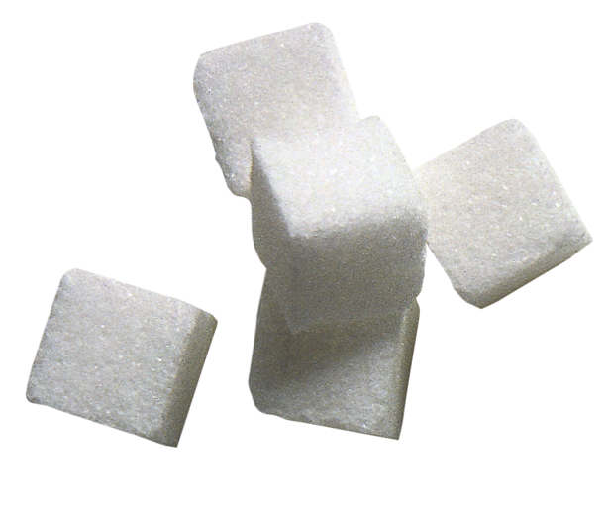
Physical properties
List as many physical properties as you can for this item

Slide 7
*Chemical properties
A Chemical property is a characteristic of a substance that can only be observed by changing the substance to a different substance.

Slide 8
*Examples of Chemical properties
Types of chemical properties | Description of property
Energy is released | in the form of a sound, gas, or light
Flammability | The ability for something to burn
Nonflammability | Inability for something to burn
Reactivity | Ability to tarnish, rust, decompose, or form into another substance
nonreactivity | Inability to tarnish, rust, decompose, or turn into another substance

Slide 9
SO what is a physical change?

Slide 10
*Physical Change
A physical change affects one or more physical properties (like size, shape, state, color, etc), but DOES NOT change the identity of the substance
Ex. Cotton can be dyed red. This cotton will still be flammable and it is still cotton so you’ve only changed the color of the cotton when you dyed it

Slide 11
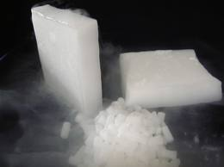
*Evidence of a Physical Change occurred
Changes in shape, form, size
Cutting, breaking, bending
Change in phase (This is always a physical change!)
Physical changes are usually reversible

Slide 12
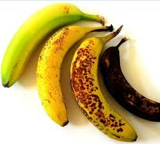
* Chemical change
A chemical change is a change in which a substance is changed into a different substance with new properties.

Slide 13
*Examples of Chemical changes
Types of chemical change | Description/ example of change
Color change | Rotting banana changes from yellow to brown
Change in odor | Spoiled milk smell changes to sour
Bubbling, clouding, or fizzing | A gas is forming
A precipitate forms | Two liquids mixed together creates a solid
Production of light or heat

Slide 14
Lets practice!

Slide 15
Write if this is a physical or chemical change
1) Glass breaking | 7) Hammering wood together to build treehouse
2) Rusting bicycle | 8) Creating glass sculpture
3) Burning toast | 9) Separating sand from gravel
4) Cutting grass | 10) Water evaporating from pond
5) Frying an egg | 11) Fireworks exploding
6) Spoiling food | 12) Pouring milk on your cereal

Slide 17
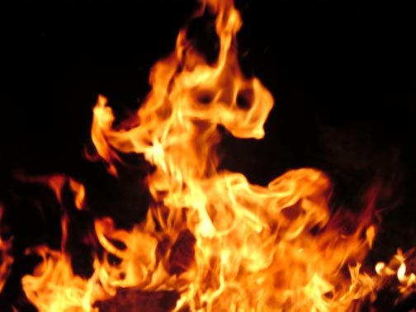
When a chemical change occurs, energy is either released or absorbed.
A chemical reaction that releases energy in the form of heat is called exothermic.
Heat comes OUT
Exo = out
Thermic = heat
It will feel HOT.

Slide 18
When a chemical change occurs, energy is either released or absorbed.
A chemical reaction that absorbs energy in the form of heat is called endothermic.
Heat goes in
Endo = In
Thermic = heat
It will feel COLD.

