Slide 1
Plankton, Plant Life, & Ocean Exploration
Created And Presented By: Aeris Drost, Brooke Baldwin, Madison Pietruszka

Slide 2
Zooplankton and Phytoplankton

Slide 3
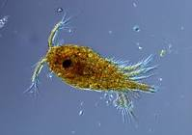
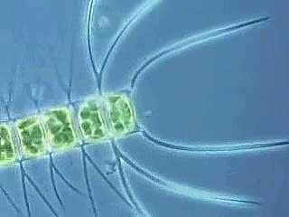
What is Phytoplankton?
Phytoplankton are microscopic plants.
Phytoplankton lives in the upper part of the ocean where light penetrates.
Phytoplankton need sunlight for photosynthesis just like any other plant.
Benefit: They provide food for many animals.

Slide 4
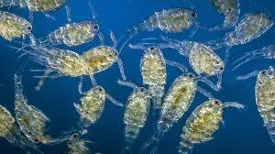
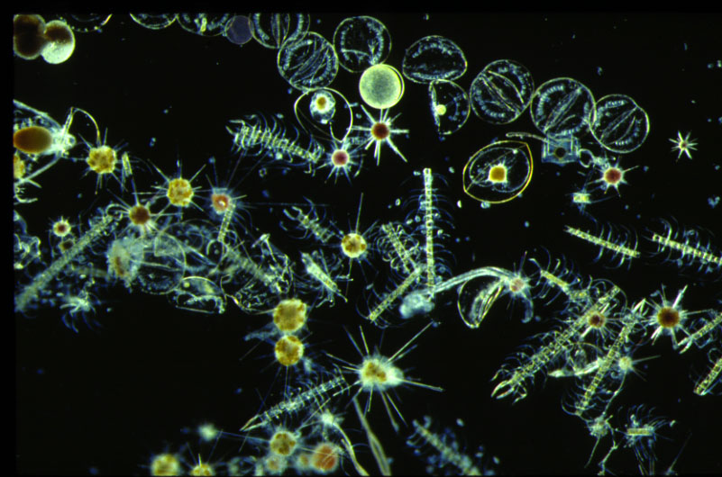
How Phytoplankton Photosynthesize
Similar to plants found on land, phytoplankton use their chlorophyll to get sunlight. They then take that sunlight and turn it into chemical energy. They also photosynthesize carbon dioxide and release oxygen. Most of the carbon is eventually returned to surface waters nearby when phytoplankton are eaten or decomposed. A little percentage may fall into the ocean as well.

Slide 5
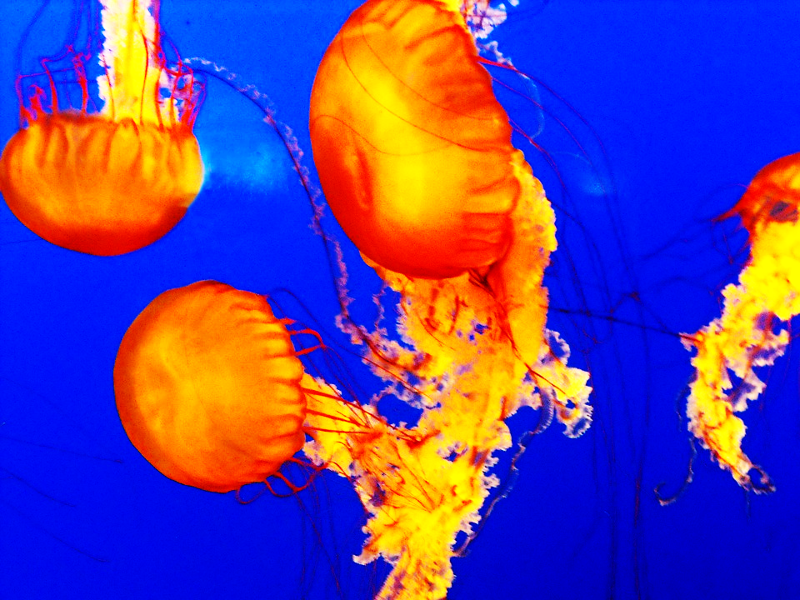
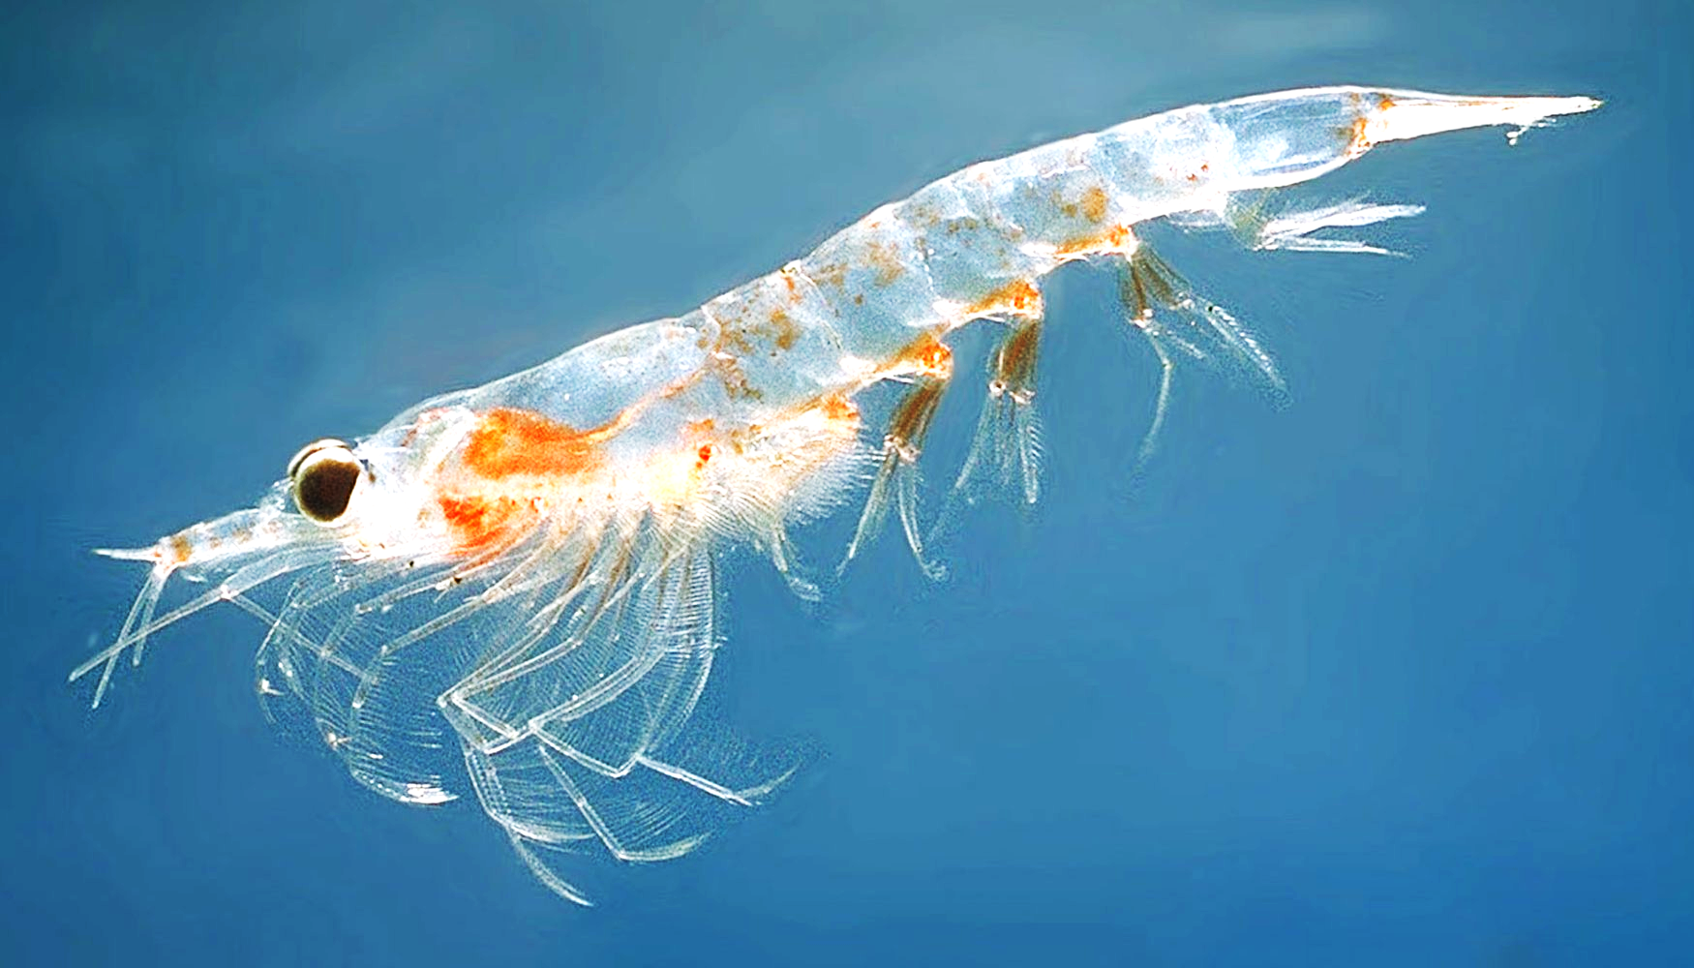
What is Zooplankton?
Small organisms that float with the current due to being weak swimmers.
Unlike phytoplankton they can’t do photosynthesis.
Benefits: They have a short life span and they can colonize habitats rapidly.
Located on the surface of the ocean and are the base of the food chain. Without them, it would disrupt the entire cycle.

Slide 6
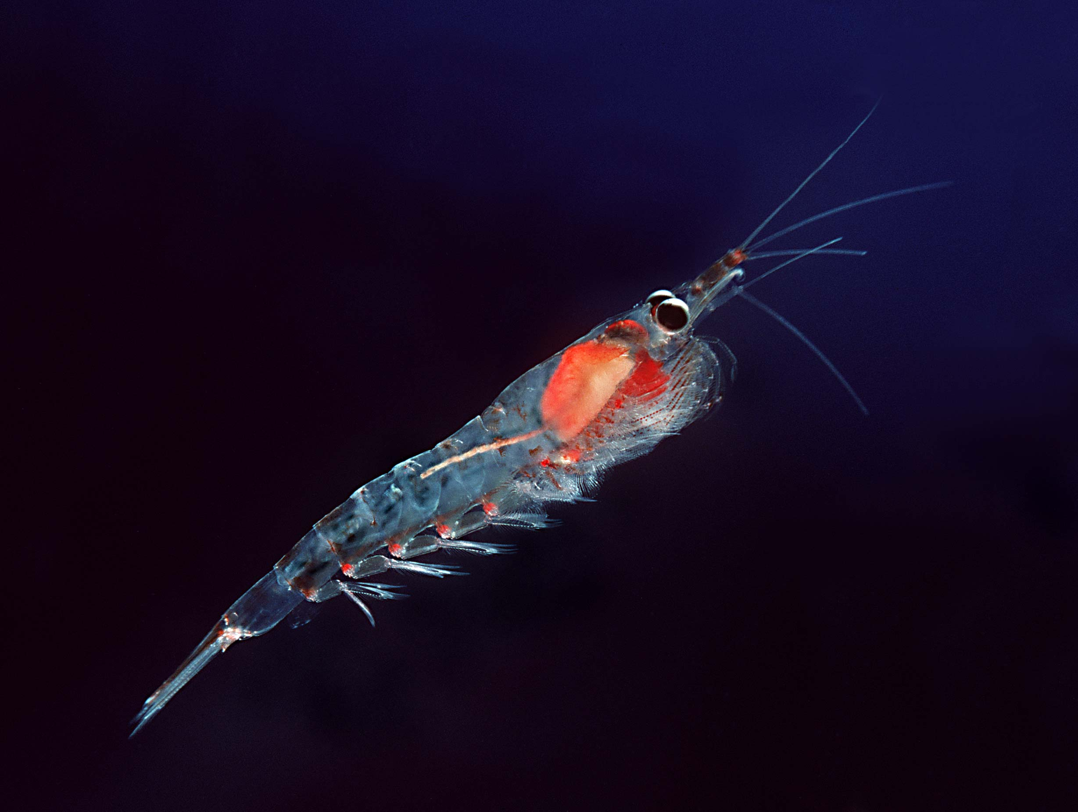
Cellular Respiration in Zooplankton
Zooplankton must have O2 spread into their bodies by moving in from the gills.
O2 spreads throughout their bodies.
Can’t make their own sugars so they eat phytoplankton.
Waste (CO2 and H2O) go out the same way they got in.
Gills

Slide 7
Fun Facts about Zooplankton & Phytoplankton
Zooplankton:
Zooplankton begin their lives in estuaries.
They are the meals of some large animals.
Jellyfish are the largest of the holoplankton (a type of zooplankton that are permanent).
Zooplankton (in greek) means “Wandering animals.”
Phytoplankton:
They make 50% of the oxygen we breathe.
Phytoplankton don’t have roots, stems, or leaves like other plants.
Phytoplankton can cause harm to fish and humans due to overpopulation causing algal blooms (make toxic substances) to form.
https://www.youtube.com/watch?v=ZEP_PJXnnNs

Slide 8
Concept Check!
What is a difference between zooplankton and phytoplankton?
a) Zooplankton is a plant and phytoplankton is an animal.
b) They are both animals
c) Zooplankton can’t do photosynthesis and phytoplankton can.
d) Zooplankton can do photosynthesis and phytoplankton can’t.
Zooplankton and Phytoplankton

Slide 9
Concept Check!
What is a difference between zooplankton and phytoplankton?
Zooplankton is a plant and phytoplankton is an animal.
b) They are both animals
c) Zooplankton can’t do photosynthesis and phytoplankton can.
d) Zooplankton can do photosynthesis and phytoplankton can’t.
Zooplankton and phytoplankton answer key.

