Slide 1
Kelp Forests and Coral Reefs

Slide 2
Coral Reefs
-Coral reefs are located in warm, tropical waters.
-The largest coral reef is The Great Barrier Reef. It is located off of the coast of Australia and stretches over 1,250 miles!
-Coral Reefs serve as a buffer zone for shorelines. They protect them against flooding, storms, and hurricanes. It prevents both the loss of life and property damage.
-Coral reefs are normally located near shore. This is because coral can not stand temperatures under approximately 64 degrees.
A coral reef is a very diverse underwater ecosystem made up of the skeletons of animals that had no vertebrae.

Slide 3
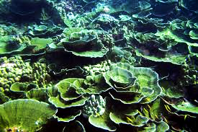
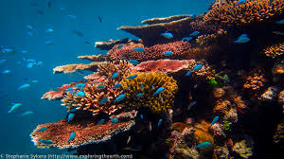
Coral Reefs
-Coral reefs can grow up to 2 centimeters for massive coral and 10 centimeters for branching corals.
-It can take up to 10,000 years for a coral reef to form.
-A coral reef contains over 25 percent of all of the species found in the ocean.
-Animals and plants use coral reefs as a shelter. Animals in particular feed off of corals and some of the seaweed that is found in the corals.

Slide 4
Coral Reefs
-A coral reef gets it’s color from tiny algae called zooxanthellae that lives inside of the coral tissue.
-Usually, at least several million zooxanthellae produce pigments in one square inch of coral.
-Coral reefs are endangered habitats! Pollution that drains off of land or that is dumped directly into the water directly causes harm to the reefs. Some fishing practices cause harm to the corals, animals, and plants found in the reef.

Slide 5
Concept Check 1/3
Coral Reefs:
2. Where do coral reefs get their color from?
Kelp Forests and Coral Reefs

Slide 6
Concept Check 1/3
Coral Reefs:
2. Where do coral reefs get their color from?
A coral reef gets it’s color from tiny algae called zooxanthellae that lives inside of the coral tissue.
Kelp Forests and Coral Reefs

Slide 7
Kelp Forests
-Kelp forests are normally found and formed in shallow waters of cold regions.
-They are filled with brown algae called kelp and grow in large groupings.
-In good physical conditions, they can grow as tall as 18 centimeters in a single day and so much as 130 feet in it’s lifespan.
-Things such as sea stars, anemones, crabs, and jellyfish are found in kelp forests.
A kelp forest is a type of habitat found underwater.

Slide 8
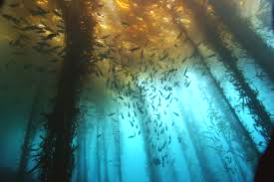
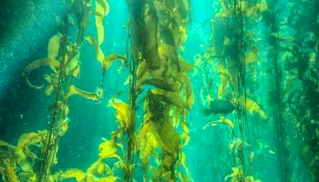
Kelp Forests
-Kelp forests depends on cold, nutrient rich, coastal waters.
-It attaches itself to the floor and grows towards the surface, relying on sunlight to create energy and food through the process of photosynthesis.
-Animals feed off of the anchors of kelp plants. Things such as sea urchins will sometimes completely remove the plant by eating through the roots.

Slide 9
Kelp Forests
-Kelp forests serve as homes for many different species of animals.
-Kelp forests are natural feeding grounds for birds such as crows, warblers, and gulls.
-The water must be clear for kelp forests to grow so that the sunlight can reach the ocean floor where the kelp begins to grow.

Slide 10
Concept Check 2/3
Kelp Forest:
Why are kelp forests only found in shallow waters?
Kelp Forests and Coral Reefs

Slide 11
Concept Check 2/3
Kelp Forest:
Why are kelp forests only found in shallow waters?
Kelp forests are only found in shallow waters because the kelp can not withstand temperatures below 64 degrees. They also need plentiful access to sunlight for photosynthesis.
Kelp Forests and Coral Reefs

Slide 12
Concept Check 3/3
Kelp Forests And Coral Reefs
3. How are kelp forests and coral reefs similar?
Both kelp forests and coral reefs are found near shore and protect the shoreline from floods, hurricanes, and a few other things.
Kelp Forests and Coral Reefs

Slide 13
Ocean Exploration

Slide 14
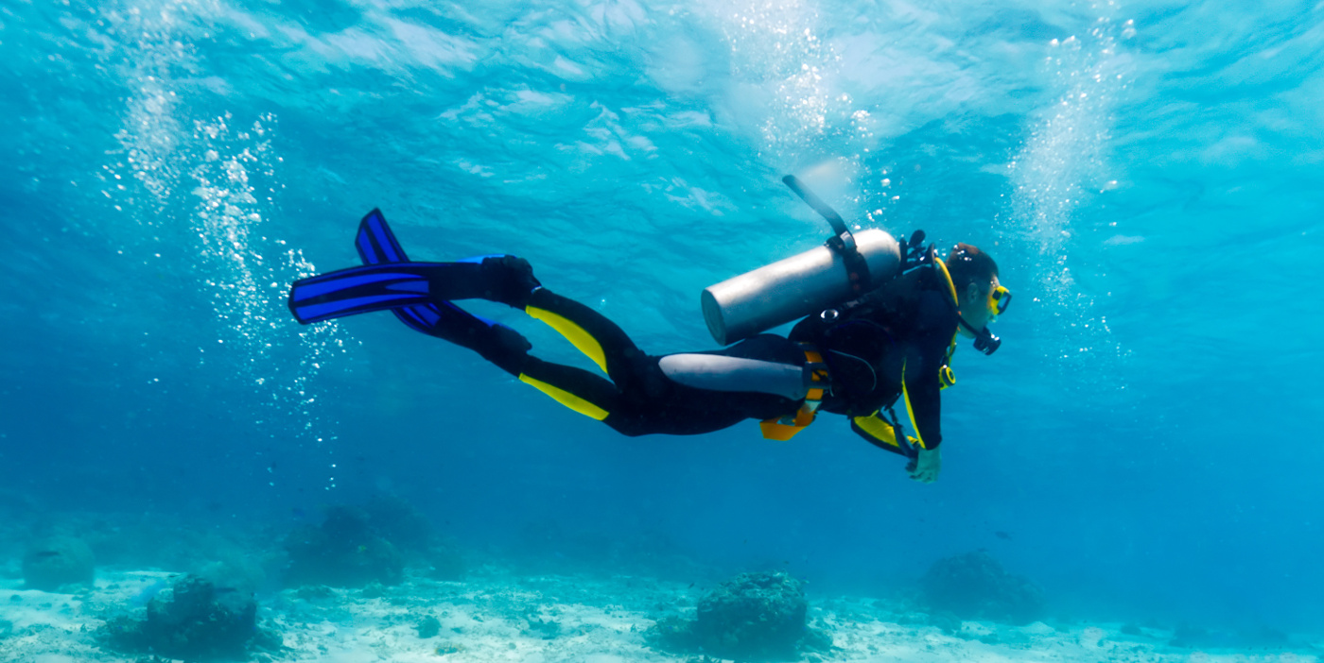
Scuba Divers
A Scuba diver is someone who goes underwater with diving materials such as masks, fins, regulators, buoyancy compensators, dive computers, wetsuits, snorkeling gear, dive watches, and underwater cameras.

Slide 15
Scuba Divers (continued)
Diving is a worldwide sport and is practiced at depths of 130 feet and below. Advanced divers usually go deeper than this.
As divers go down, the water pressure goes up, which causes ear and sinus pain. Divers can usually go longer if they are in more shallow water because they don’t have to use as much oxygen because of the water pressure being low. The deeper you go, the more oxygen you use.
Fun Fact: The world record for the deepest someone has scuba dived is 1,090 feet!

Slide 16
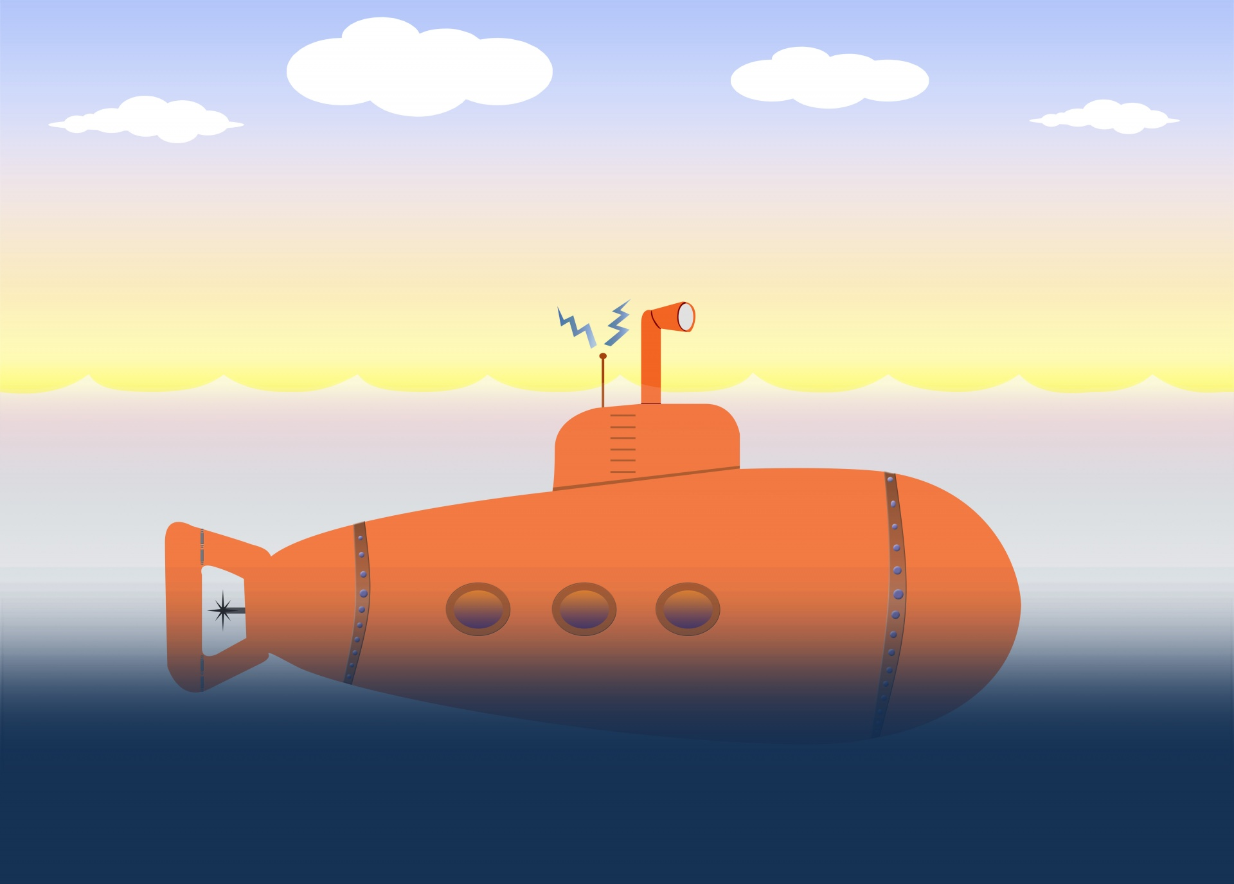
Submarines
A submarine is a watercraft that operates under the sea for long periods of time that are used in the military.
Submarines can dive anywhere from about 660 feet-35,000 feet.
Some submarines can stay underwater for months at a time.
Submarines were used during World War l and ll, and were called German U-boats.

Slide 17
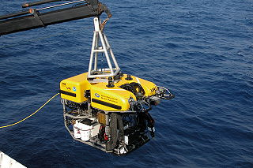
ROVs
An ROV, or remotely operated vehicle, is an unoccupied underwater robot that connects to a ship by a series of cables.
This vehicle has a video camera, lights, a sonar system, and an articulating arm.
The cables attached to the ship transfer command and control signals between the operator and the ROV, allowing the vehicle to navigate from a distance.
ROVs can dive from about 13,000 feet to 35,000 feet.

Slide 18
What are sonar waves?
A sonar is a system that uses sonar waves to measure distance and locate objects.
Ships aim sound waves toward the bottom of the ocean and measure the amount of time it takes to receive an echo. These waves can also bounce off of submarines and fish. The deeper the ocean floor, the longer it takes to get an echo.
A sonar can also show detailed images of small areas of the ocean floor.
This exploration continues to bring new discoveries of geological formations and events.

Slide 19
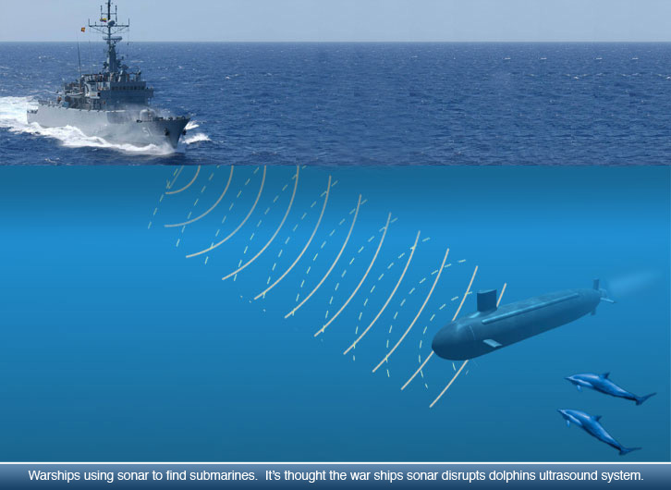
Sonar

Slide 20
Concept check! (Ocean Exploration)
Which of these do scientists use to map the ocean floor?
An ROV
B) a submarine
C) a sonar
D) a telescope

Slide 21
Correct Answer:
An ROV
B) a submarine
C) a sonar
D) a telescope

Slide 22
Websites Used When Completing This Presentation:
https://www.livescience.com/40276-coral-reefs.html
http://oceana.org/marine-life/marine-science-and-ecosystems/kelp-forest
https://sanctuaries.noaa.gov/visit/ecosystems/kelp-welcome.html
http://marinebio.org/oceans/zooplankton/index.aspx
https://www.britannica.com/science/zooplankton
http://www.encyclopedia.com/plants-and-animals/microbes-algae-and-fungi/moneran-and-protistan/zooplankton
http://www.edc.uri.edu/restoration/html/gallery/invert/zoo.htm
https://www.sportdiver.com/gear

Slide 23
Websites Used When Completing This Presentation.
http://life.bio.sunysb.edu/marinebio/kelpforest.html
https://oceanservice.noaa.gov/facts/auv-rov.html
https://oceanservice.noaa.gov/facts/kelplives.html
https://www.nauticalcharts.noaa.gov/csdl/ROV.html
https://www.thoughtco.com/zooplankton-definition-2291632
http://brookwood.edu/sites/brookwood.edu/files/plankton_hw.pdf
http://www.mbgnet.net/salt/coral/where.htm
https://oceanservice.noaa.gov/facts/coral_protect.html

Slide 24
Websites Used When Completing This Presentation:
http://brookwood.edu/sites/brookwood.edu/files/plankton_hw.pdf
http://www.sports-information.org/scuba-diving.htm
https://oceanservice.noaa.gov/education/kits/corals/coral04_reefs.html
https://earthobservatory.nasa.gov/Features/Phytoplankton/
https://oceanservice.noaa.gov/facts/phyto.html
http://www.mesa.edu.au/atoz/phytoplankton.asp
http://www.imas.utas.edu.au/zooplankton/about/what-are-zooplankton
https://www.marineinsight.com/naval-architecture/introduction-to-submarine-design/

Slide 25
Websites Used When Completing This Presentation:
https://www.youtube.com/watch?v=ZEP_PJXnnNs
https://earthobservatory.nasa.gov/Features/Phytoplankton/
https://earthobservatory.nasa.gov/Features/Phytoplankton/page2.php
Textbook pg.C82

