Slide 1
#27 Properties of water

Slide 2
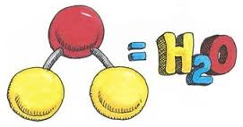
But before we look at these standards let’s talk about the properties of water
https://www.youtube.com/watch?v=3jwAGWky98c
(6:50 min)

Slide 3
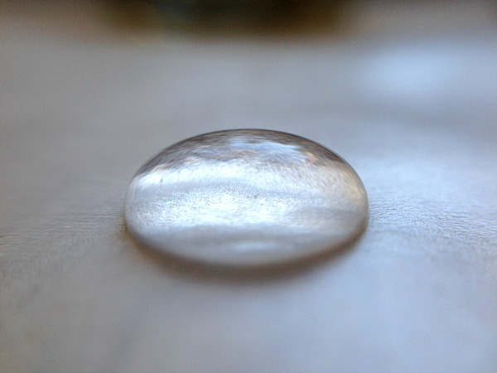
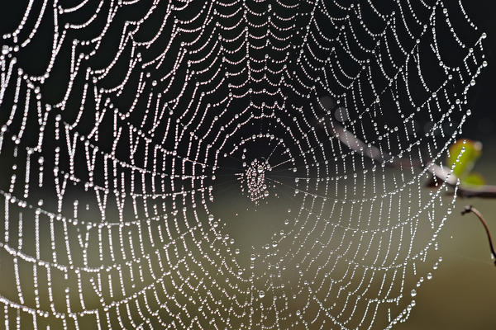
Cohesion and Adhesion
Cohesion
*Water that clings with water
Adhesion
*Water that sticks to another substance

Slide 4
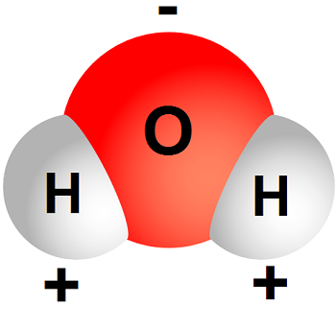
*Polarity
Polarity is the unequal charge between a water molecule, where oxygen takes on a slightly negative charge, and hydrogen takes on a slightly positive charge.
Like a magnet, a water molecule has different charges at each end, making other molecules attracted to the opposite charge.
As you can see in this diagram, the negative charge of the bottom molecule is attracted to the positive charge of the top molecule (like a magnet).
Notes:
http://www.biology.arizona.edu/biochemistry/tutorials/chemistry/page3.html
https://www.universetoday.com/82128/parts-of-an-atom/
https://www.thoughtco.com/why-is-water-a-polar-molecule-609416

Slide 5
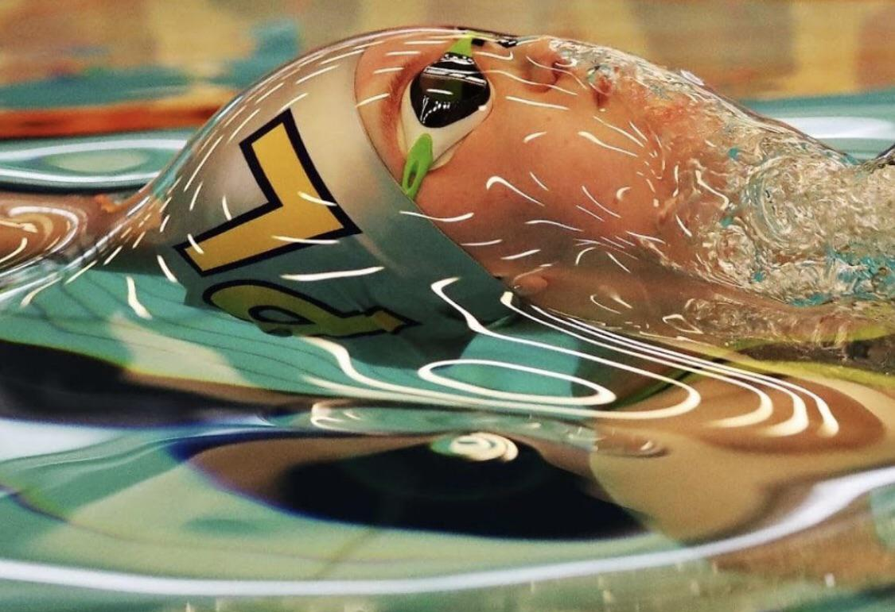
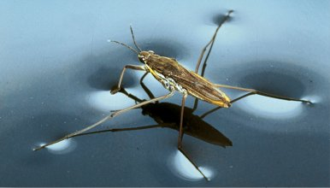
Surface tension
Water is clingy…
*Water molecules want to “attach itself” or cohere with other water molecules. This creates a strong bond between water molecules

Slide 6
*Specific heat
Specific heat is the amount of heat it takes to raise the temperature of water up by 1*C
Water has a high specific heat and that is important because helps regulate temperatures in extreme environment.

Slide 7
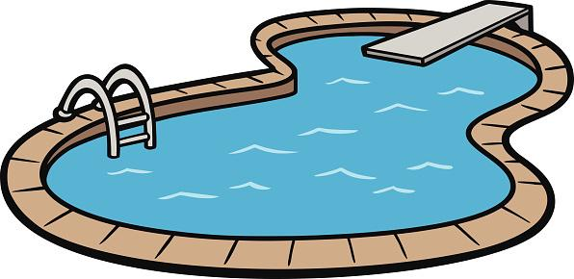
Specific heat
For example: water has a high specific heat and that’s why your swimming pool water is still cold even on scorching hot summer days. It takes a lot of energy to raise waters temperature, even by 1*C

Slide 8
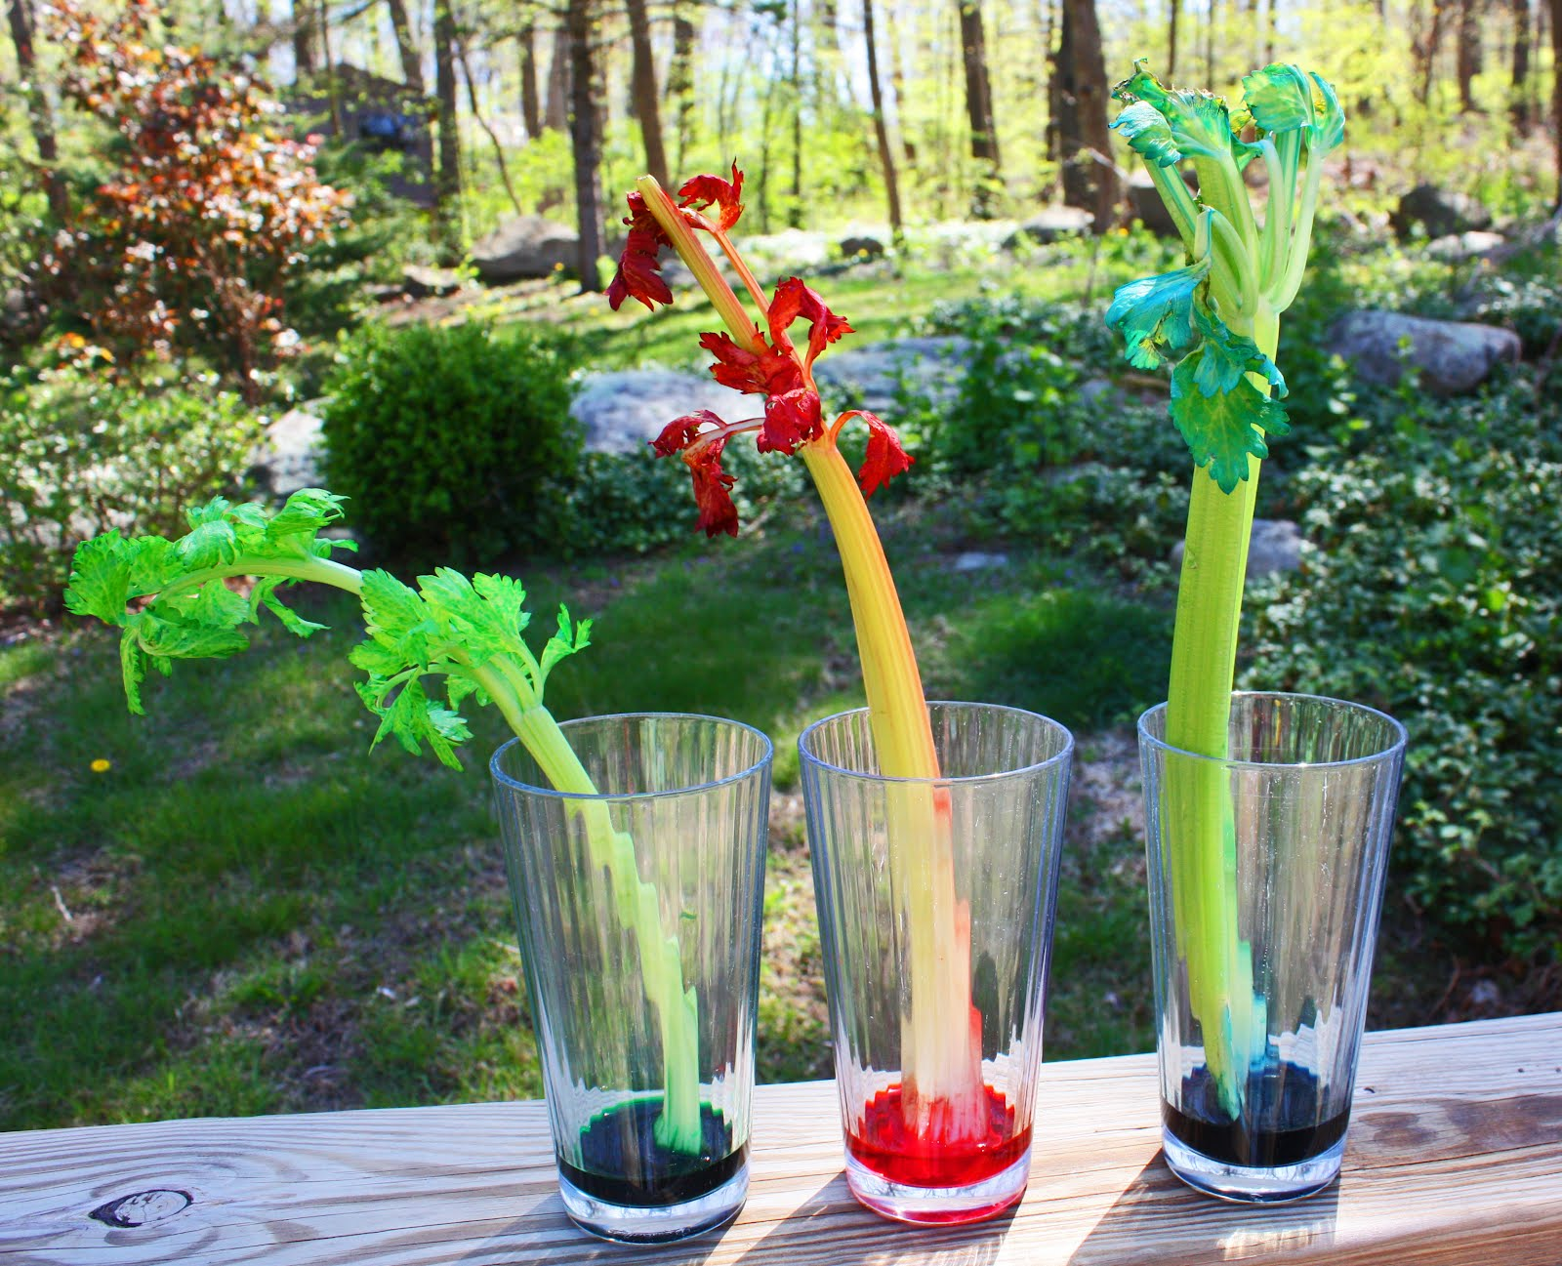
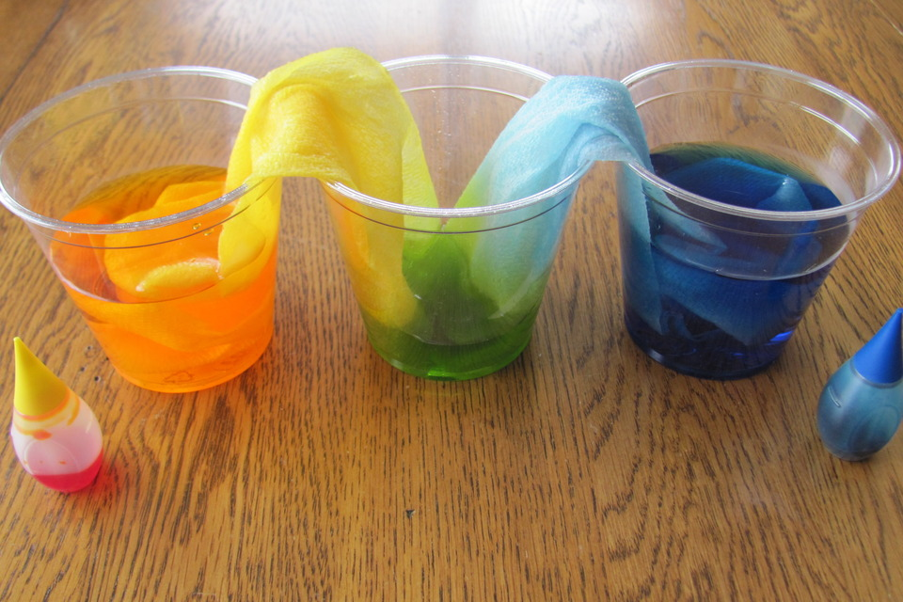
Capillary action
*Capillary action is important for the movement of water due to adhesion, cohesion, and surface tension. Capillary action allows water to move up through things despite gravity acting on it.

Slide 9
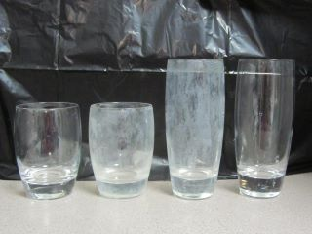
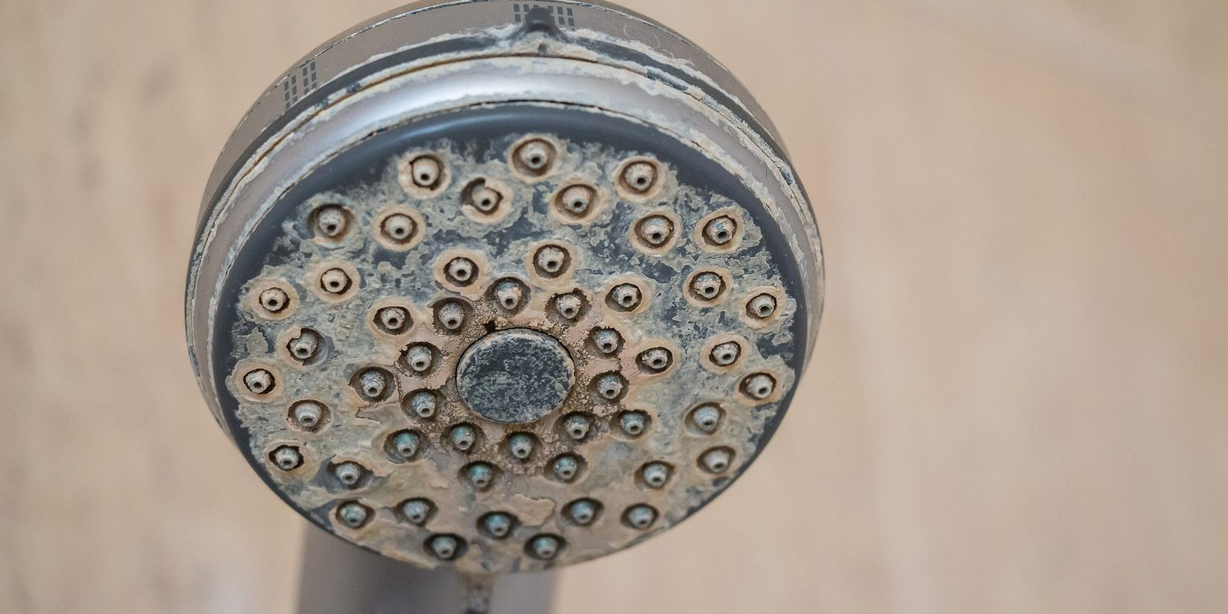
Hardness of water
Have you ever looked at a glass after it’s been in the dishwasher and it seems cloudy? Or maybe the Well this is probably due to the hardness of water.

Slide 10
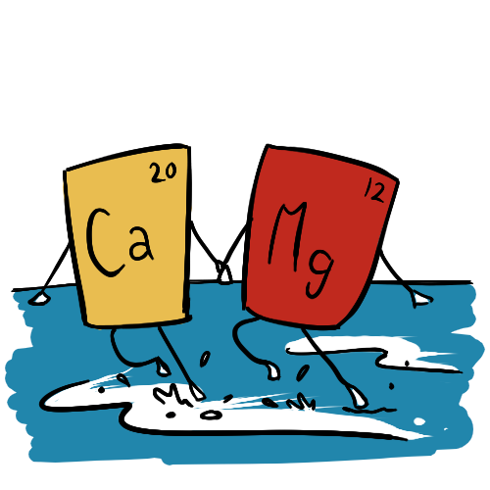
*Hardness of water
The hardness of water is amount of dissolved calcium and magnesium in water
Although this is not a health concern, water hardness can cause calcium and magnesium minerals to build up and clog the flow of water.

Slide 11
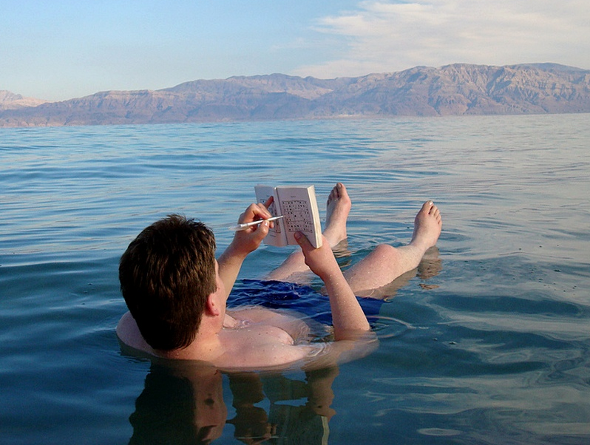
Density
*When water is frozen the molecules push further away from each other, increasing volume.
*Also, in sea water, water's density is changed due to you adding salt in the water.

