Slide 1
Properties of water and water treatment

Slide 2
Exploring Mariana Trench
https://youtu.be/Wb0NdmDs9_E
Deep ocean

Slide 3
Water is a precious resource that must be managed and protected. Federal and state governments have set water quality standards to keep water clean and safe. Waste water also must be treated to get pollutants out of aquatic ecosystems and drinking water.
Scientist monitor the water quality in both freshwater systems in the ocean. Scientist collect samples and run tests in order to determine the overall health of the body of water.

Slide 4
The Environmental Protection Agency, (EPA) enforces water quality standards for wastewater that is released by industry and local governments. The EPA and other agencies have also set up educational programs to help reduce nonpoint source pollution, such as chemicals in runoff.
Nonpoint source pollution - is run-off pollution that is hard to trace back where the pollution entered the waterway
Point source pollution - pollution where you can pinpoint how it got in the body of water

Slide 5
Great Pacific Garbage patch
https://www.youtube.com/watch?v=WtewmJ78hzw&t=195s

Slide 6
How water is treated (*only if needed)
Water is piped to the treatment plant
Clumping agents are added to the water, this makes dirt and bacteria clump together
Water flows into a clarifying pool where dirt and other particles can settle to the bottom and get scraped away
Water flows through levels of coal, sand, and gravel, which filters out tiny particles of dirt
Chlorine is added to kill any remaining bacteria

Slide 7
Water treatment plant

Slide 8
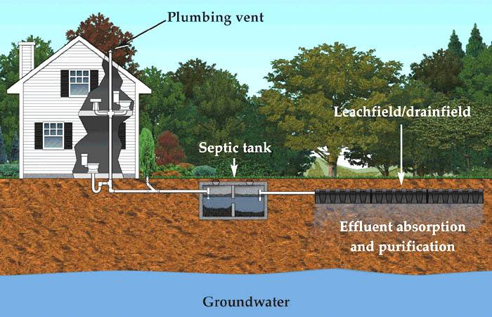
Sewage System vs Septic System
A sewage system collects and treats wastewater from a city or town in comparison to a septic system which are small wastewater systems that are usually used in rural houses or farms.

Slide 9
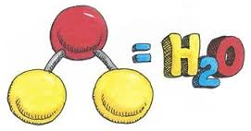
But before we look at these standards let’s talk about the properties of water
https://www.youtube.com/watch?v=3jwAGWky98c

Slide 10
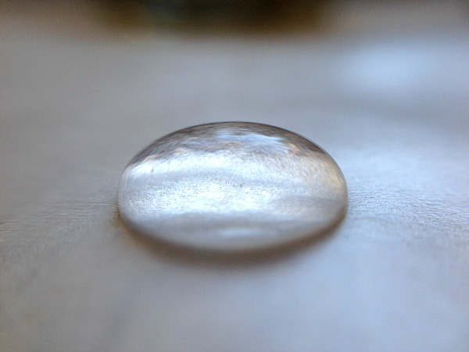
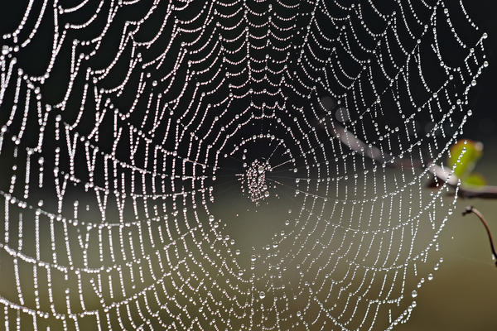
Cohesion and Adhesion
Cohesion
*Water that clings with water
Adhesion
*Water that sticks to another substance

Slide 11
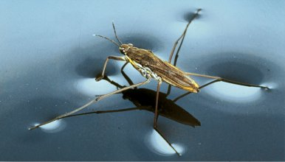
Surface tension
Water is clingy…
*Water molecules want to “attach itself” or cohere to other water molecules. This creates a strong bond between water molecules

Slide 12
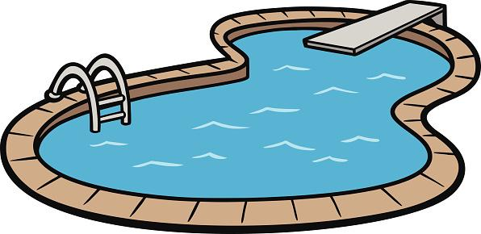
Specific heat
*Specific heat is the amount of heat it takes to raise the temperature of water up by 1*C
*Water has a high specific heat and that is important because helps regulate temperatures in extreme environment.
For example: water has a high specific heat and that’s why your swimming pool water is still cold even on scorching hot summer days

Slide 13
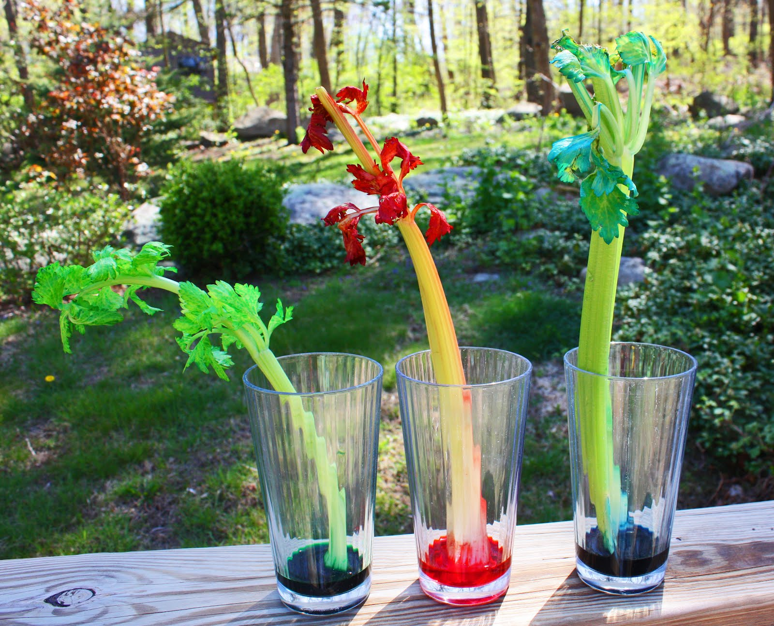
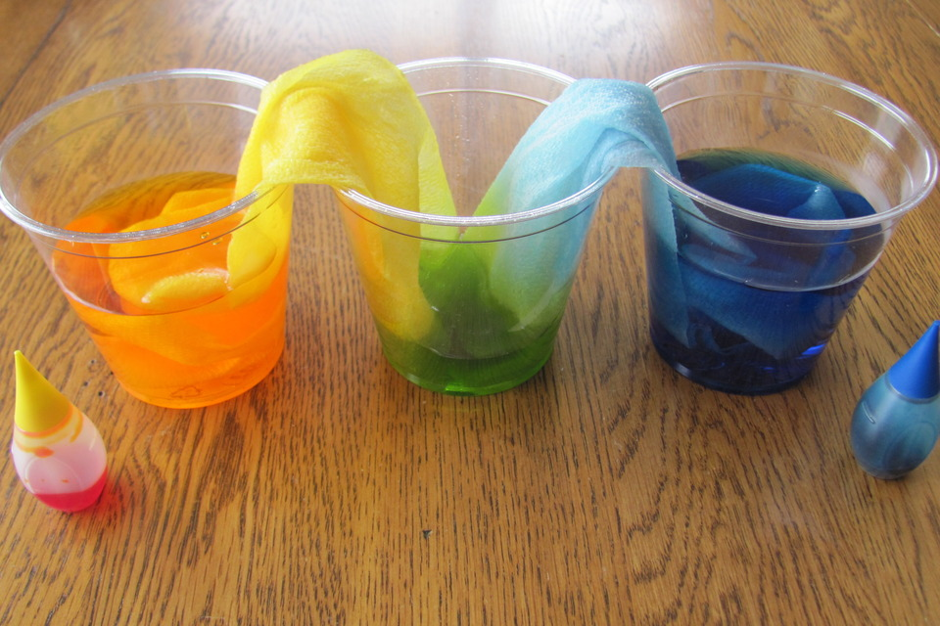
Capillary action
*Capillary action is important for the movement of water due to adhesion, cohesion, and surface tension. Capillary action allows water to move up through things despite gravity acting on it.

Slide 14
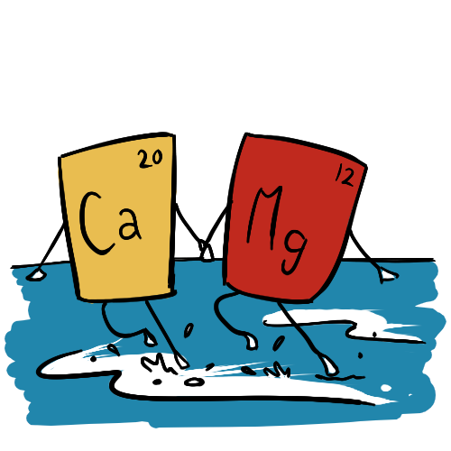
Hardness of water
Have you ever looked at a glass after it’s been in the dishwasher and it seems cloudy? Well this is probably due to the hardness of water.
*The hardness of water is amount of dissolved calcium and magnesium in water
*Although this is not a health concern, water hardness can cause calcium and magnesium minerals to build up and clog the flow of water.

Slide 15
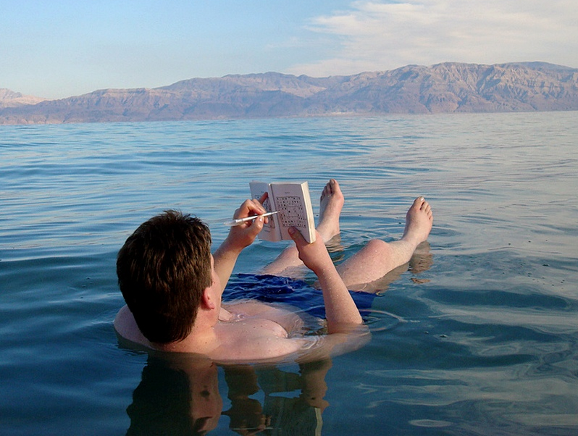
Density
*When water is frozen the molecules push further away from each other, increasing volume.
*Also, in sea water, water's density is changed due to you adding salt in the water.

