Slide 1
Does this equation satisfy the law of conservation of matter?
Pb(OH)2 + HCl → H2O + PbCl2
Explain how you know

Slide 2
#52 Combustion of Isopropyl alcohol demo
#53 Rate
of reactions
Notes:
Textbook pages D74-76

Slide 3
All chemical reactions do not occur instantly
In some cases it takes an extended period of time for the chemical reaction to occur.

Slide 4
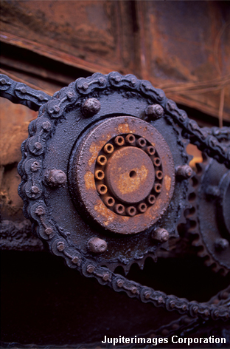
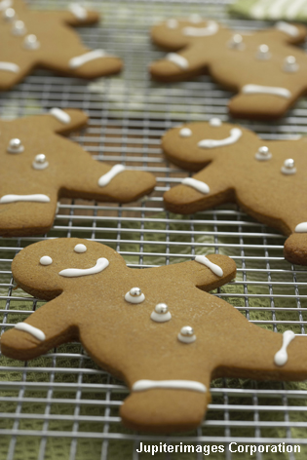
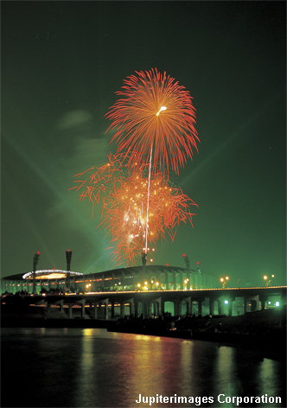
*Rate of reactions
The speed of how fast or slow a substance reacts is known as the rate of reaction.
rusting
baking
explosion
slow
fast
very fast
Notes:
Photo credit: © 2007 Jupiterimages Corporation

Slide 5
*Rate of reactions
The rate of reactions depend on:
How often matter collides together
The amount of energy that is needed or released
Things that increase the number of collisions will speed up the rate of reactions.

Slide 6
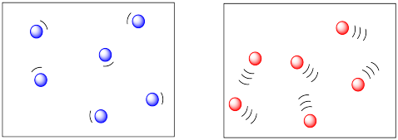
*Increased temperature
When you increase the temperature of a reaction, more collisions between particles occur since the particles are moving faster.
adding energy to the reactants will raise the temperature.
Example –
when cooking in most occasions chemical reactions occur slowly or do not take place at all until you add heat to the reactants. Adding heat increases the amount of energy and makes particles move faster and collide more with other particles

Slide 7
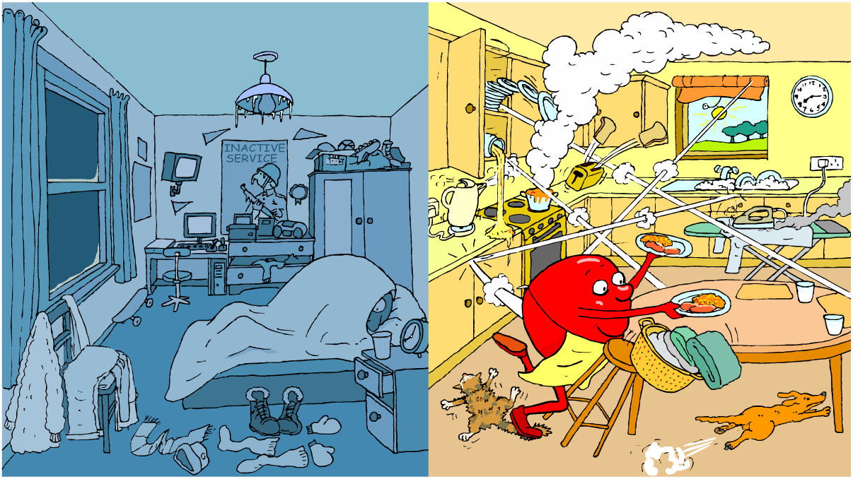
What is this cartoon saying about temperature

Slide 8
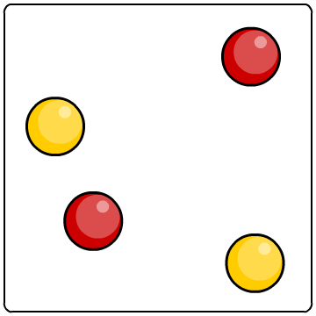
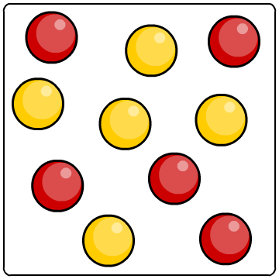
*Increased concentration
When increasing concentration, there are more particles in the same amount of space. This means that the particles are more likely to collide and therefore more likely to react with one another.
lower concentration
higher concentration

Slide 9
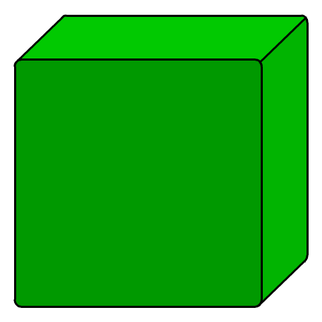
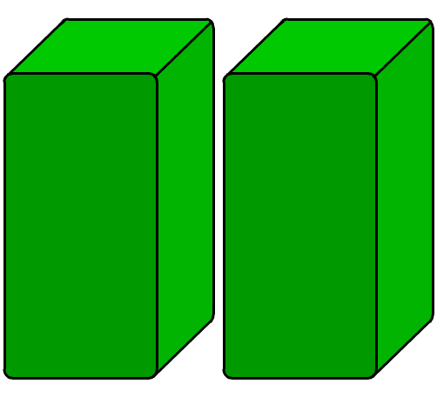
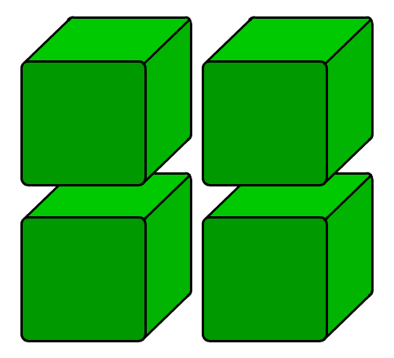
*Increased surface area
Chemical reactions of solids only take place on the surface of the particle.
Splitting the solid into multiple pieces increases the number of surfaces/surface area in which the particle can collide with
The smaller the piece, the larger the surface area, and greater chance of collisions
low surface area
high surface area

Slide 10
*Adding a catalyst
A catalyst is a substance that increases the rate of reaction without being used in the reaction.
A catalyst never produces more product, they only produce the same amount of product faster. At the end of a chemical reaction a catalyst remains unchanged.

Slide 11
catalyst example…
Stirring koolaid mix to form koolaid drink… spoon is catalyst because it helps speed up chemical reactions, but it is not a part of the koolaid drink solution

Slide 12
Ted Ed – rate of reactions
https://www.youtube.com/watch?v=OttRV5ykP7A
(4:55)

Slide 13
Concept check
Changing the _______ affects the frequency of solid reactants
Changing the _______ affects the frequency and energy of collisions
Changing the _______ affects the frequency of dissolved reactants
Explain a catalyst in your own words.
Notes:
Surface area, temperature, concentration.

Slide 15
Description | Physical or Chemical | Property or change
The play-do is stringy
A teacher got brown highlights
Cotton can burn easily
Water boils at 100*C
Silver tarnish's over time
Food is warmed in the oven

