Slide 1
#34 Reading the Periodic table

Slide 2
Write these questions down
What is an atom?
When atoms combine what do they make?
Protons? Neutrons? Electrons? What are they
Everything in the universe is either _______________ or _______________. The smallest pieces of matter are ____________________.

Slide 3
*All matter is made up of atoms.
*An element consists of one type of atom that cannot be broken down into simpler substances by chemical or physical means.

Slide 4
*All atoms have three subatomic particles that helps determine the atoms identity.
The three subatomic particles are protons, neutrons, and electrons.
*Proton (P) = positively charged particle
*Neutron (N) = uncharged particle
*Electron (e)= negatively charged particle that moves/orbits around the nucleus of an atom
*Protons and neutrons are grouped together in the atoms center called the nucleus.

Slide 5
*HELIUM ATOM
Shell or
electron cloud
proton
Nucleus
N
+
-
+
-
N
neutron
electron

Slide 6
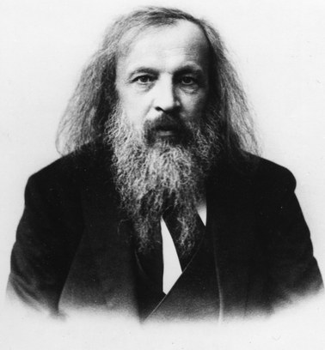
Who established the arrangements of elements? Dmitri Mendeleev
*In the 1860’s Dmitri Mendeleev created a periodic table where the elements were ordered by their atomic masses.
*He did this by grouping elements together according to their similarities

Slide 7
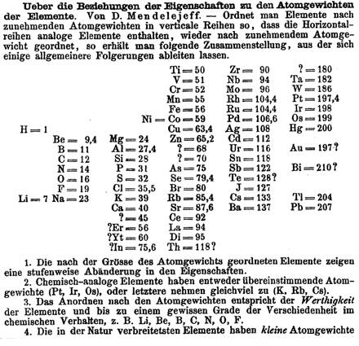
Mendeleev’s Published Periodic Table of Elements
Why do you think there are question marks here?

Slide 8
Mendeleev’s Predictions
Although Mendeleev’s Periodic Table of Elements had missing elements or “gaps,” he was able to predict the characteristics of these missing elements because of Periodic Law.
“Ekasilicon”
Germanium
Date Predicted | 1871 | Date Discovered | 1886
Atomic Mass | 72 | Atomic Mass | 72.6
Density | 5.5 g/cm³ | Density | 5.47 g/cm³
Bonding Power | 4 | Bonding Power | 4
Color | Dark Gray | Color | Grayish White
Notice how Mendeleev’s
predictions (orange column) were very
accurate when compared to Germanium’s actual characteristics (green column)

Slide 9
He was very accurate in his predictions, which led the world to accept his ideas about periodicity and a logical periodic table.
Mendeleev wasn’t the first to arrange elements in a table, but he was the first to publish and make predictions about undiscovered elements

Slide 10
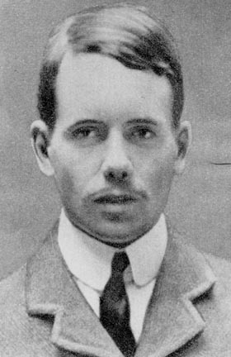
Until…
*In 1914, Henry Moseley revised Mendeleev’s periodic table by rearranging the elements by their atomic numbers
*He concluded that the number of protons in an atom is its atomic number this arrangement is still used today!

Slide 11
So what is the Periodic Table?
Lets think of the word periodic… if something is periodic it occurs at regular or at least generally predictable intervals
*Periodic Table of Elements – is a table of the elements, arranged by atomic number, that shows the patterns in their properties; called the periodic law

Slide 12
Atomic symbol
One or two letter abbreviation of an element. Written with a capital letter or a capital followed by a lower case if two letters
*ATOMIC STRUCTURE
He
Atomic number
2
the number of protons in an atom
4
Atomic mass
the number of protons and
neutrons in an atom
Helium
Element Name
The name of the element
*# of electrons = # of protons

