Slide 1
Review of the ocean zones

Slide 2
Warm-up
Why are oceans salty? Explain at least two places where you think the salt found on ocean waters comes from.

Slide 3
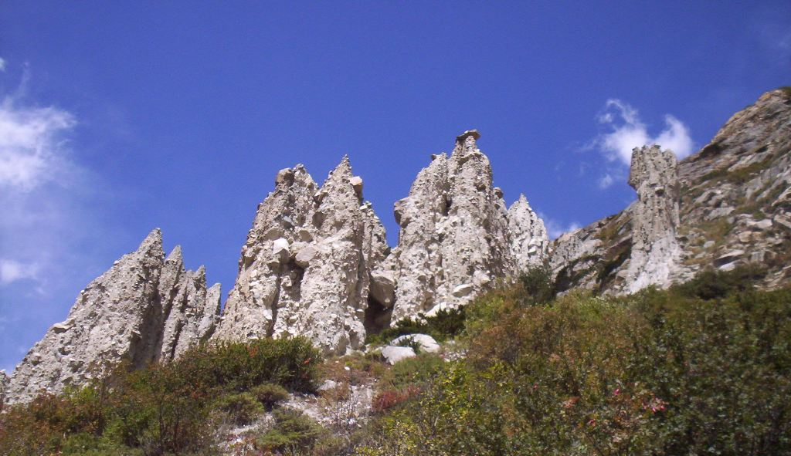
Why are oceans SALTY?
Eroding land - salt in rocks.

Slide 4
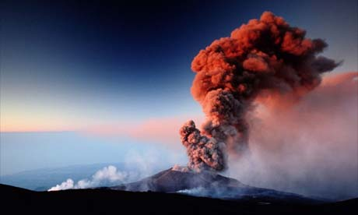
Why are oceans SALTY?
Eroding land
Volcanic emissions

Slide 5
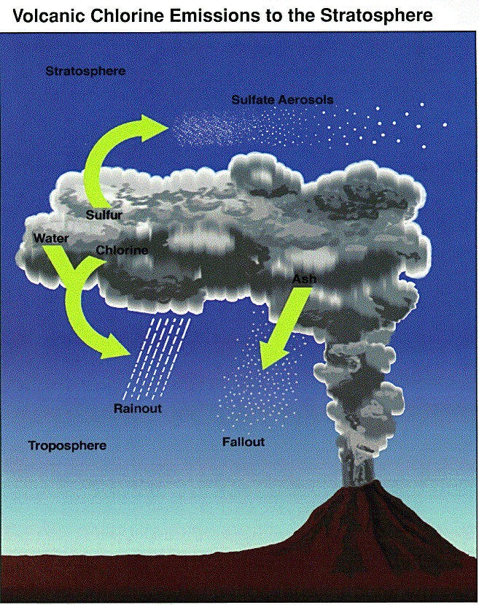

Slide 6
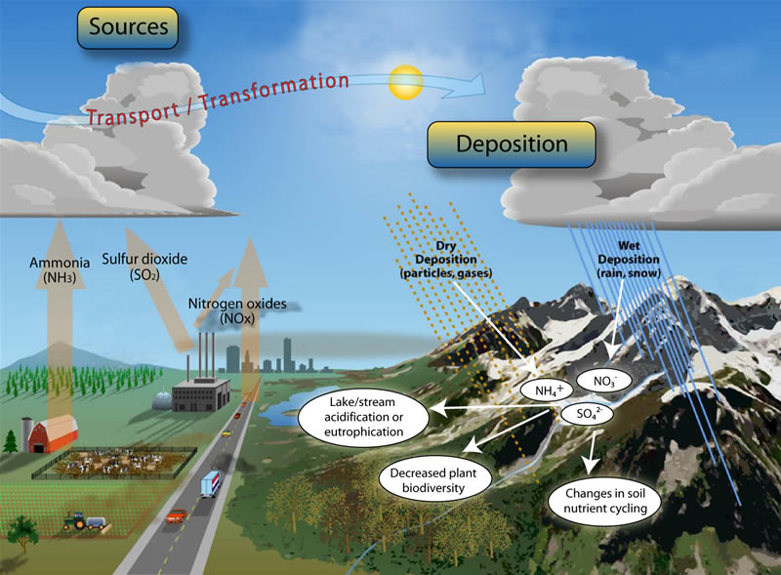
Why are oceans SALTY?
Eroding land
Volcanic emissions
Atmospheric
Deposition
(All sorts of stuff gets up in our air and comes back down.)

Slide 7
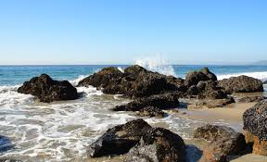
Intertidal Zone
The Intertidal Zone is the area closest to the shore
This is where land and sea meet between high and low tides
Organisms that live here must survive great changes in temperature, sunlight, and salinity

Slide 8
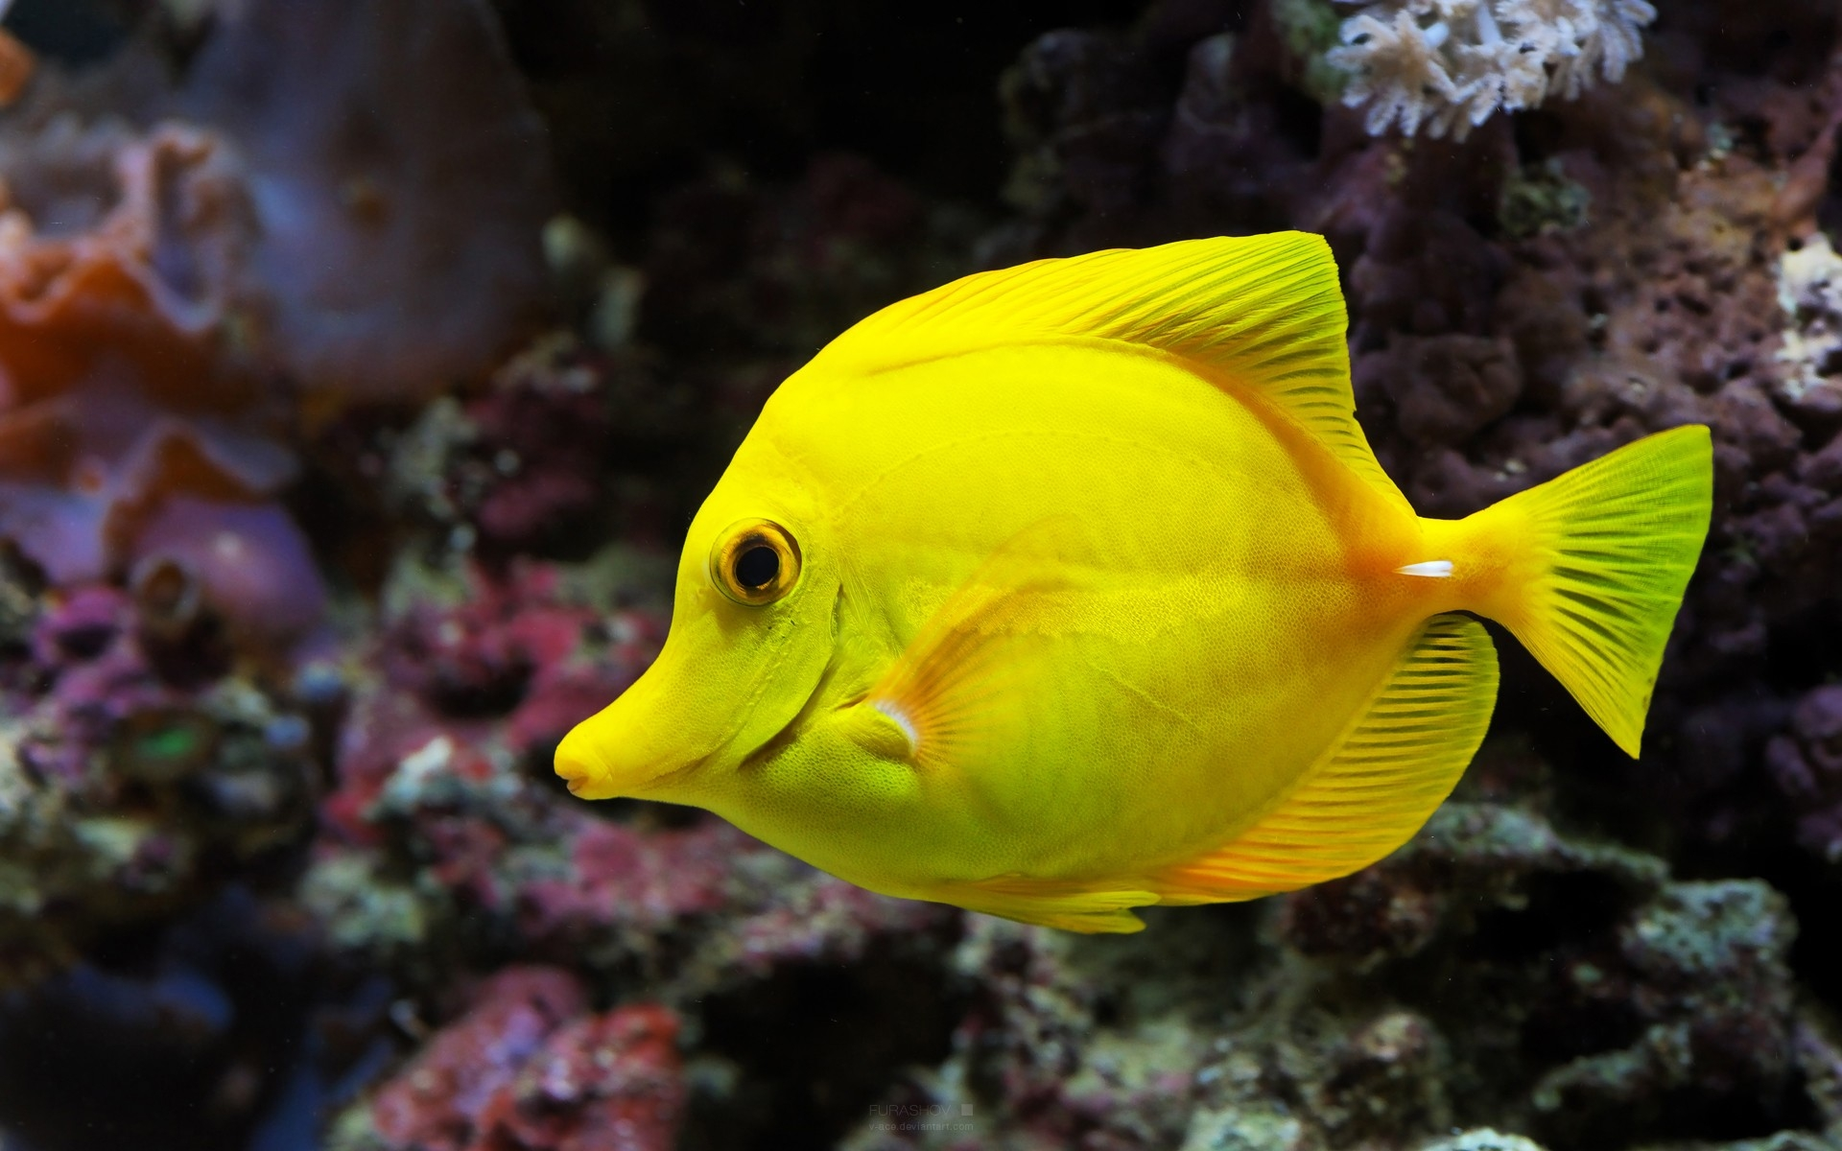
Neritic Zone
The Neritic Zone consists of all waters extending from the low tide mark to the continental shelf.
The continental shelf is the gradual sinking of continental crust into water
The Neritic Zone has the GREATEST AMOUNT (most #) of life because:
Sunlight reaches throughout this layer
Temperature and salinity are nearly constant throughout the entire layer
https://www.youtube.com/watch?v=SdNqFVsyoms

Slide 9
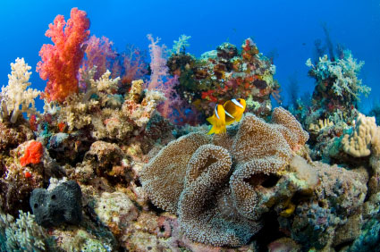
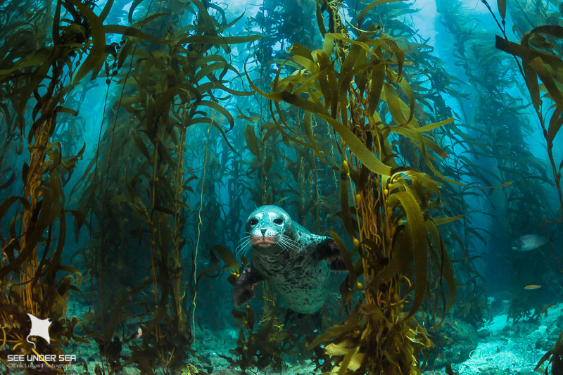
There are 2 type of habitats found in the Neritic Zone
CORAL REEFS
KELP FORESTS

Slide 10
There are 2 type of habitats found in the Neritic Zone
Coral Reefs
Kelp Forests
In warm tropical regions
Built up limestone deposits from small organisms called corals
Corals depend on a certain type of algae for food needs, algae uses sunlight to produce food
Only exist in areas where sunlight reaches
In cold waters
Type of seaweed that attaches itself to ocean floor
Appox 130 feet tall
Uses sunlight to produce food
Only found in waters near shore
Provides habitats for many animals

Slide 11
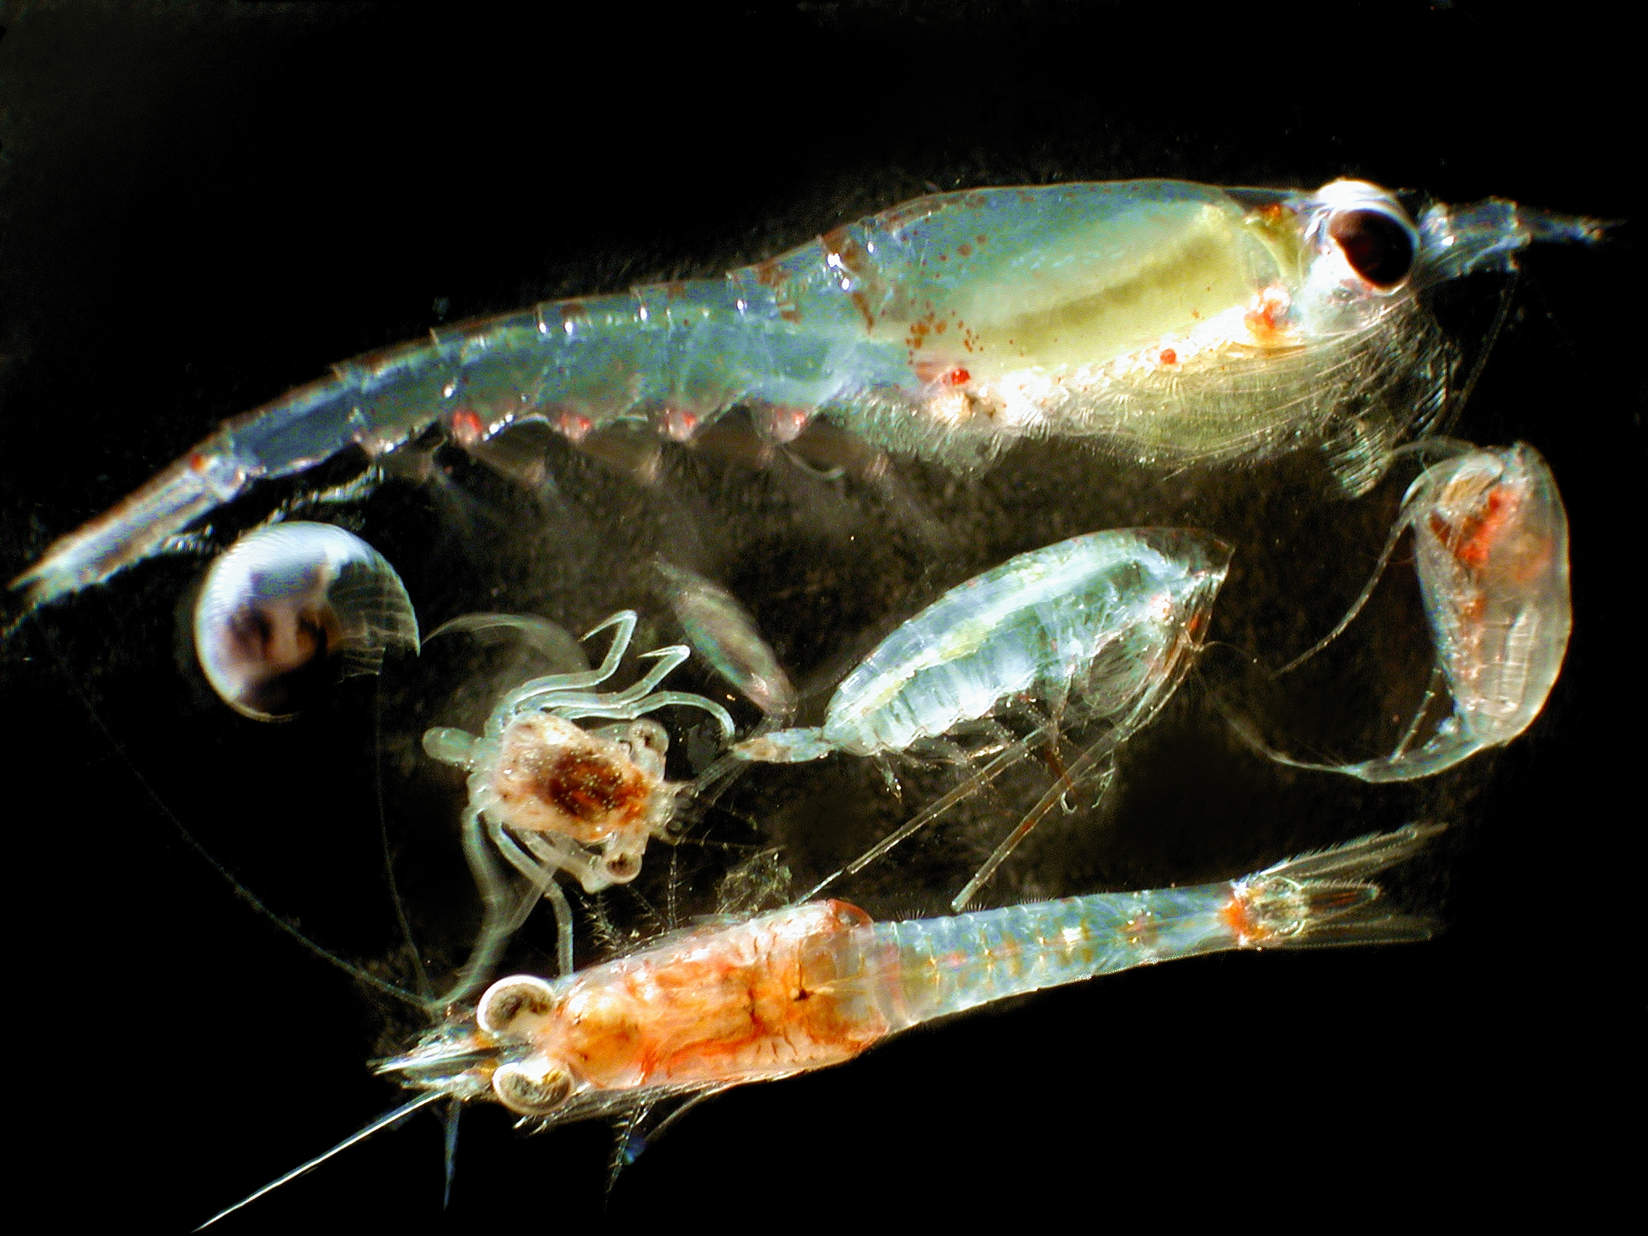
Also in the Neritic Zone are:
Phytoplankton
Zooplankton
Converts sunlight and carbon dioxide into food and oxygen. Greek and Latin word “photo” meaning light
in fact it converts about as much CO2 (carbon dioxide) into oxygen as all land plants combined.
Important source of oxygen that you are breathing right now
algae
plant-like protists
Greek and Latin word “zo” meaning animal
Zooplankton eat phytoplankton and then become food for other organisms

Slide 12
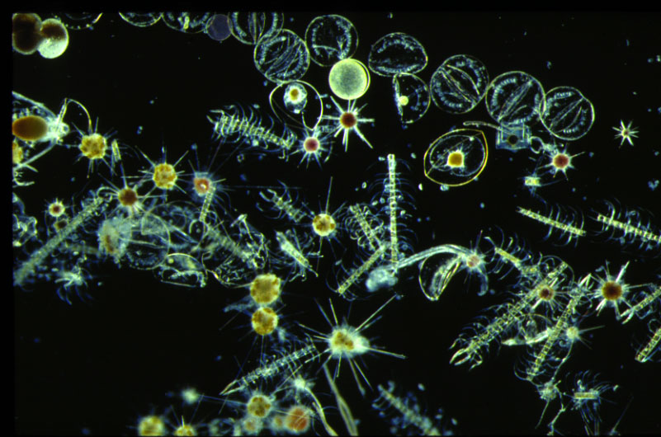
Phytoplankton are the beginning of most marine food chains. Why?
PHOTOSYNTHESIS – organisms make their own food from the sun.

Slide 13
Benthic Deep Ocean
The Deep Ocean begins at the continental slope and extends all the way to the sea floor.
The Benthic zone is the deepest, darkest, and coldest part of the ocean.
Pressure greatly increases as you travel from the neritic to the benthic zone.

Slide 14
The Deep Zone makes up 65% of all ocean water.
COOL FACT! Most of the Benthic Zone is unexplored…because humans can’t survive the crushing pressure and vastness of the ocean

Slide 15
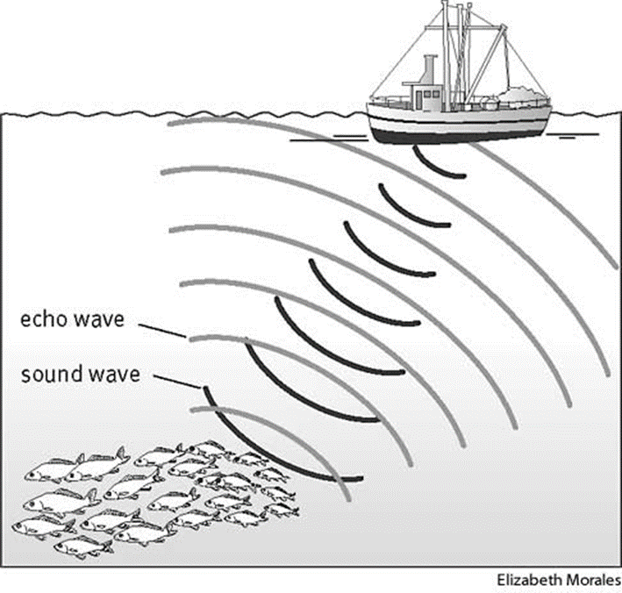
So how do we study this ocean zone?
Sonar Waves are sound waves that map sea floor.
Sonar vibrations travel down and reflect (bounce back) from the sea floor or animals to tell us the depth (how far down) something is.

Slide 16
So how do we study this ocean zone?
Submersibles are underwater ocean technology that is used to explore the ocean.
Submarines are occupied vehicles that have crew in them as they explore ocean life.
Remotely Operated Vehicles aka ROV’s are unoccupied vehicles that are suspended under water by a cable and are operated by someone on the surface

Slide 17
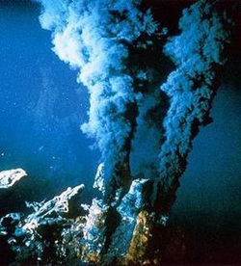
How does life exist in the deep ocean without the presence of the sun?
hydrothermal vents are underwater volcanoes that seeps methane gas and other nutrients from the earths interior into the water, providing food and heat that plants need/use
-This process of converting chemicals to energy is called chemosynthesis
Chemosynthesis vs. photosynthesis
https://oceanexplorer.noaa.gov/edu/learning/player/lesson05/l5ex1.htm

Slide 18
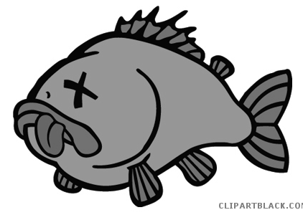
How does life exist in the deep ocean without the presence of the sun?
When organisms die:
they sink to the sea floor where they will be consumed by another organism
or they decay on the sea floor until….

Slide 19
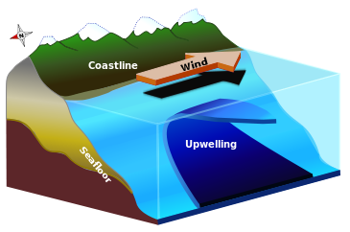
AN UPWELLING OCCURS
UPWELLING
An upwelling is the process in which water from the deeper parts of the ocean moves up to the surface (coast)by the wind, bringing nutrients from the ocean floor to the surface
This brings nutrients to the surface of the water and makes great fishing spots for fishermen

Slide 20
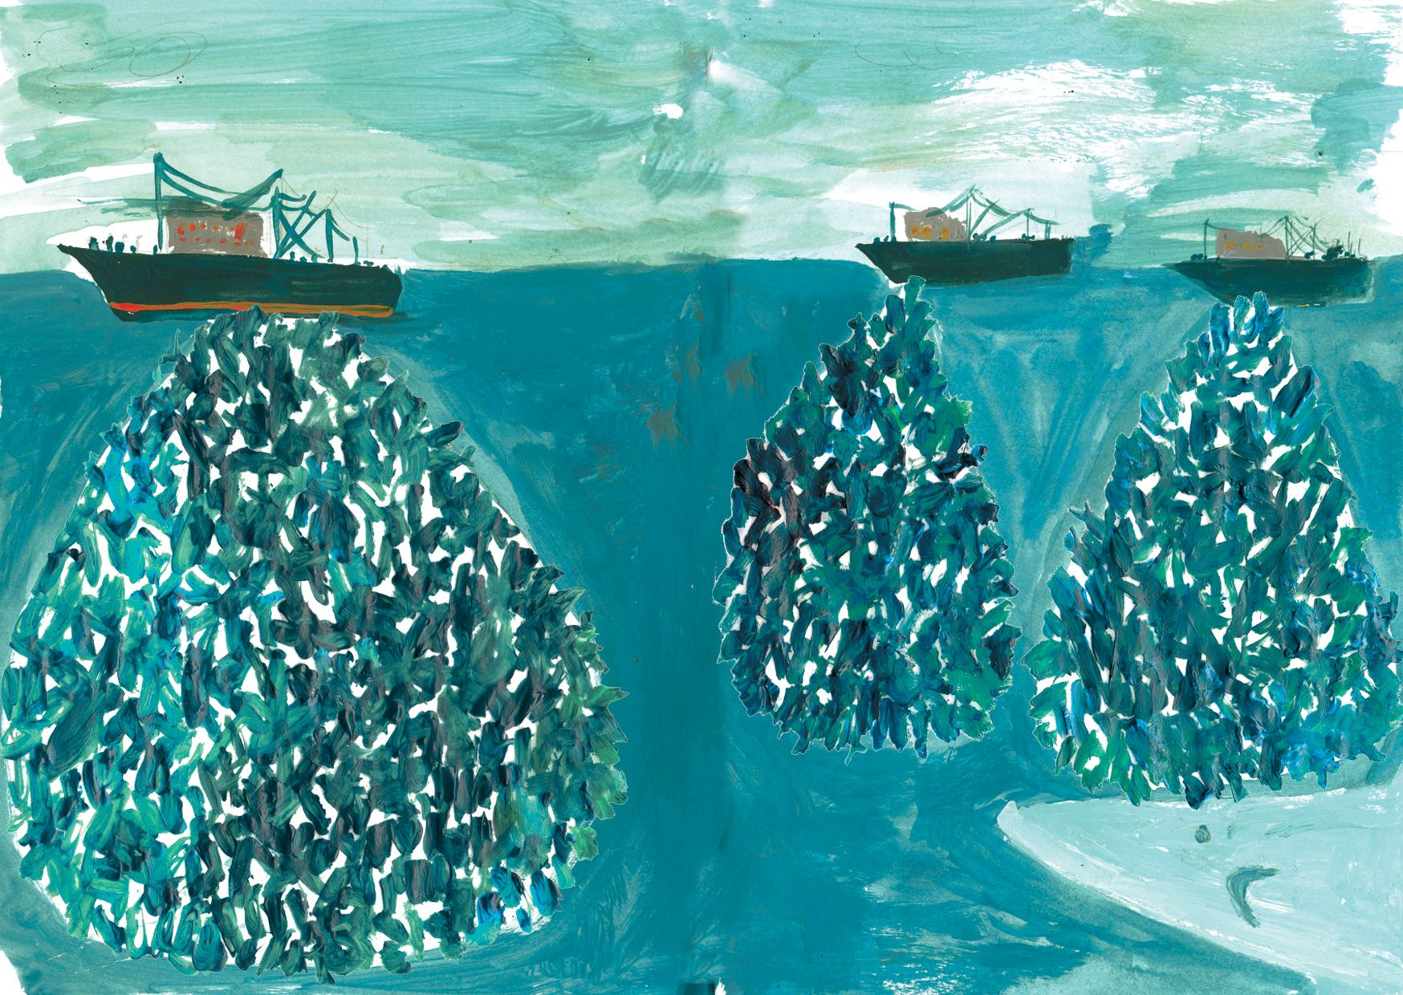
Got Fish?
OVERFISHING
Overfishing is when so many fish are caught, that the population can’t reproduce fast enough to replace them.
Caused by Mass Fishing and Commercial Fishing.
We catch three times more fish than we need.

Slide 21
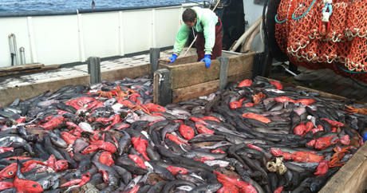
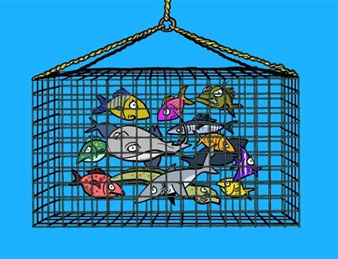
Got Fish?
BYCATCHING
By-catching is when commercial fishermen catch a portion of animals that they didn’t originally intend on catching in their nets, which eventually get thrown back into the ocean in most case injured or dead
Sometimes the by-catch numbers are greater than the portion of fish actually intended to be caught

Slide 23
Extra…
https://www.youtube.com/watch?v=2lNCj1_zZTk&t=634s

