Slide 1
Water Treatment
By: Justin Sanders, Harry Black, Terrence Carothers and Noah Myers

Slide 2
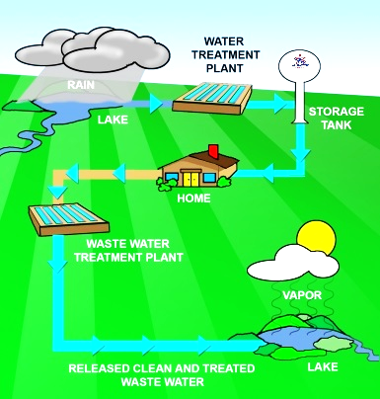
What happens in the sewage treatment?
What it does:The sewage treatment removes particles from the water to make it fresh water.
Wastewater: Wastewater is any water that has been affected by pollution, dirt, and other organisms.
Where can We find a sewage treatment? Near Neighborhoods where the water comes from to clean the houses water. (Septic System).

Slide 3
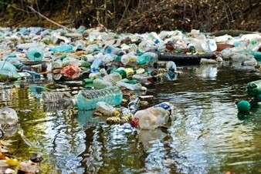
Why Do We Need A Sewage Treatment
We need a sewage treatment in order to clean water. A lot of places where we get water are polluted. We cannot keep taking the remaining fresh water because it is limited. Sewage Treatment help clean our water and prevent us from getting sick from drinking polluted water. Which may have bacteria, chemicals, and living organisms.

Slide 4
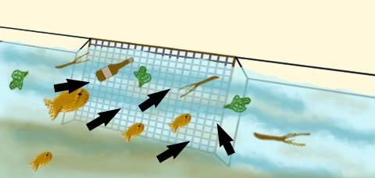
Water Treatment Process Steps
Screening
Wastewater is pumped to the screening before entering the treatment. The screen is the most important because it blocks plants, wood and fish from entering the treatment, but groundwater does not need to go through a screening because it has already been filtered.
Coagulation
Alum is added and other chemicals to the water.Which causes tiny sticky particles to form and makes the particles
to become sticky and clumped together, forcing
Them to stick to the ground.

Slide 5
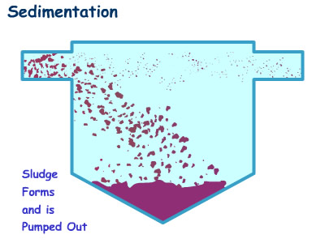
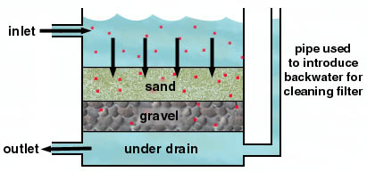
Water Treatment Process Steps
Sedimentation: As the water is sitting there the heavy floc or particles sinks to the ground and settles there until they are removed.
Filtration: The water passes through layers of gravel which is 1 feet down and sand which is 2 ½ feet down. This process is to filter out any remains of particles from the water.
Notes:
uuii

Slide 6
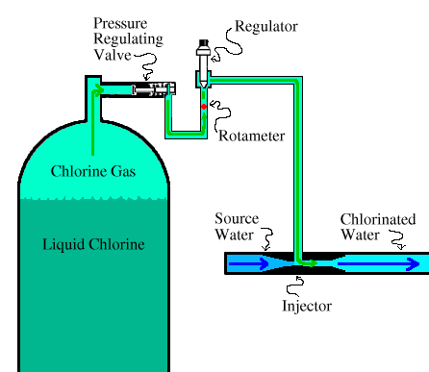
Water Treatment Process Steps
Disinfection
The water goes into a close tank to kill any remaining bacteria in the water and keeps the water clean until it is used. If it only used groundwater then Disinfection may be the only treatment to clean the water then it will just sit there or it will flow underground in pipes.

Slide 7
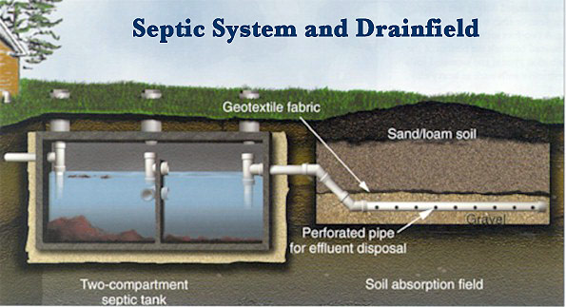
Septic System
What is it? A septic system is an wastewater treatment system that takes place underground. A septic system is made up of the following…
1) A Septic Tank: A giant solid tank that holds the water from sewage pipes. Heavier solid materials sink to the bottom, “sludge.” Less dense materials float to the top leaving “wastewater” in the middle. Baffles prevent the materials from getting out of the tank.
2) A Drainage System: When the water gets high enough in a tank it flows into a pipe that filters the water even more by removing harmful chemicals.

Slide 8
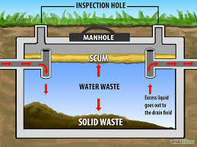
Septic System (Continued)
Soil: Finally the water is brought to the soil where it seeps in between the permeable rock where the remaining bacteria, viruses, and nutrients are removed

Slide 9
Sewage Treatment Plan vs. Septic System
Sewage treatment: These plants clean the water coming from lakes, rivers, and streams. They take the potentially materials out of it, and turn it into drinkable water for us.
Septic System: A system that takes water from neighborhoods, and puts it through a system that cleans the dirty water.
The difference is that sewage treatment plants clean water from rivers, streams, and lakes while septic systems clean water from neighborhoods.

Slide 10
Nonpoint Source Pollution
What Does it Do: Nonpoint Source Pollution is when pollution in water cannot be traced back to where it came from.
What does this Mean: This means that if a company or factory releases something into the air, the pollutants will be absorbed into condensing water. When it becomes precipitation the pollutants rain back down into the water with the water droplets. Therefore, the water is polluted leaving no trace to how it was polluted.
Example: Urban runoff which is when runoff picks up pollutants gathered in urban areas.

Slide 11
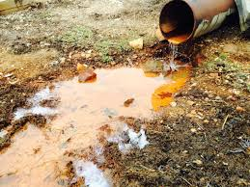
Point Source Pollution
A point source pollution is when you can locate a specific location where pollutants are coming from such as factory chimneys or drainage pipes that are dumping pollutants from a location.
An example of this are factory chimneys or drainage pipes that can be traced back to where the pollution is coming from like the picture below.

Slide 12
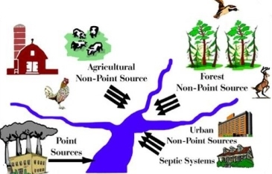

Slide 13
Non Point Source vs. Point Source
Nonpoint Source Pollution is when there is no trace as to how the water was polluted. This means that the pollution cannot be traced back to anyone or anything. Because of this Non Point Source pollution is worse because there is no punishment for whoever did it because there is no way of knowing who did it. In Point Source Pollution the pollution can be traced back to a single point but not in Nonpoint Source Pollution.
Also, scientists found that the majority of water pollution is because of Nonpoint Source Pollution.

Slide 14
How Can Pollution be Prevented?
1.Don’t litter. Don’t throw trash on the ground and pick up trash if
2.Use natural lawn fertilizers (cow manure). An example of unnatural lawn fertilizers would be, chemicals.
3.Buy organic food that is produced without the use of chemical pesticides or fertilizers.
4.Dispose of hazardous materials, such as paint, motor oil, antifreeze and lawn fertilizers responsibly, never down household drains or in the gutter.

Slide 15
Quiz
1. Why is nonpoint source pollution so bad?
Possible Answer: Nonpoint Source Pollution is so bad because it pollutes our water and can cause harm to the body if consumed. It cannot be traced back to where it came from.
2. At what point in the septic system are harmful chemicals removed from the water?
Answer: After the drainage system

Slide 16
Vocabulary
Atmospheric Deposition: Water pollution that is caused by air pollutants that rain down back into a body of water.
Baffles: A water treatment device that prevents sediment and other materials, and filter the materials from the water.
Floc: A loosely clumped mass of particles
Hazardous: Risky, Dangerous
Hydrologic Modification: Manmade changes in streamflow
Pesticides: A substance used for destroying insects or other organisms harmful to cultivated plants or to animals.

Slide 17
Web sites
http://www.livestrong.com/article/170866-reverse-osmosis-purifier-vs-ionization/
http://www.familyeducation.com/life/septic-system/all-about-septic-systems
http://www.nesc.wvu.edu/subpages/septic_defined.cfm
http://www.livestrong.com/article/128483-steps-water-purification/
https://www.epa.gov/nps/what-nonpoint-source
http://www.nyc.gov/html/dep/html/wastewater/wwsystem-process.shtml
http://greenliving.lovetoknow.com/ways-stop-pollution
http://www.freedrinkingwater.com/water_quality/quality1/1-how-do-water-treatment-plants-work.htm

