Slide 1
#11 Snack Tectonics: what's happening at the plate boundaries

Slide 2
Materials
Wax paper
Popsicle stick
Frosting
Graham crackers
Fruit roll up

Slide 3
Brainpop: Plate Tectonics
https://www.brainpop.com/science/earthsystem/platetectonics/

Slide 4
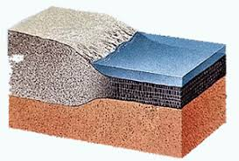
Continental Crust vs. Oceanic Crust
Continental
The rock that forms continents and landmasses
Less dense (particles of rock are not as closely compacted together)
Thicker
Oceanic
Below the ocean (makes up the sea floor)
Very dense (particles of rock are compacted closer together)
Thinner

Slide 5
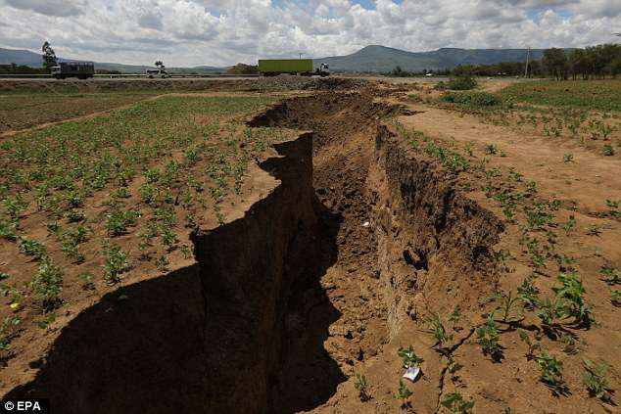
*Continental-Continental Crust Divergent Boundary
Rift valleys form
This is when 2 plates move away from one another in 2 different directions

Slide 6
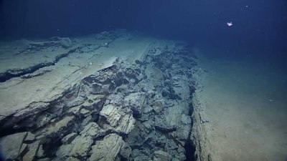
*Oceanic- Oceanic Crust Divergent Boundary
New crust forms here
As oceanic crust spreads, magma fills the new rift valley creating new crust
Mid ocean ridges form at divergent boundaries

Slide 7
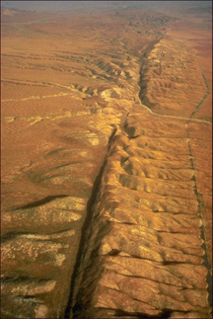
*Continental – Continental Crust Transform Boundary
Crust is not created or destroyed
Earthquakes occur along this boundary

Slide 8
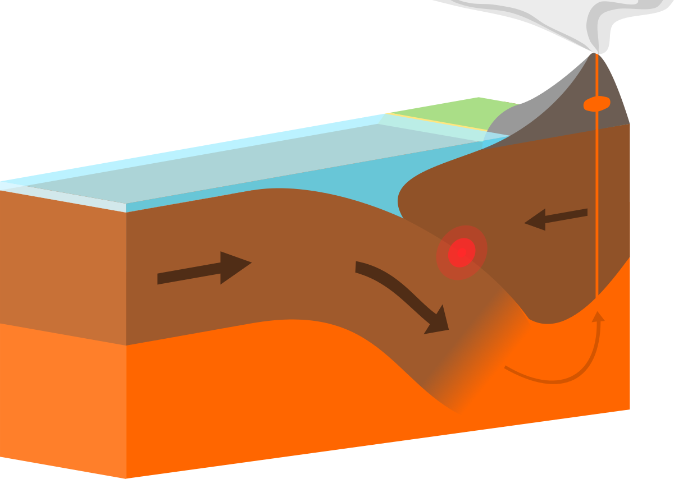
*Continental-Oceanic Crust Convergent Boundary
Oceanic crust sinks below continental crust because its more dense
Crust melts and is destroyed as it sinks below continental crust
This is also called an ocean trench

Slide 9
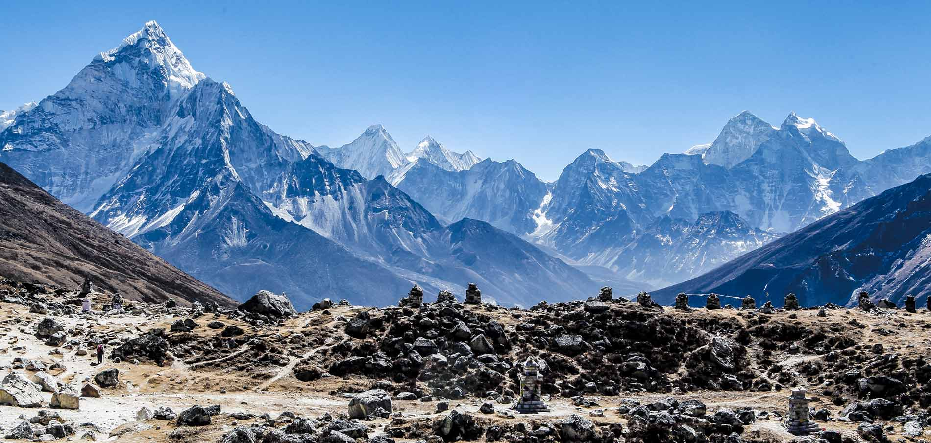
*Continental- Continental Crust Convergent Boundary
Land is forced up causing mountains to form
Crust is destroyed here

Slide 11
Extra…
How are these two crustal plates different?
What process allows Earth's plates move?
What is a plate boundary?
What occurs at each plate boundary; divergent, convergent, and transform?
What type of crust is represented by the graham crackers?
What type of crust is represented by the fruit roll-up?
What physical layer of the earth does the frosting represent?
If two oceanic crusts are pushed away from one another, what happens?
If the continental crust is pushed towards the oceanic crust, what happens?
If two continental crusts are pushed towards one another, what happens?
If two continental crusts slide past each other, what happens?
What are some of the limitations of the models you've created?

Slide 12
100 Greatest discoveries: sea floor spreading
https://www.youtube.com/watch?v=GyMLlLxbfa4

