Slide 1
Surface Water and It’s Properties
Ryan Harris - Asher Fazal - Cooper Mok - Sebastian Mesanza

Slide 2
Discuss at your table what you already know about water’s properties
Before we start...

Slide 3
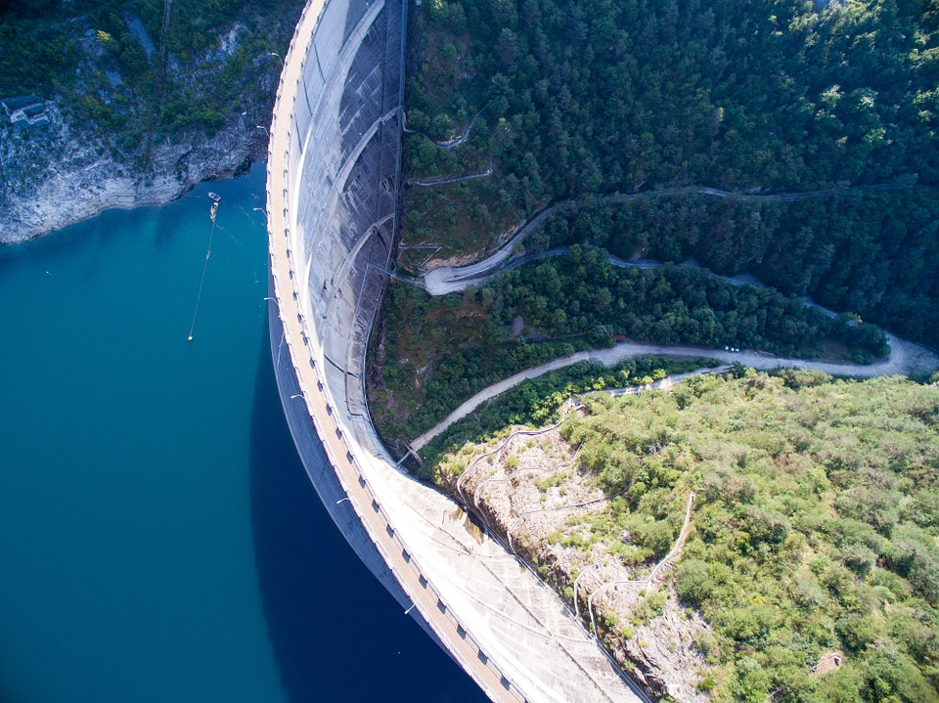
Reservoirs
Reservoirs are places where water is stored in artificial or natural lakes created by dams. Most reservoirs are formed by constructing dams across rivers, the dams keep water in and control how much water goes out or stays in.
An example would be Lake Mead which was created by The Hoover Dam
Reservoirs are used for electricity and other things like fishing, irrigation, and boating. Without reservoirs the us would be left without 7% of our electricity.

Slide 4
Lake Turnover
Lake Turnover is the process in which the warm water at the top of a lake sinks and the cool water at the bottom rises to the top.
Lake turnover is important when it comes to lakes. It usually occurs during spring and fall.
Lake turnover mixes the lake water, distributing nutrients from the bottom up and oxygen from the top down
In the fall, the surface layer of water cools because of cooler air temperatures. As it cools, it becomes more dense, causing it to sink. This dense water forces the water at the bottom to rise, turning over the layers.

Slide 5
What is Eutrophication?
Eutrophication is the process in which excess nutrients leads to the death of entire aquatic ecosystems. Let’s break it down:
1. Rain washes fertilizers or other nutrient rich substances into lakes or rivers.
5. The lack of oxygen leads to the ultimate downfall of the ecosystem.
3. All the new plants prevent sunlight from reaching smaller plants. These plants die and lead to decrease in oxygen.
2. These lakes/river, having an overload of nutrients, experience a rapid growth in plant life.
4. The bacteria that decomposes these dead plants take even more oxygen.

Slide 6
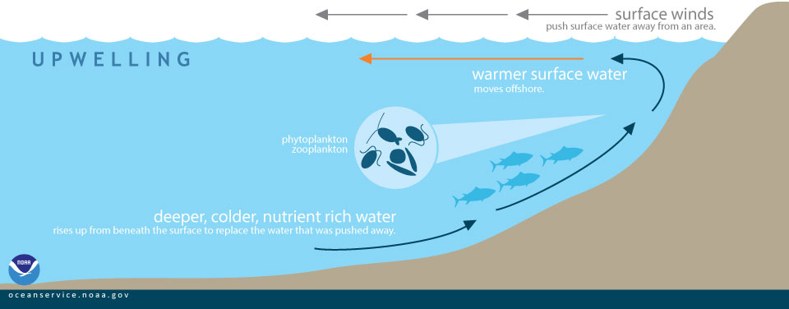
Upwelling and Its Marine Life Benefits
Upwelling - The movement of water up to the surface from the deep ocean.
This is initiated by global/surface winds
The deep ocean has way more nutrients than surface water because there are less plants at the bottom to use nutrients from the water.
Because the deep is nutrient rich, when the nutrients rise to the top, ocean life can feed on this abundant nutrients, sustaining ocean life.
This is why the most upwelled areas have the best fishing, because they become rich areas for feeding.

Slide 7
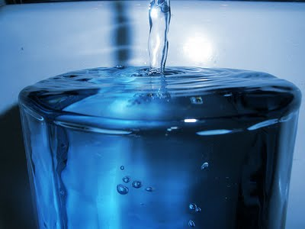
Vocab
Adhesion-The tendency for water particles to stick to other surfaces
Water strongly attracts to glass more so than any other object.
Adhesion is important because it contributes to the movement of water. Without adhesion their would be no transportation because water wouldn’t stick to plants which would damage the water cycle
Example: water sticking to a glass cup
Cohesion- The tendency for water molecules to stick to each other.
This is what is responsible for surface tension which is a liquid’s ability to stick together when its surface is disrupted
Without cohesion water could not come together in clouds during condensation.
Example: Water in a cup forming a bubble like shape before overflowing

Slide 8
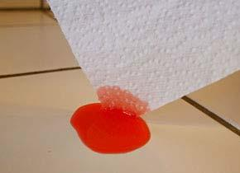
More Vocab
Specific Heat- The heat needed to raise an object's temperature.
Specific Heat is important because without it nothing would be able to heat anything up.
Example- a stove heating up
Capillary action- The process where water rises into porous substances.
It is important because without it, cleaning up spills would be a lot harder
Capillary action is what is going on when paper towels absorb water

Slide 9
Even More Vocab
Surface tension -Describes the tightness of the surface of a liquid. This is why force is required to disrupt the surface of a liquid
Surface tension is important it allows insects, usually denser than water, to float and stride on a water surface.
Water Polarity- One side of every water molecule is negatively charged, while the other is positively charged
Water Polarity is important because it allows water to dissolve other polar substances quite easily
Water Polarity is the reason water has cohesion, the negative and positive ends attract.

Slide 10
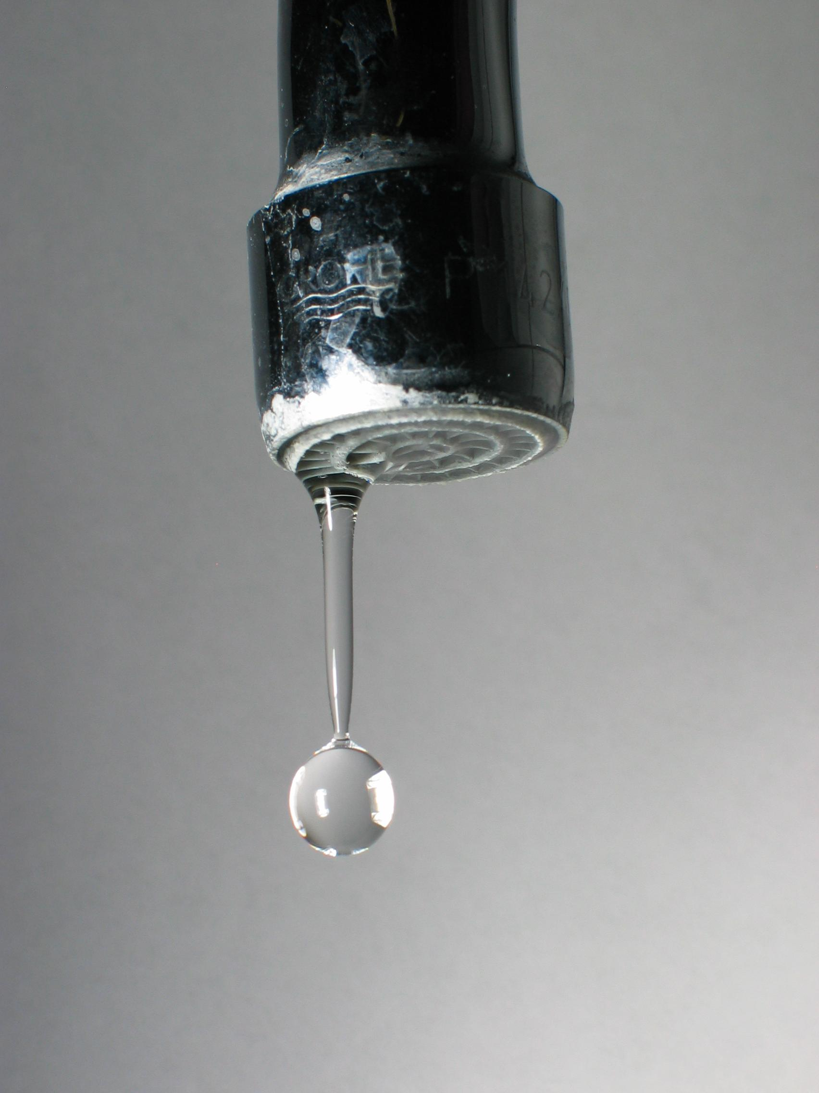
Yep, More Vocab
Water Hardness
Water hardness is the hardness of water based upon its mineral content mainly calcium and magnesium.
Water hardness is important, because without it minerals wouldn't dissolve, and washing your hands would be useless. The water wouldn't be powerful enough to get things off your hands.
Two elements responsible for water hardness: calcium and magnesium carbonate.

Slide 11
Assessment questions
What are reservoirs used for?
2. How does lake turnover distribute nutrients?
3. Why does the deep ocean have more nutrients than the surface ocean?

Slide 12
What percent of electricity do reservoirs produce?
76%
79%
19%
7%
8%
5%
50%
76%
79%
19%
7%
8%
5%
50%

Slide 13
REFERENCES
Lake Turnover - National Geographic Society
https://www.nature.com/scitable/knowledge/library/eutrophication-causes-consequences-and-controls-in-aquatic-102364466
Cohesion and adhesion of water (article) | Khan Academy
Surface Tension (Water Properties), USGS Water Science School
https://water.usgs.gov/edu/hardness.html
What is upwelling? - NOAA's National Ocean Service
https://www.thoughtco.com/why-is-water-a-polar-molecule-609416

Slide 14
THE END!

