Slide 1
Surface Water & Ocean Currents
By: Lauren E., Michaela G., Michael M.

Slide 2
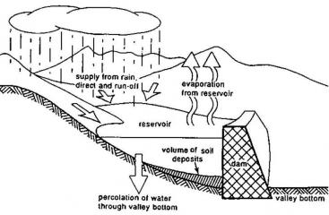
Reservoirs & Their Importance
A reservoir is an “large natural or artificial lake, which is used as a source to supply water.“
When it is natural it is formed by runoff and when it is manmade we make them by digging out the large area and filling it with water that was extracted from another source.
The role of reservoirs is to store the water when we have a massive rainfall to prevent floods. They also keep all the water into one easy accessible place.

Slide 3
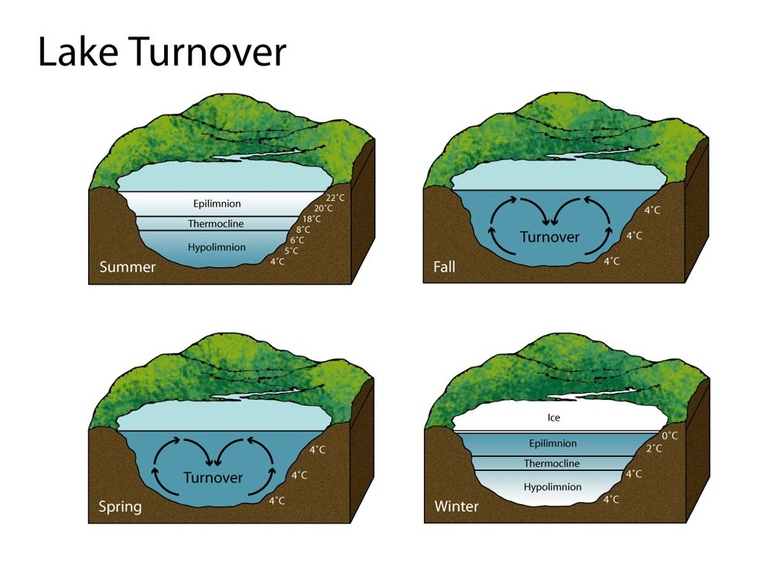
Lake Turnovers
A lake turnover is when the seasonal movement of layers and water occurs.
During the summer the top layer is the hottest and get colder the deeper you go, and during the winter it’s the opposite. So when the seasonal weather changes occur in the spring or the fall it makes the hot and cold layers rotate like convection.
While if it is a little pond, since it's not deep, lake turnovers can’t occur.

Slide 4
Eutrophication
Eutrophication is an “increase of nutrients in water which causes plant and algae growth in bodies of water.” It can happen naturally or humans can cause it.
Causes- Effects-
Phosphorous and Nitrogen
When runoff washes over land into water it carries fertilizers with it. Those fertilizers then feed the plant life and cause them to grow
Natural events, like floods
Sometimes sewage is discharged into water which causes a buildup of nutrients that feed the plant life
Takes oxygen from water
Blocks sunlight from getting to lower parts
Takes up space, causing crowding among aquatic animals

Slide 5
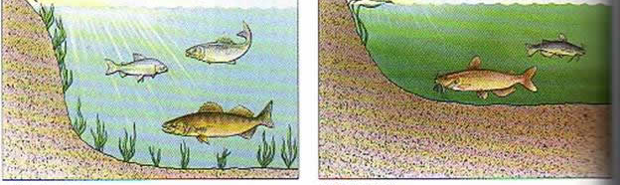
Eutrophication cont.
While Eutrophication has a role it is not a good one-
Its role is causing “harmful algae blooms.” That means it causes large areas of algae to form that are bad for the aquatic ecosystem.
Facts-
It can occur naturally, but takes a very long time
It can cause “hypoxic” which is when oxygen levels are too low
It is referred to as “too much of a good thing”

Slide 6
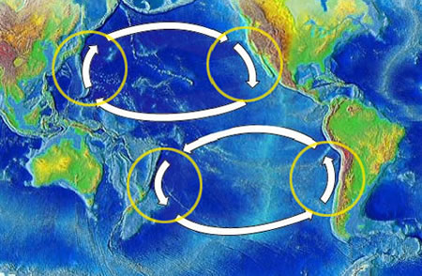
How winds create ocean currents
There is two “circulations” in our ocean. These are the two different areas that currents occur in. Our wind only affects the “surface circulation” which goes from zero to 1312 feet.
Our global winds push the surface water currents in the direction our wind is blowing. The coriolis effect turn our wind certain directions which affects our currents. More specifically, it turns it to a clockwise direction in our Northern hemisphere and in a counterclockwise motion in the Southern hemisphere.

Slide 7
How Weather & Climate are Related to Currents
El nino is where the climate of the pacific ocean, around the equator only, changes in temperature. This is only short-term and doesn’t stay for awhile.
The North Atlantic Oscillation happens in the North Atlantic Ocean and it’s the changing of the atmospheric pressure. It controls the winds in the West and does not last for a specific time.
The currents and weather interact in a very compound way. When the wind heats up it drives the currents towards the shore giving us waves which then heat up the air and it continues like a big circle.

Slide 8
So What Is An Upwelling? And How Does It Affect Marine Life?
An Upwelling is basically when cold, nutrient-rich water rises from the bottom and then the wind pushes it back.
It affects marine life because the nutrients in the water that had risen had taken in more sunlight therefore multiplying its nutrients so when the wind pushes the water back more organisms are able to get to it and the multiplied nutrients becomes a great feeding source.

Slide 9
Questions-
What knowledge of yours has changed about Ocean Currents and Surface water after seeing this presentation?
Which two can be manmade and naturally made?
Reservoirs and Ocean currents
Reservoirs and Eutrophication
Eutrophication and Upwelling
Upwelling and El nino
3. In your own words describe Eutrophication.

Slide 10
Sources
http://www.eartheclipse.com/ecosystem/causes-and-effects-of-eutrophication.html
https://www.britannica.com/technology/reservoir
http://www.eo.ucar.edu/kids/green/wild3.htm
http://www.unep.or.jp/ietc/Publications/Short_Series/LakeReservoirs-1/3.asp
http://www.sswm.info/content/man-made-reservoirs
http://tos.org/oceanography/article/the-role-of-eutrophication-in-the-global-proliferation-of-harmfulalgal-bloo
http://nationalgeographic.org/media/lake-turnover/
http://oceanservice.noaa.gov/education/kits/currents/05currents3.html
http://earth.rice.edu/mtpe/hydro/hydrosphere/topics/Ocean_Atm_Circ_ElNino.html
http://oceanservice.noaa.gov/facts/upwelling.html
http://nationalgeographic.org/media/lake-turnover/
Science Textbook

