Slide 1
#4 The Scientific Method Notes

Slide 2
Warm-Up 8/29 On the top of page 4 write a newspaper headline for this picture using exactly 8 words

Slide 3
Scientific Method
*1. State the problem
*Often in the form of a question
*Sometimes requires research
So when thinking about what you are going to wear today… who can state the problem

Slide 4
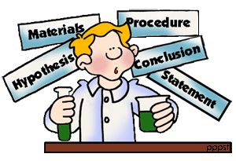
*Scientific Method
2. Form a hypothesis
(Possible solution/answer to the problem)
It’s an educated guess

Slide 5
*Scientific Method
#3 Gather materials to do experiment
This should be listed in specific detail
Consider the variables being used (independent and dependent)

Slide 6
*Scientific Method
#4 Do the experiment
Also known as the procedures
This is where you test your hypothesis.

Slide 7
*Scientific Method
5. Record and analyze data
Organize all of your information by creating graphs and charts
Compare information

Slide 8
*Scientific Method
6. State the conclusion
Answer the problem in step #1, use data to back up your answer
State what your hypothesis was and if it was correct or incorrect
Are there other variables you didn’t consider?
Everything should be in a complete sentence (as if the reader had no idea what you were talking about).

Slide 9
*Parts of an experiment
Control vs. Variable
Control : The thing in the experiment that does NOT change
Variable : The thing that changes or has different values.

Slide 10
*2 types of variables
Independent Variable : the part of the experiment that is changed by the experimenter.
Example: moldy bread experiment – wrap plastic wrap around a piece of bread compare how fast it will mold compared to the control
Dependent Variable : The part of the experiment that is affected or changed because of the independent variable.
Example- moldy bread - amount of mold on bread and how fast the mold grows it will change due to one being wrapped and the other not.

Slide 11
Cool down activity
Come up with an acronym to help you remember the correct order of the scientific method
(for example the order of operations in math is PEMDAS- “please excuse my dear aunt sally.”)
P-
H-
M-
E-
D-
C-

