Slide 1
This is how we bond:
molecular bonding chem. sets

Slide 2
The activity
In this activity you are going to model how atoms join together to form bonds, creating molecules.

Slide 3
Recap…
Remember the joining together of two or more atoms creates molecules.
But what is responsible for these atoms wanting to bond?
VALENCE ELECTRONS!

Slide 4
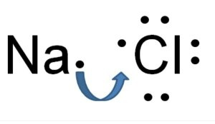
Why does Sodium bond with Chlorine to create table salt?
Sodium (Na) is located in group 1. Na has 1 VE
Chlorine (Cl) is located in group 17. It has 7 VE.
Sodium is willing to give its VE away to Chlorine so they can bond and have an octet. Below is a Lewis dot diagram showing you how these atoms bond together

Slide 5
Sometimes you have to move the valence electrons to make sure you are making an octet
For example look at Ozone (O3)
Notice how there are only 8 valence electrons surrounding each oxygen atom

Slide 6
Sometimes you have to move the valence electrons to make sure you are making an octet
If you look at the green dots you will notice that 4 valence electrons are together. This creates a double bond.
Single bonds are drawn with one --
Double bonds have two =

Slide 7
Each line represents 2 shared VE’s
Na-Cl
O=O-O

Slide 8
Create models of these molecules and draw the Lewis structure showing the bond
H₂
Cl₂
O₂
H₂O
Create the molecule | Draw the Lewis Bond

Slide 9
Create models of these molecules and draw the Lewis structure showing the bond
ammonia (NH₃)
carbon dioxide (CO₂)
hydrochloric acid (HCl)
Glucose (C₆H₁₂O₆)
Create the molecule | Draw the Lewis Bond

