Slide 1
Types of Fossils
Chapter 2.1

Slide 2
Types of fossils
Molds and Casts
Trace fossils
Petrified wood and carbon films
Ice cores and tree rings
Original remains
Draw a picture of a fossil

Slide 3
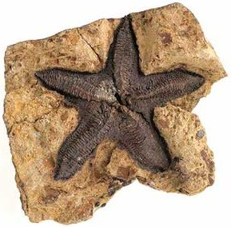
*Original Remains
Fossils that are the actual bodies or body parts of organisms are called original remains
Original remains are found in places where conditions prevent the decomposition or breakdown to occur

Slide 4
*Types of Original Remains
Ice – best preserver of prehistoric life. Ice has preserved original remains of things such as a 10,000 year old mammoth which have been found with bones, muscles, skin, and hair still in place
Amber – formed from the sticky substance inside trees that flows like syrup. If an insect is caught in the sap, the sap will cover the insects entire body and harden.
Tar – thick, oily pool of liquid. Things such as saber toothed cats and other animals were trapped and preserved

Slide 5
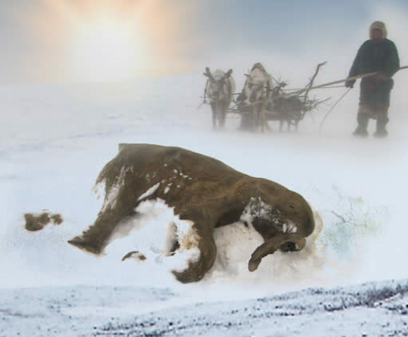
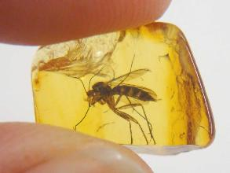
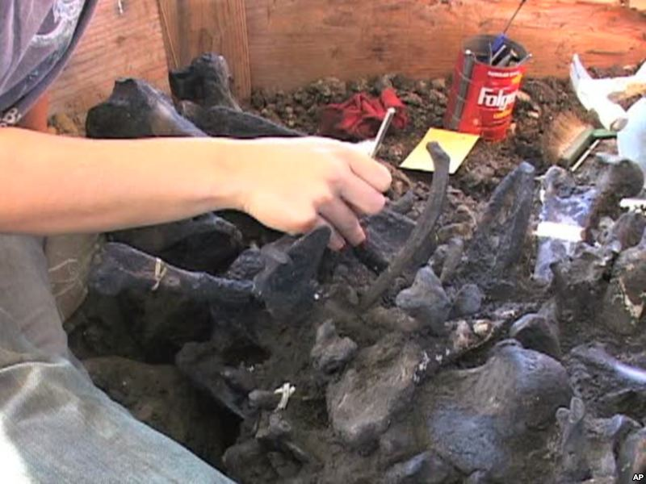

Slide 6
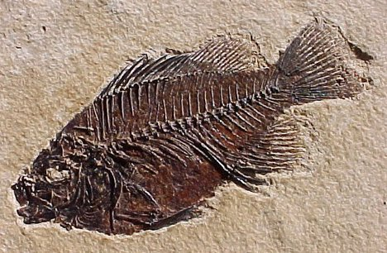
Fossils in Rocks
Some fossils are not original remains or actual body parts, instead they are impressions or traces made in rock.

Slide 7
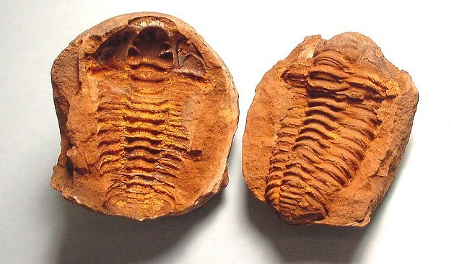
*types of Rock Fossils
A mold is a visible shape that was left after an animal or plant was buried in sediment and then decayed away.
A cast is an object that is created when sediment fills a mold and becomes rock.

Slide 8
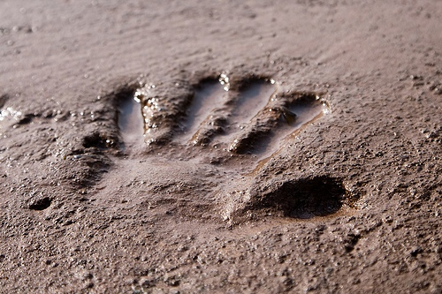
Mold or cast?

Slide 9
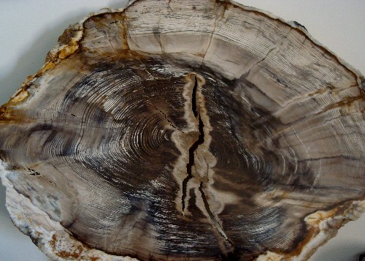
*Petrification (Petrified Wood)
The process in which minerals pass through and replace the organisms cells with minerals which produces a stone-likeness to the object. Commonly happens with trees that die and are covered in sediment

Slide 10
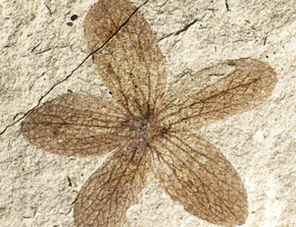
*Carbon Films
Carbon is found in every living thing. Sometimes when a dead plant or animal decays, a visible carbon layer is left behind. Carbon films show the soft parts of these organisms that are rarely seen in other fossils

Slide 11
*Trace Fossils
Preserved evidence of animal activity or movement
Examples of trace fossils:
Tracks – which tells us the size of animal and speed
Burrows – shelters made by animals buried in sediment
Feces – preserved animal poop
Notes:
This can tell you thing like how fast the dinosaur could run

Slide 12
Ice core video
http://teachertube.com/viewVideo.php?video_id=240111

Slide 13
*So what do ice cores tell?
One big thing they tell us is the connection between CO² and climate long time ago.
When looking at ice core samples, scientist use bubbles of past atmosphere as indicators of past life.
This helps us analyze and determine past levels of greenhouse gases, which helps us understand temperature
Notes:
One of the most valuable indicators we get from ice cores comes in the form of tiny bubbles of past atmosphere that get trapped between the snow flakes as the ice builds up on the continent. We can bring the ice cores back to the laboratory, crack open the bubbles which are like tiny time capsules of past atmosphere and analyze them to determine past levels of greenhouse gases. What we find is really startling. The carbon dioxide levels over the past 800,000 years track the temperature record incredibly closely, showing that there is a tight link between CO2 and climate.

Slide 14
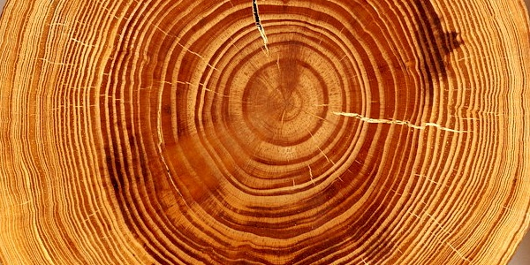
*Tree rings
The width of a tree ring tells us about weather patterns throughout a season
If the tree ring is thick, then we had a good growing season (a lot of rain)
If the tree ring is thin, the tree did not receive a lot of rainfall and didn’t grow as much
Cool Fact: the number of rings tells the trees age.

