Slide 1
Upcoming Dates this fri – interim mon – projects due tues 12/19 – post quiz

Slide 2
#37 chem 1 review ws #38 Elements, compounds, mixture notes

Slide 3
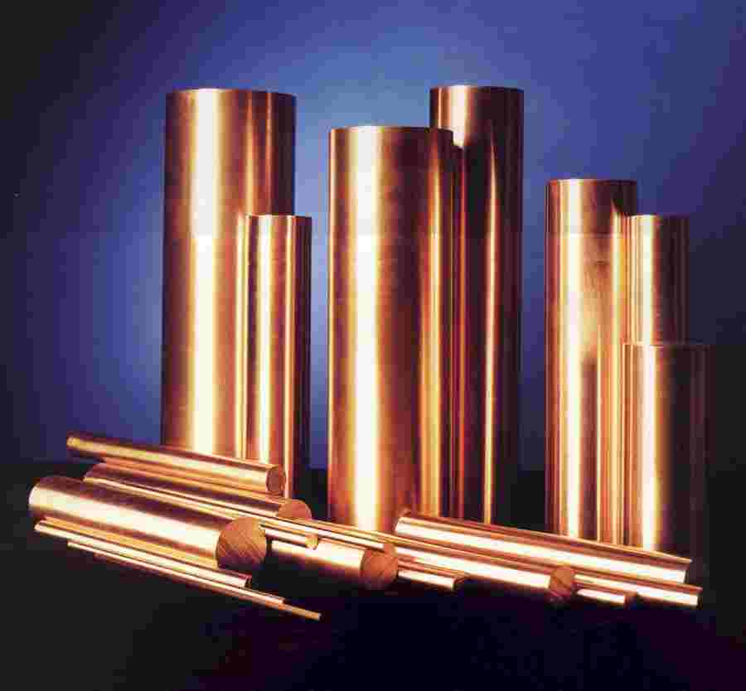
*Element
Elements are composed of one kind of atom, which are listed and found on the periodic table

Slide 4
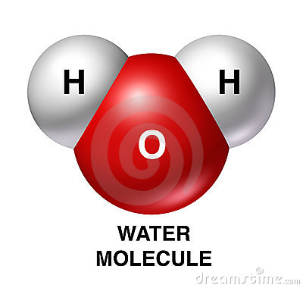
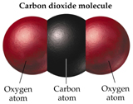
*Compound
A compound is a substance made up of atoms of two or more different elements joined by chemical bonds.
Compounds cannot be separated physically

Slide 5
*Molecule
A molecule is formed when any two or more atoms join together chemically.
For example:
O2 N2 H2O

Slide 6
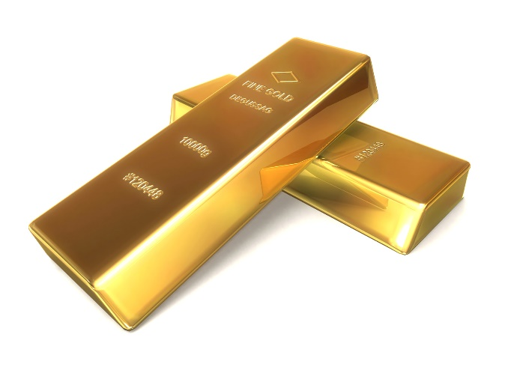
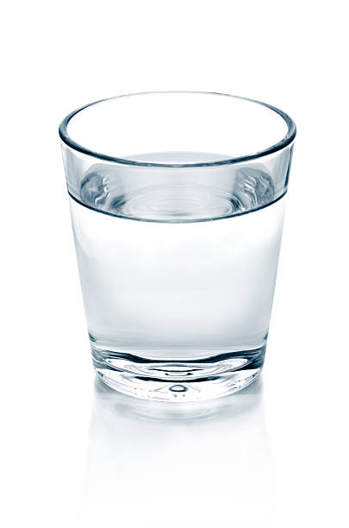
*Pure substance
A pure substance is a substance made of only one type of atom or one type of molecule.
Examples are:
A block of gold (Au) glass of water (H20)

Slide 7
Explain which is true:
Molecules can be compounds but not all compounds can be molecules
OR
Compounds can be molecules but not all molecules can be compounds

Slide 8
Mixture
*Mixtures are combinations of two or more different elements or molecules that are mixed together.
*Mixtures can be separated by physical means such as filtration, sifting, or evaporation
There are two types of mixtures:
-Heterogeneous
-Homogeneous

Slide 9
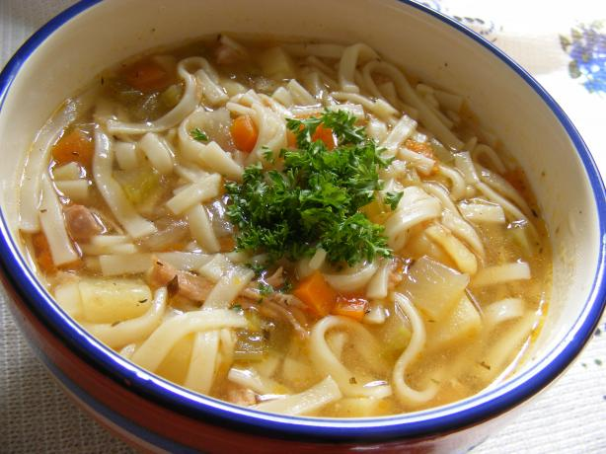
*Heterogeneous mixture
A heterogeneous mixture contains more than one type of matter and is not the same throughout
(you can see the different parts of the mixture)
For example:

Slide 10
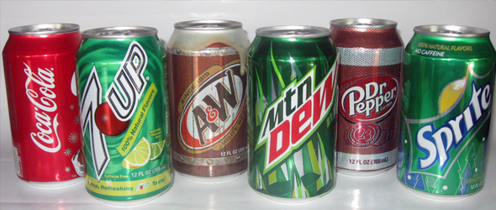
*Homogeneous Mixture
A homogeneous mixture contains more than one type of matter and is the same throughout
(you cannot see the different parts of the mixture)
For example:

Slide 11
Mixtures vs. compounds
Mixtures | Compounds
Made of elements, compounds, or both | Made of elements
No change in original properties of components | Change in original properties of components
Separated by physical means | Separated by chemical means
Formed using any ratio of components | Formed using a set ratio of components

Slide 12
Elements, Compounds, Mixtures Song
Mr. Lee Rap
http://www.youtube.com/watch?v=B0d-fzj9oMQ

Slide 13
Diagram on next slide
Fill in blanks with the following words:
Matter
Element
Homogeneous
Mixture
Substance
Compound
Heterogeneous

Slide 15
Warm-up
How can we tell the difference between elements, compounds, and mixtures. What do they look like and give an example of each

