Slide 1
Page 19 Understanding Relative Age
Join my Google classroom:
Red: 275du3
Yellow: kyz2fk
Green: y6l37a
Blue: krtjm8

Slide 2
Upcoming Dates
Wed 10/4 – Greek and Latin Quiz 3 Flashcards Due
Fri 10/6 – Earth 2 Post Quiz
Tues 10/10 – Earth 2 Test
Fri 10/13 – Greek and Latin Quiz 3
Thurs 10/19 – Science Interim Test
(formal grade on Earth 1, Earth 2, some Hydrology)

Slide 3
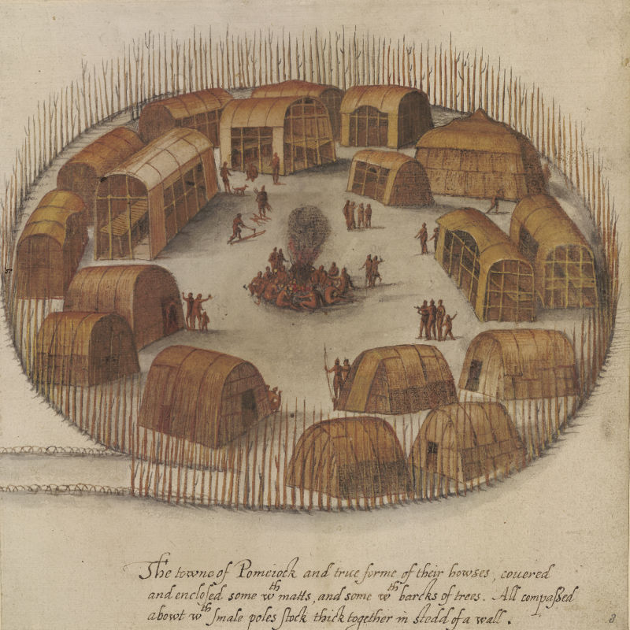
Warm-up
Which evidence---a trace fossil, a petrified fossil, a tree ring, or an ice core would be most helpful to a historian studying how the Indians grew food at the Roanoke Colony (also known as the Lost Colony) of 1587? Explain your answer in complete sentences
Notes:
A tree ring because you could find trees dating back to 1587 and their rings would provide information on their climate.

Slide 4
Relative Dating | Superposition
Geologic Column | Cross Cutting Law

Slide 5
Faults | Intrusions
Tilting | Folding

Slide 6
Geologic Column
*Geologic column is an arrangement of rock layers in which the older rocks are at the bottom. This helps scientist find the relative age of the Earth.

Slide 7
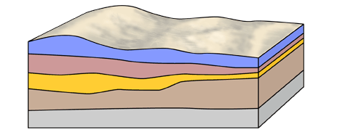
Color this diagram
B
D
C
A
E

Slide 8
Relative dating
*Relative Dating: scientist use this to determine whether an event or object is older or younger than another event or object
*Relative Dating is just an ESTIMATE of events… There is no absolute information
*Example:
Layer ______ is older than layer ________
Notes:
Until about the 1900’s geologists didn’t have a way of determining the absolute age of objects. So instead they used the relative age and clues to give them a better idea of things

Slide 9
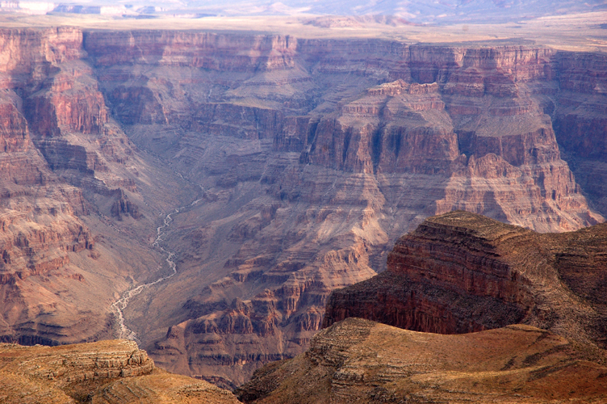
Law of Superposition
*The Law of Superposition states:
-Younger rock lies above older rock in an undisturbed sequence. (undisturbed rock means the next rock layer lies on top of the older rock without having something mess up the arrangement of rocks)
-Each layer is older then the layer that rests above it.
Notes:
The answer to the pervious question is Sedimentary Rock. The bottom layer of rock forms first, which means it is the oldest. The layer above that is younger and the layers become younger and younger as the layers lay on top.

Slide 10
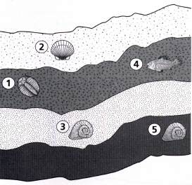
Notes:
Which layer is the the oldest

Slide 11
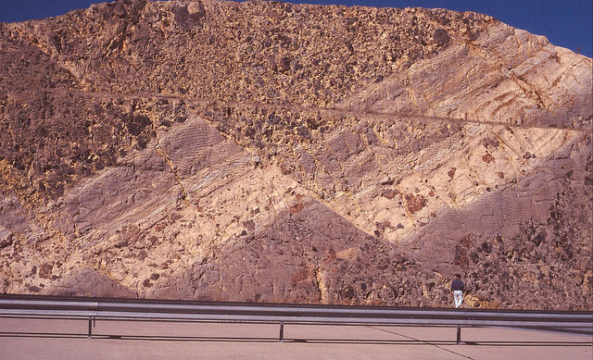
So what about disturbed rock?
*Faults – break in the Earth’s crust, where blocks of crust shift past one another

Slide 12
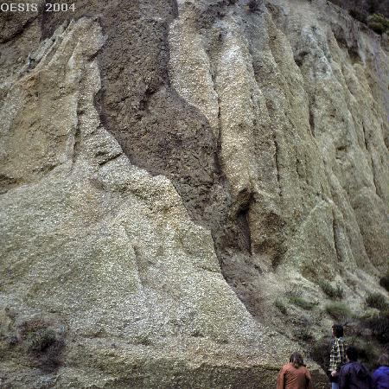
*Igneous Intrusion – Igneous rock (molted rock) from the Earth’s interior that squeezes into existing rock and cools (younger then sedimentary layers)

Slide 13
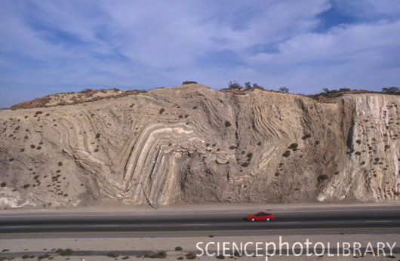
*Folding – Occurs when rock layers bend and buckle from Earth’s internal forces

Slide 14
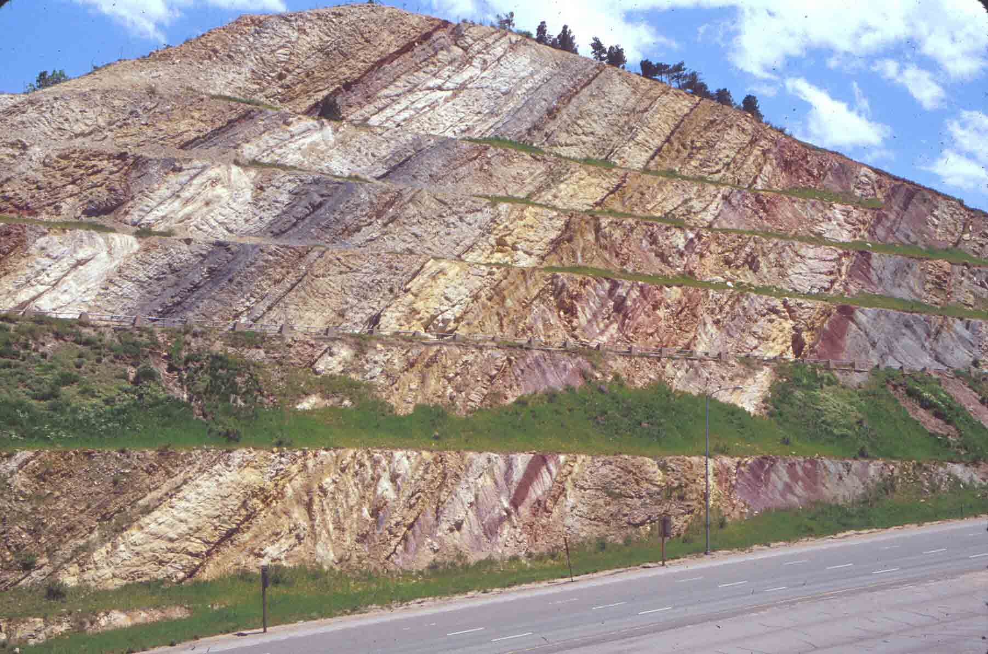
*Tilting -occurs when Earth’s forces move rock layers until they become slanted.

Slide 15
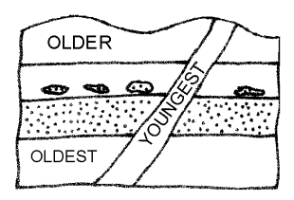
*Cross cutting law
Faults or intrusions that cuts across a body of sediment or rock are younger than the already established sediment or rock that it cuts through.

Slide 16
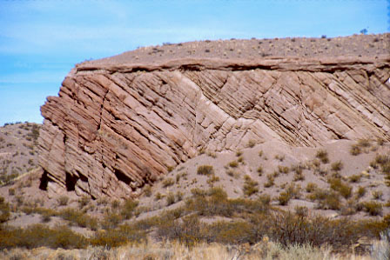
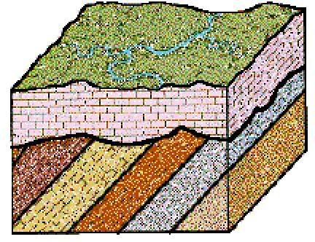
*Unconformity: A break in the geologic record created when rock layers are eroded or when sediment is not deposited for a long time.
*So basically an unconformity is layers of rock that is lost because they erode away before a new layer forms over top of it.

Slide 17
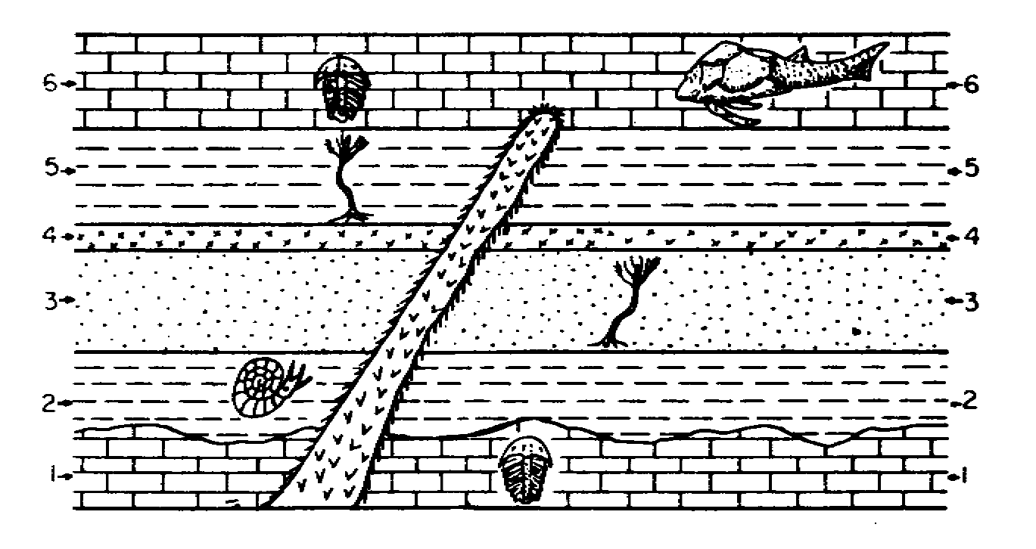
LIST THE LAYERS FROM YOUNGEST TO OLDEST… which layer shows a mass extinction?
B
G
E
A
D
F
C
Notes:
Answer
D, B, E, G, A, F, C

Slide 18
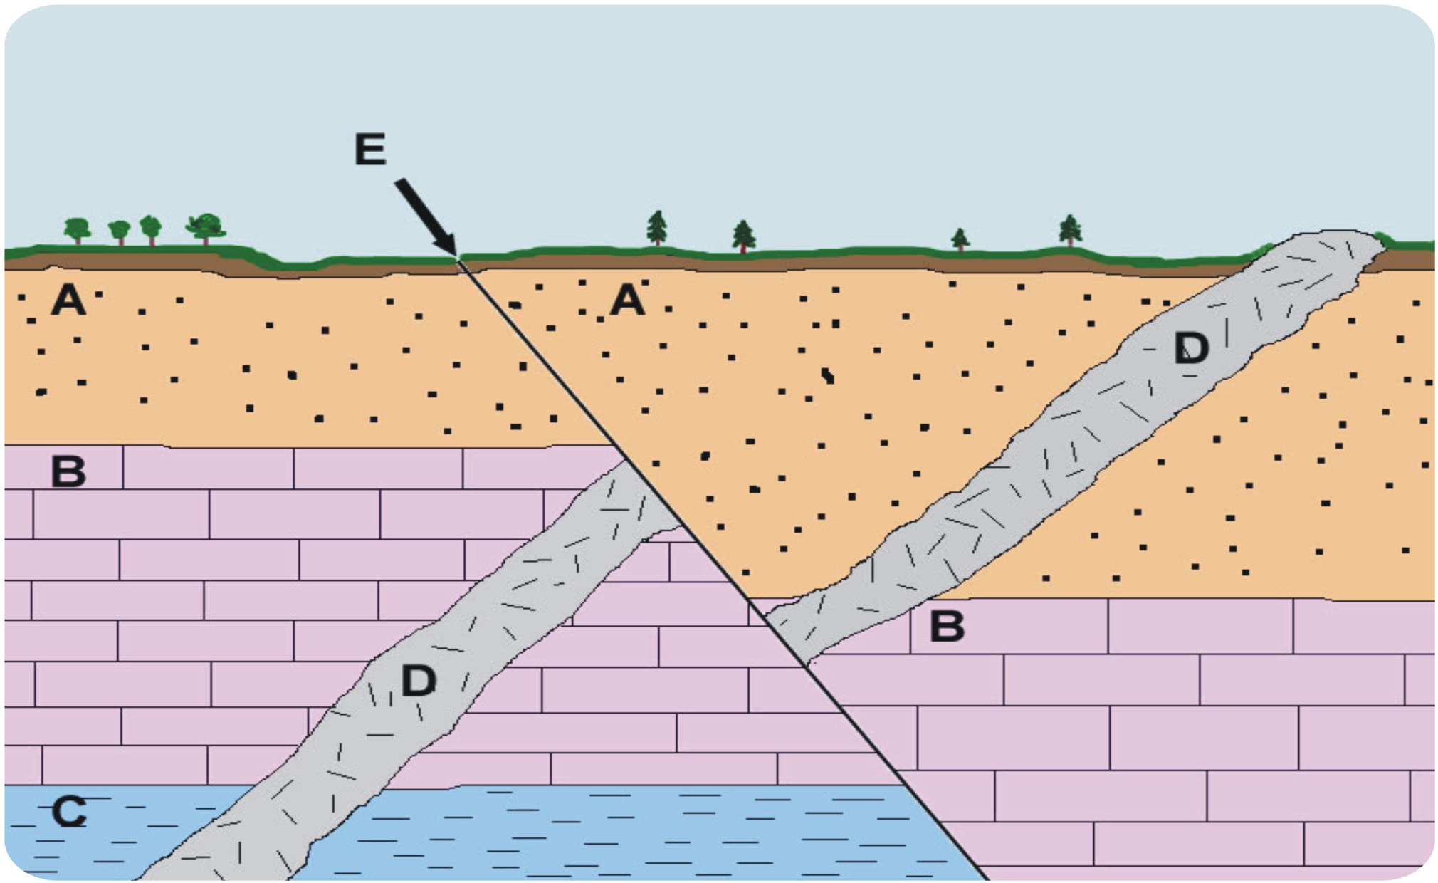
LIST THE LAYERS FROM YOUNGEST TO OLDEST
Notes:
Answer
E, D, A, B, C

Slide 19
Recap: Is the rock in this picture disturbed? If so, explain how.

Slide 20
How about now?

Slide 21
Last one…

Slide 22
