Slide 1
#27 Earth Pt 2 Test Corrections #28 Unique Properties of Water Hydrology Pt 1 Test corrections due Fri 11/16

Slide 2
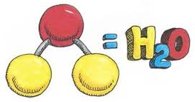
properties of water video
https://www.youtube.com/watch?v=3jwAGWky98c

Slide 3
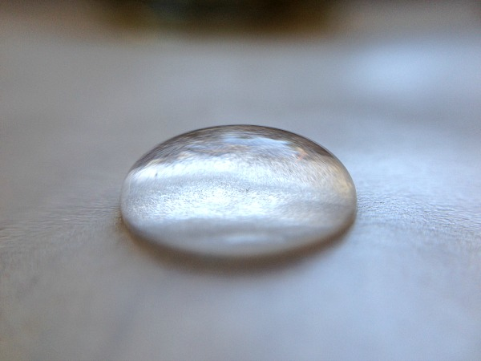
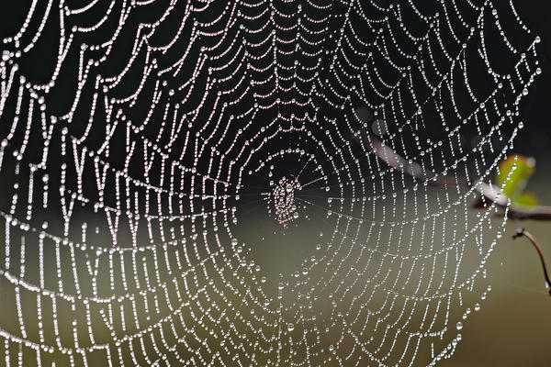
Cohesion and Adhesion
Cohesion
*Water that clings with water
Adhesion
*Water that sticks to another substance

Slide 4
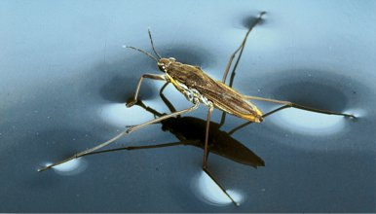
Surface tension
Water is clingy…
*Water molecules want to “attach itself” or cohere to other water molecules. This creates a strong bond between water molecules

Slide 5
Specific heat
*Specific heat is the amount of heat it takes to raise the temperature of water up by 1*C
*Water has a high specific heat and that is important because helps regulate temperatures in extreme environment.
For example: water has a high specific heat and that’s why your swimming pool water is still cold even on scorching hot summer days. It takes a lot of energy to raise waters temperature, even by 1*C

Slide 6
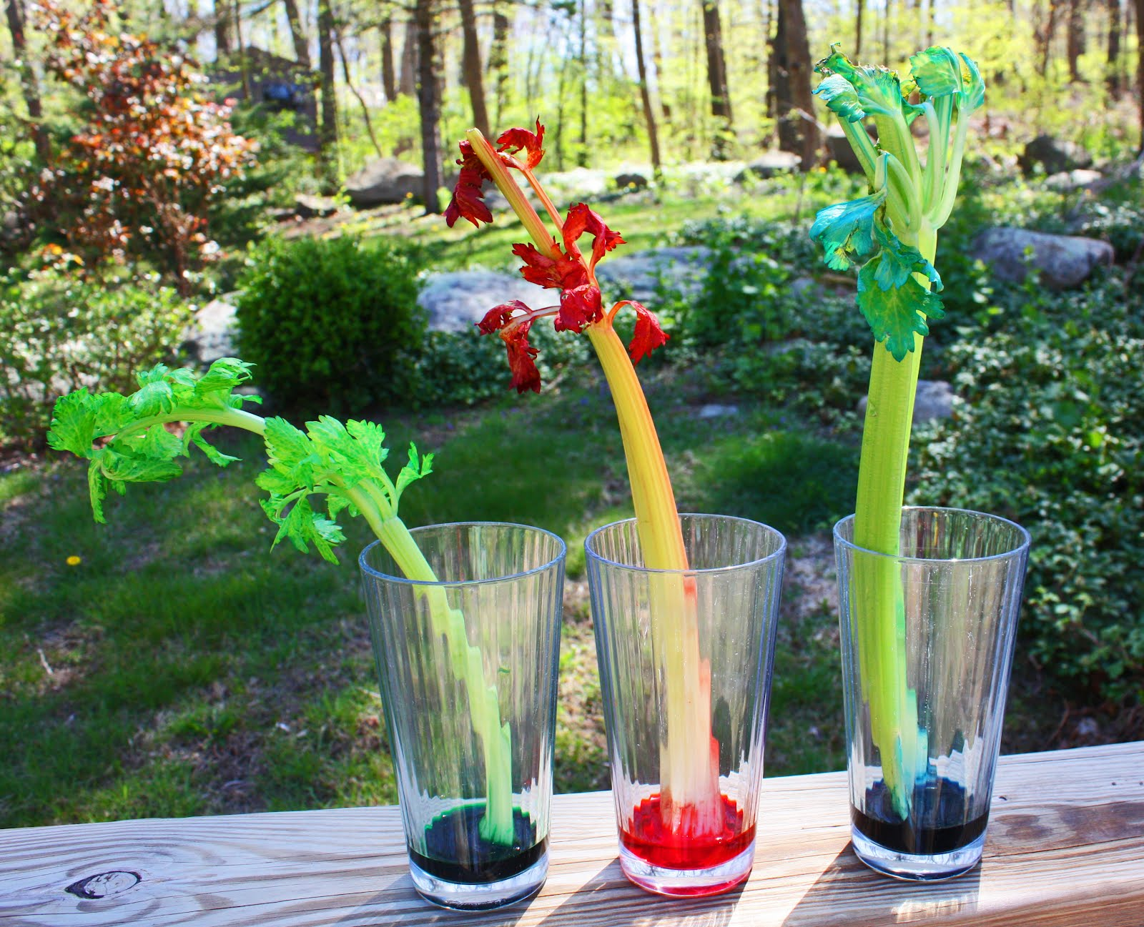
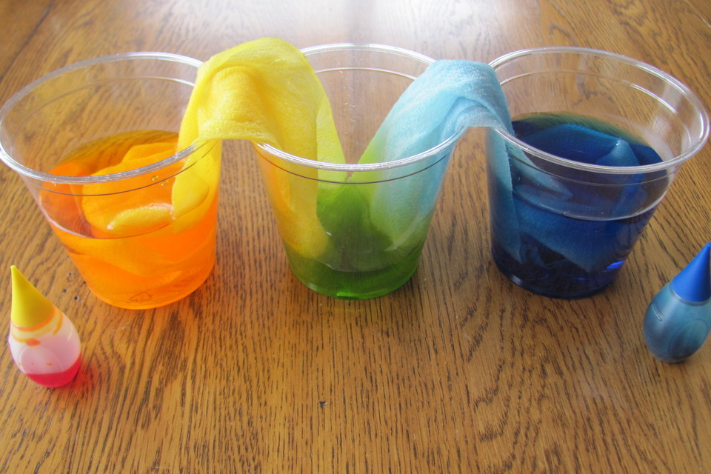
Capillary action
*Capillary action is important for the movement of water due to adhesion, cohesion, and surface tension. Capillary action allows water to move up through things despite gravity acting on it.

Slide 7
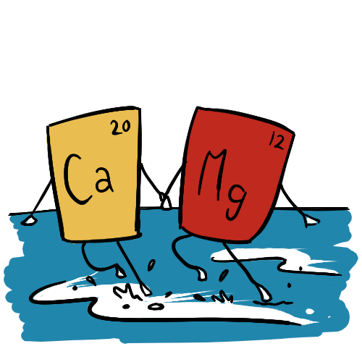
Hardness of water
Have you ever looked at a glass after it’s been in the dishwasher and it seems cloudy? Well this is probably due to the hardness of water.
*The hardness of water is amount of dissolved calcium and magnesium in water
*Although this is not a health concern, water hardness can cause calcium and magnesium minerals to build up and clog the flow of water.

