Slide 1
Page 25 Universal Solvent Notes
Take out your homework

Slide 2
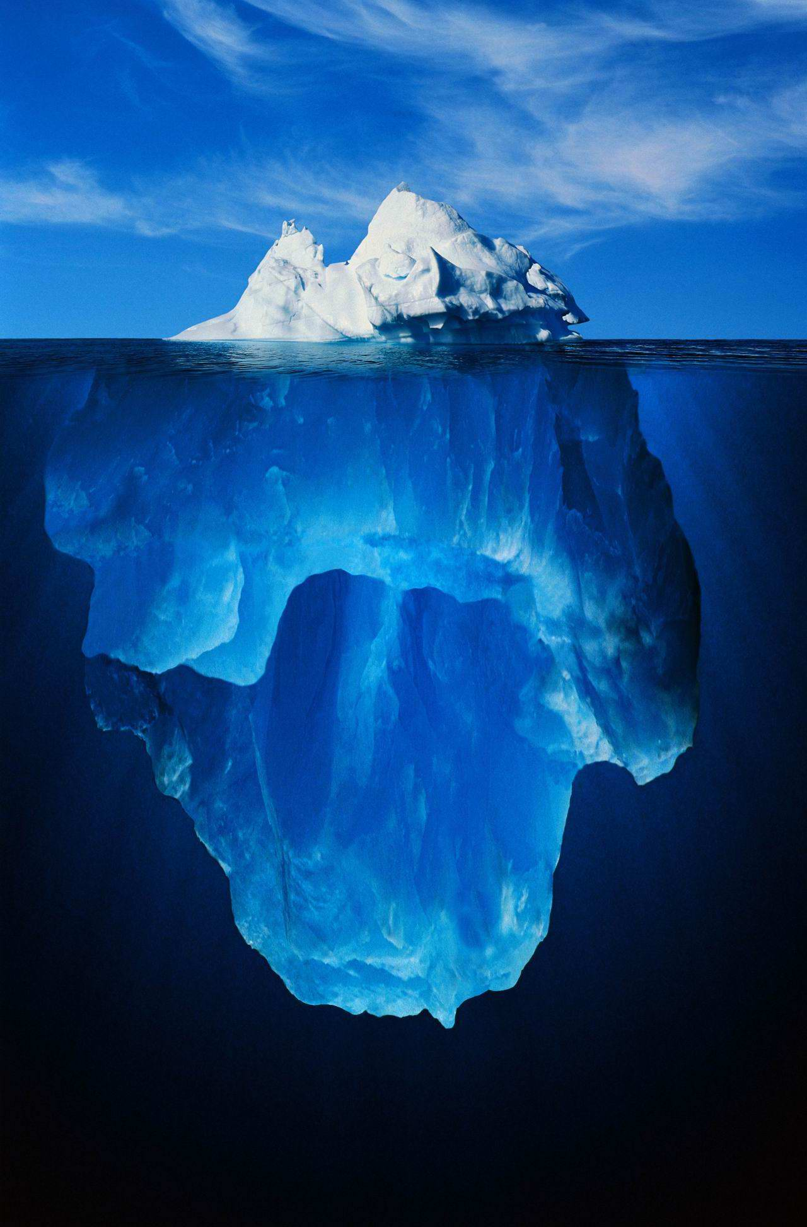
WARM-UP
3 inferences
2 observations
1 rational reason why freshwater icebergs float in saltwater sea

Slide 3
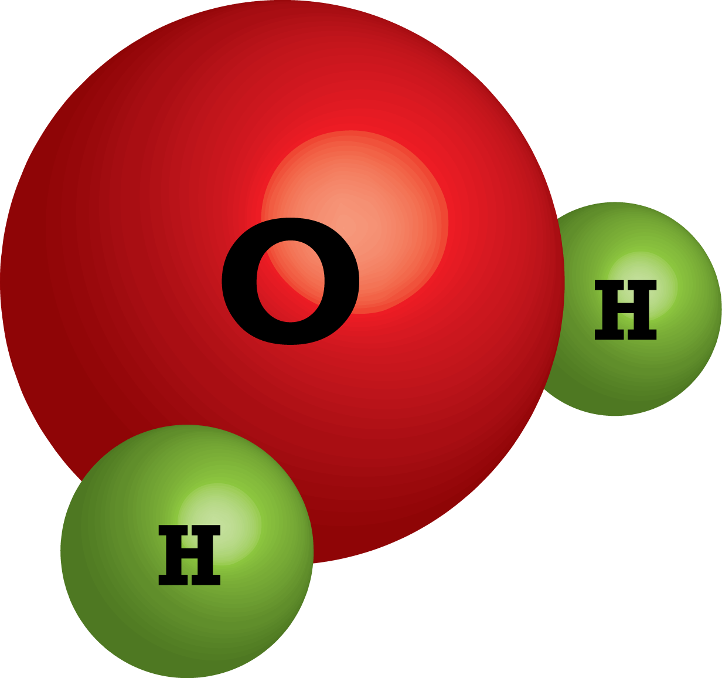
* Water is the only substance on Earth that occurs as a solid, liquid, or gas.
* A water molecule is made up of two hydrogen (H) atoms bonded to one oxygen (O) atom. Water is written as H2O
Draw this in your Notebook

Slide 4
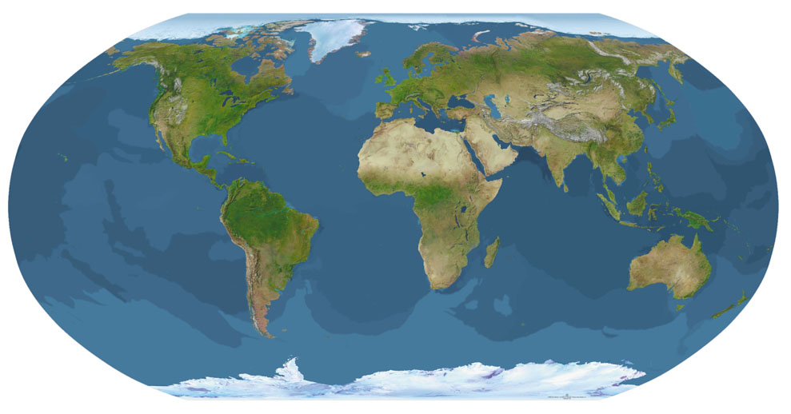
*Where does most precipitation fall?
*Most precipitation falls in the ocean because nearly ¾ our planet is covered by oceans.

Slide 5
*Does the precipitation that lands over the ocean remain freshwater?
No… as the precipitation lands in the ocean, it will mix with ocean water making it salty.
The saltiness of water is called salinity.

Slide 6
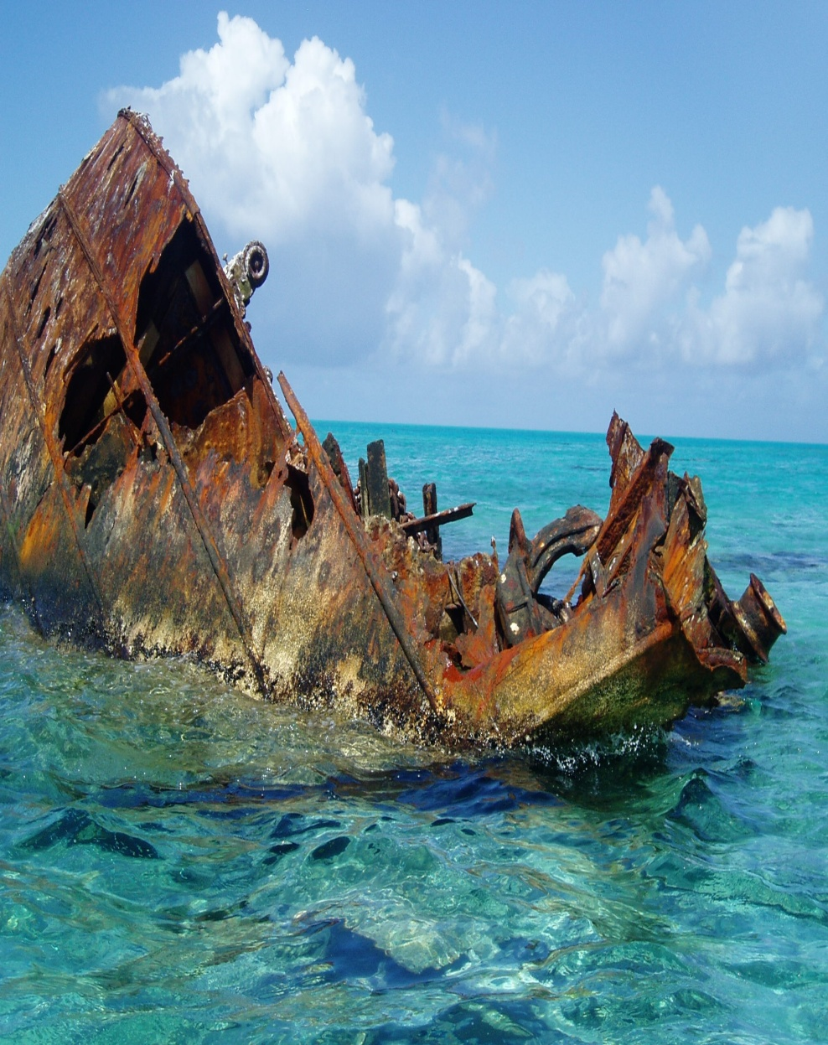
Water is powerful….
*Water is called the universal solvent because several substances dissolves in it.

Slide 7
Mixture terminology…
*Solvent – the liquid in which a substance is dissolved when a solution is formed (liquid that does the dissolving)
*Ex1. Water is the (solvent) in saltwater lakes
*Ex2. water is the (solvent) in Koolaid drink mix

Slide 8
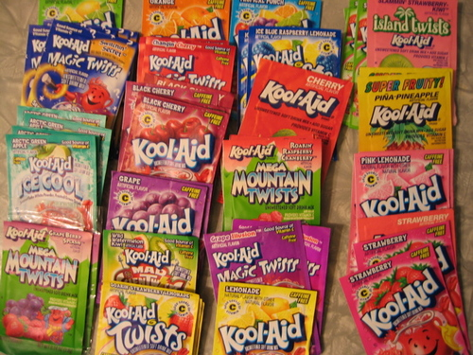
*Solute – the substance that is being dissolved when a solution is formed
*Ex1. Salt is a (solute) in saltwater lakes
*Ex2. Koolaid powder is a (solute) in Koolaid drink mix

Slide 9
*Solution – a mixture of one or more substances with water that forms a clear, colored, or colorless liquid
*Ex1. water (solvent) + salt (solute) = saltwater lake (solution)
*Ex2. water (solvent) + Koolaid powder (solute) = Koolaid drink mix (solution)

Slide 10
Identify the solvent, solute, and solution

Slide 11
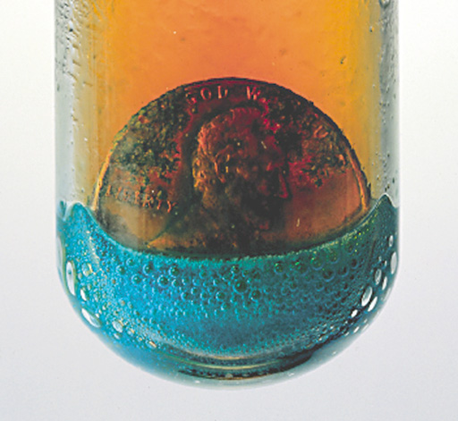
solvent
solute
solution

Slide 12
Remember….
*Solutes dissolve in solvents to make a solution.

Slide 13
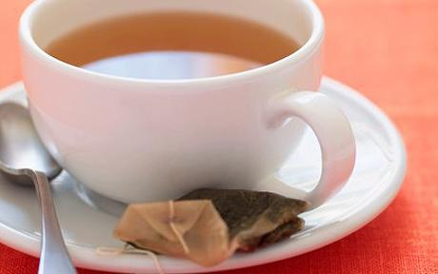
Mrs. Thomas wanted your help making her usual morning cup of English Tea.
She then decided to see how smart you were and asked:
You to identify the parts: Solute, solution, and solvent
Explain a way you can separate the water from the other contents after its already been mixed

