Slide 1
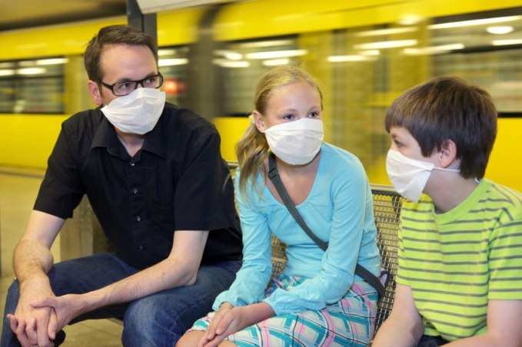
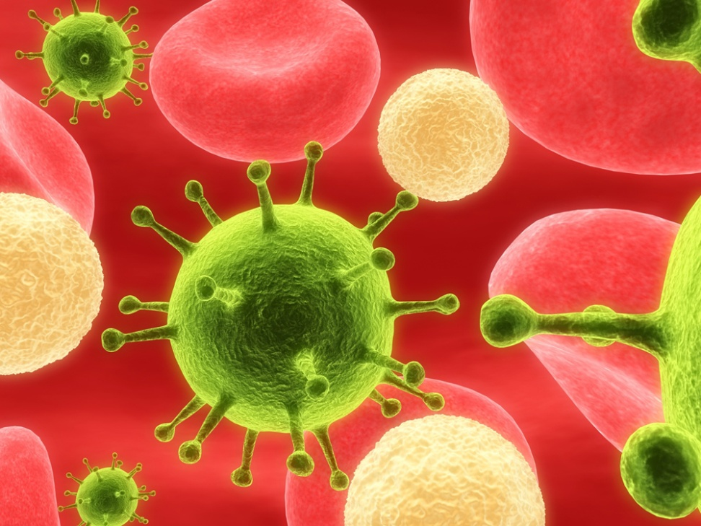
#68 Virus Pathogens

Slide 2
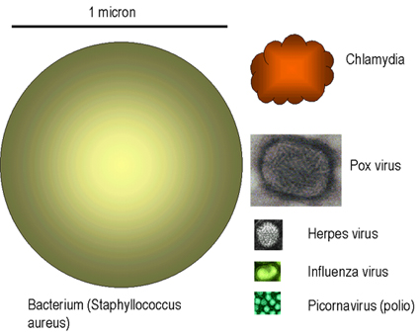
Bacteria vs. viruses

Slide 3
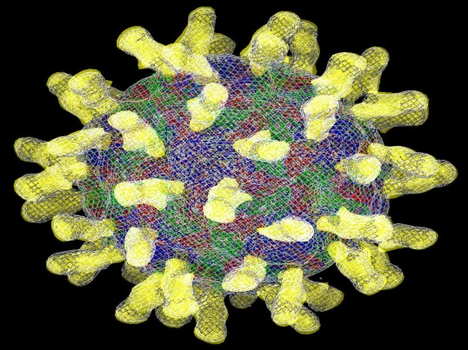
Viruses
Virus in latin means, “poison”
*A virus is an infectious non-living particle that duplicates in the cells of an infected host.

Slide 4
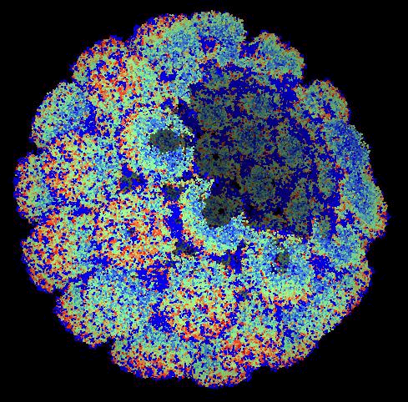
*Why don’t we call viruses living?
They:
Are NOT made up of cells
Don’t eat
Don’t grow
Don’t carry out biological functions (ex. - breathing)
Cannot reproduce outside of a host.

Slide 5
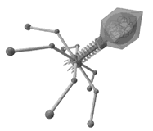
*A virus is surrounded by a capsid (protein coat) which determines the shape of the virus.
*The capsid contains nucleic acids (either DNA or RNA).
*Tail fibers (not on all viruses)
for attachment to host cell.

Slide 6
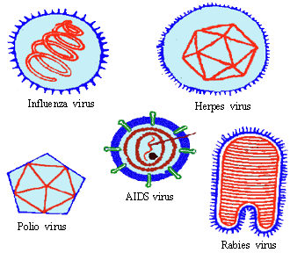
*Viruses are shaped round, rodded, or as a bullet

Slide 7
*How a virus reproduces in host cell
2
The virus’ RNA hijacks the host cell and starts making copies of virus
1
The virus attaches to the cell and inserts its RNA
4
3
The host cell breaks apart, freeing the newly assembled viruses. Those viruses will go to attack more cells, continuing the process
The virus makes and assembles new viral parts within the host cell

Slide 8
*Treatment
There are no cures for viral diseases
You can not treat a virus with antibiotics
However…
Some viruses can be prevented through the use of vaccines.

Slide 9
*How Vaccines Work
Weakened or dead strand of the virus enters the body (nasal spray or injection)
Your body responds to it by making antibodies (used to help fight off virus).
Then, when your body comes in contact with the viruses later you don’t become symptomatic, you are immune.
Vaccines contain
weakened or killed strain of the virus

Slide 10
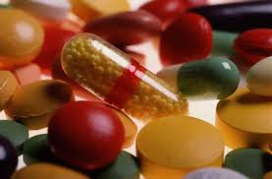
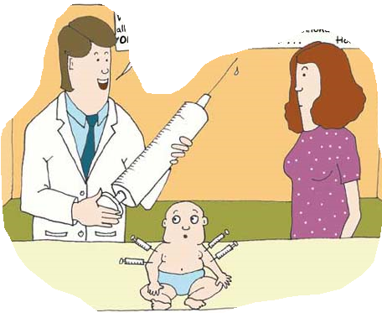
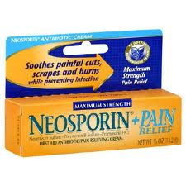
*Easy way to remember
Bacteria! Virus!
-Antibiotics
-kills or slows
the growth of
the bacteria
-Vaccines
-we use vaccines to try to prevent us from getting the virus

Slide 11
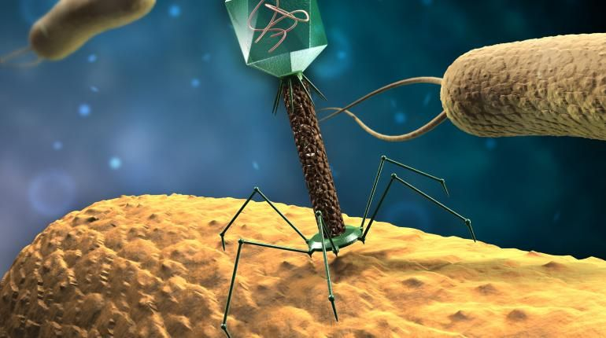

Slide 12
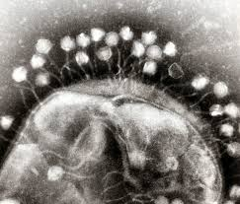
*A bacteriophage is a virus that attacks/hijacks specific bacteria cells.
*Bacteriophage can sometimes kill the bacteria it hijacks, harm the host, and in worst cases possibly kill the host
An example of this is E. Coli 0157.
The E.Coli strand is attacked by
Bacteriophage causing it to turn into
E. Coli 0157

Slide 13
FYI: What about Tamiflu?
Not a vaccine
Not an antibiotic
Tamiflu targets a protein on the flu virus cells.
Normally, this protein helps the flu virus break through the cell walls so it can move on to other cells and replicate itself.
Tamiflu stops the protein from doing this, so that the virus can't leave the cell to infect other cells.

Slide 14
20/20 on nail salons
http://abcnews.go.com/2020/video/nail-salon-health-hazards-revealed-22828794

Slide 16
Cell size and scale
http://learn.genetics.utah.edu/content/cells/scale/

Slide 17
Feeling creative? Write a short story about what going on in this picture. Minimum 5 sentences

Slide 18
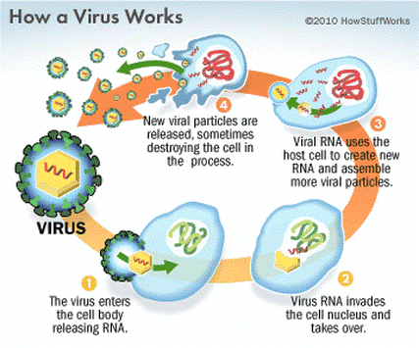
3
The host cell breaks apart, freeing the newly assembled viruses. Those viruses will go to attack more cells, continuing the process
4
The virus makes and assembles new viral parts within the host cell
2
1
The virus attaches to the cell and inserts its RNA
The virus’ RNA hijacks the host cell and starts making copies of virus

Slide 19
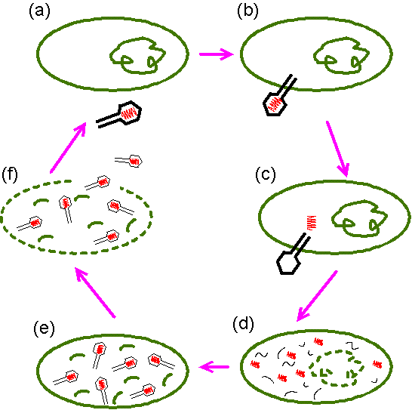
One way a Virus Reproduces
Virus injects its DNA
Virus attaches to host cell.
Cell breaks apart and new viruses are released
Virus DNA hijacks host cell to make new viral parts
New viral parts assembled

