Slide 1
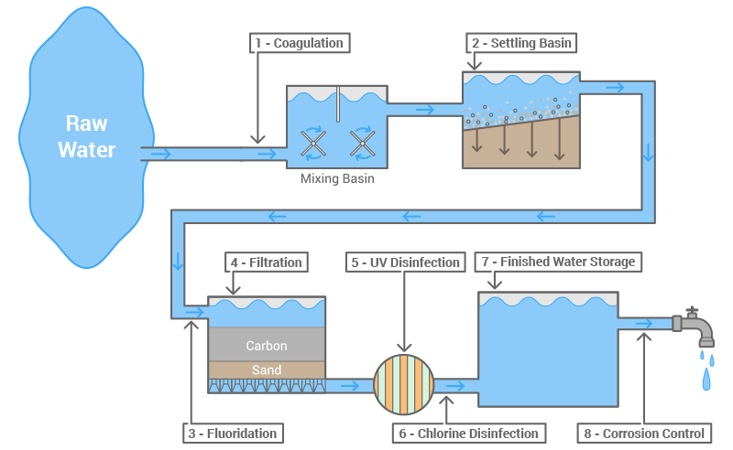
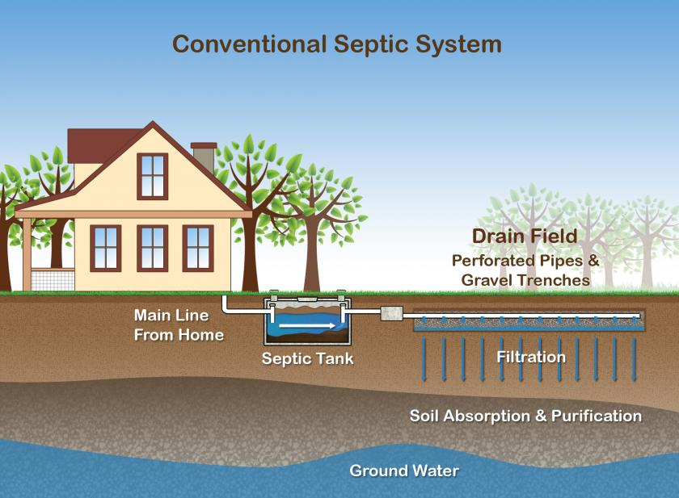
#26 Wastewater Treatment and Septic Systems

Slide 2
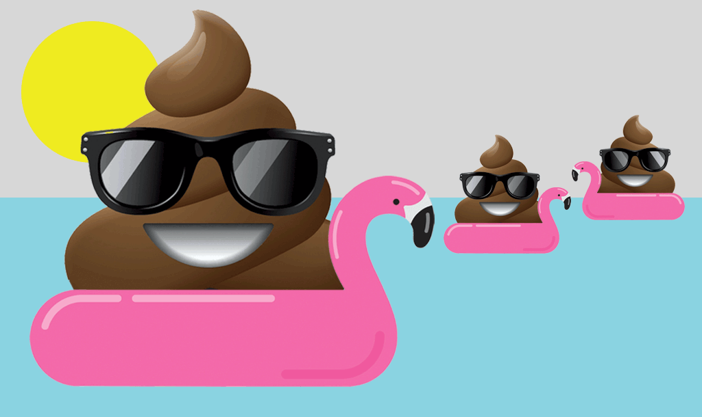
Where does wastewater go?
Water leaving our homes generally goes either into a septic tank in the back yard where it seeps back into the ground, or is sent to a wastewater-treatment plant through a sewer system.
Different treatment is used depending on the type of water coming into the plant and the water-quality requirements of water leaving the plant. We are going to discuss how water treatment plant and septic system treats water

Slide 3
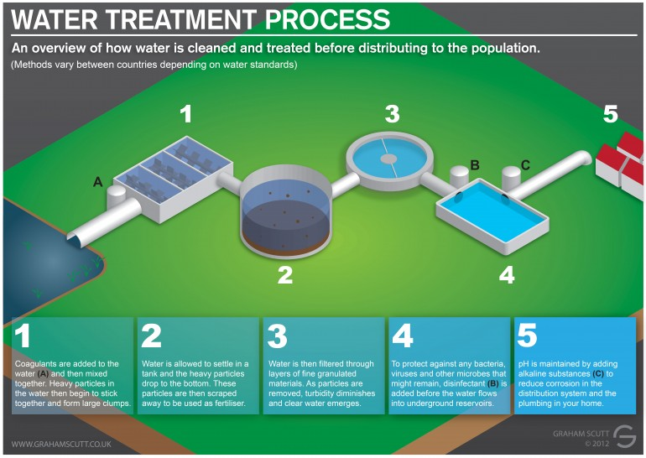
Water/Sewage Treatment Process

Slide 4
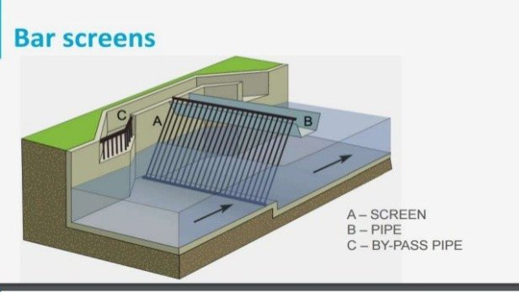
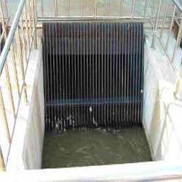
* Step 1: Screening
Wastewater is pumped into the facility and moved through large screens. This removes large waste items such as branches, toys, flushable wipes etc.

Slide 5
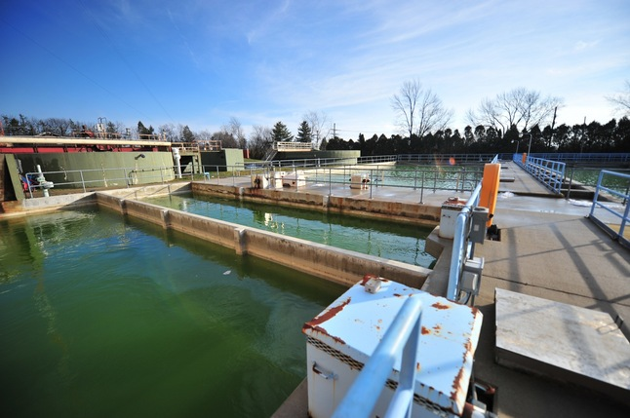
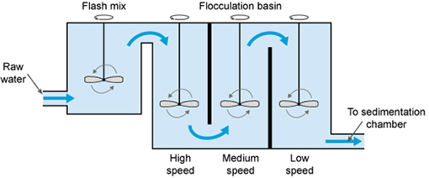
* Step 2: Coagulation and Flocculation
Clumping agents are added to the water, this makes dirt and bacteria clump together

Slide 6
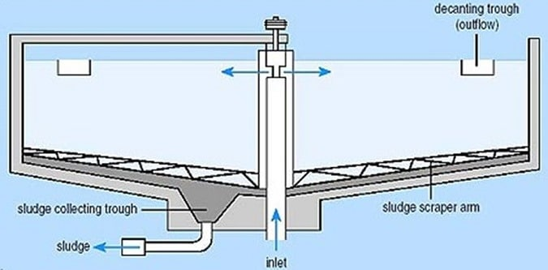
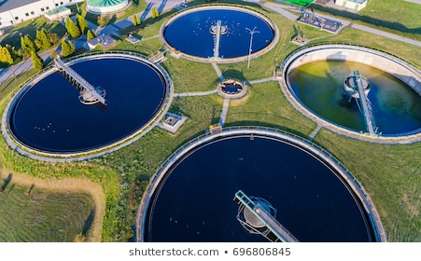
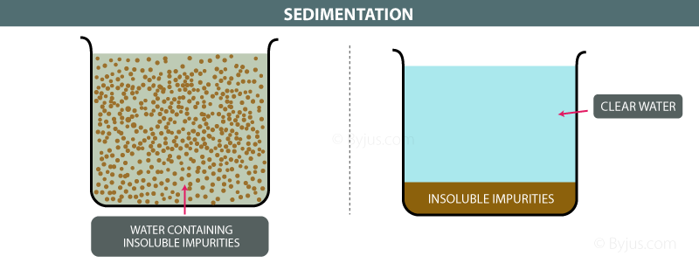
* Step 3: Sedimentation
Water flows into a clarifying pool where dirt and other particles can settle to the bottom and get scraped away

Slide 7
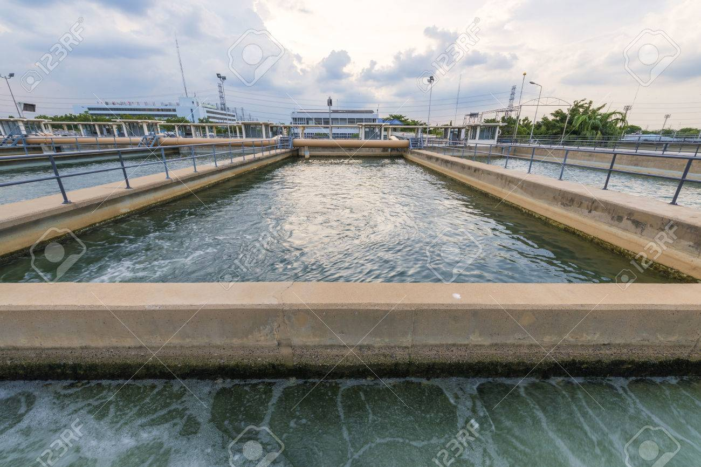
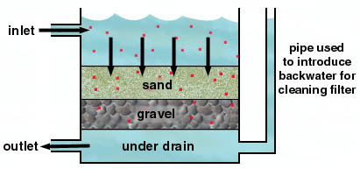
* Step 4: Filtration
Water flows through levels of coal, sand, and gravel, which filters out tiny particles of dirt

Slide 8
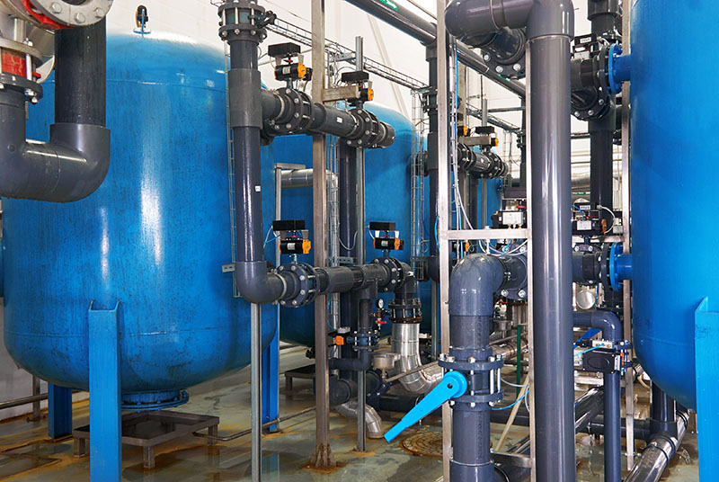
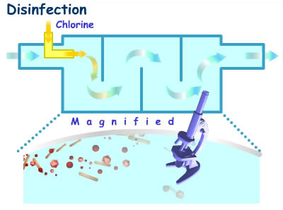
* Step 5: Disinfection
Chlorine is added to kill any remaining bacteria
UV light may also be used at this step to do the same thing

Slide 9
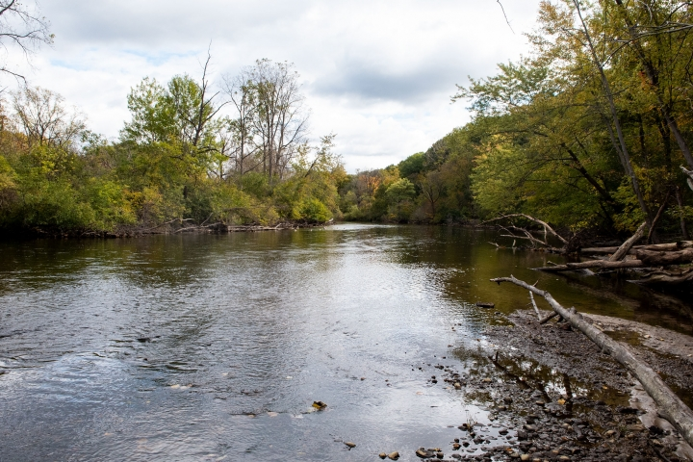
What’s next for the water?
Water is usually stored and sent through another process to meet drinking water regulations
Or
Water is piped and returned to a nearby body of water

Slide 10
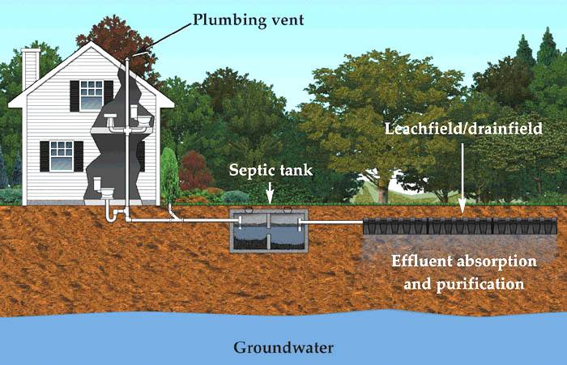
Does all water go to wastewater facilities?
No. If a building is not connected to the city or towns sewer system, then it most likely uses a septic system.
*A septic system is an on-site waste disposal process is installed underground to treated waste water

Slide 11
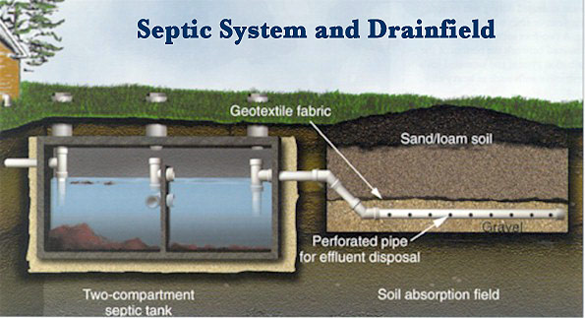
Septic systems
*Septic systems are usually installed in rural homes or farmland
During this process wastewater is treated and returned to the ground where it will be filtered within an aquifer.

Slide 12
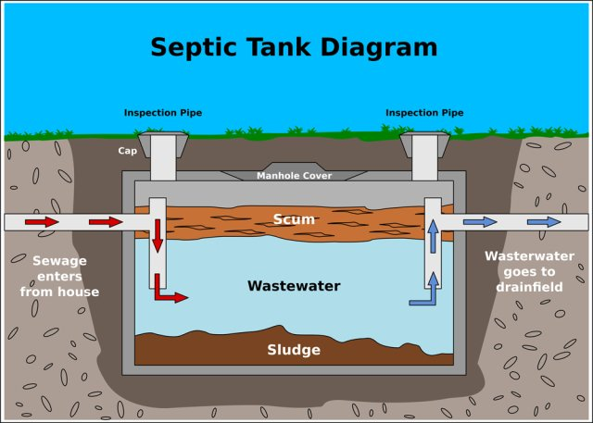
How a Septic System Treats Water
Wastewater from a home exits by a drainage pipe and into a septic tank. The septic tank is a water-tight, buried container that holds wastewater to be separated and treated.
Within the tank, solids (called sludge) settle to the bottom of the tank and things such as oils, fats, and grease float to the top (known as scum). Compartments and a T-shaped outlet prevent the scum and sludge from exiting the tank, and allows water to pass through.
Notes:
https://www.epa.gov/septic/septic-systems-and-drinking-water
https://inspectapedia.com/septic/tank.gif

Slide 13
How a Septic System Treats Water
Water then leaves the tank and enters the drain field. The drain field is a shallow and covered pit above the water table. The wastewater is released into porous ground while the soil allows water to pass through, treating it in the process. As the water filters through the soil, it eventually make its way into the groundwater.
Notes:
https://www.epa.gov/septic/septic-systems-and-drinking-water
https://inspectapedia.com/septic/tank.gif

Slide 15
Compare and contrast a sewage treatment facility with a septic system
Water Treatment
Plant
Septic System

Slide 16
Sewage System vs Septic System
Although both systems treat wastewater and return it back to the earth. Sewage systems collects and treats wastewater from a city or town in comparison to a septic systems, which are small wastewater systems that are usually used in rural houses or farms.
Sewage treatment plants – larger scale
Septic systems – small scale unit per house

