Slide 1
Water Quality & Monitoring

Slide 2
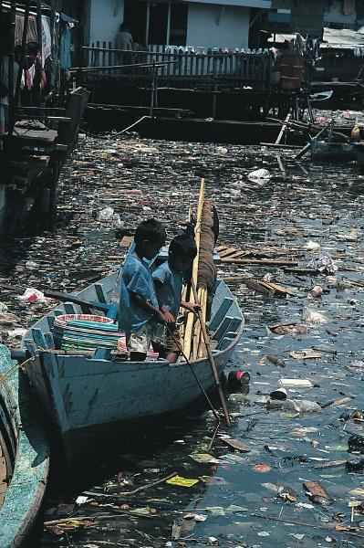
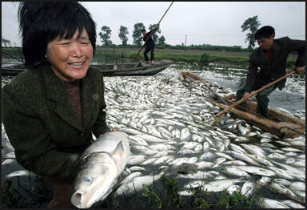
What’s wrong with the water? Explain any methods scientist use to determine healthy water

Slide 3
pH (potential of hydrogen)
Identifies the acid/base balance of water
Ranges from 0-14
The closer the number is to 0 the more acidic, the closer it is to 14 the more basic
What do you think the normal range of water is?
6.5 – 8.5
Pure water is 7 – very healthy
pH is important to living things because:
Living things grow and survive in a particular pH environment

Slide 4
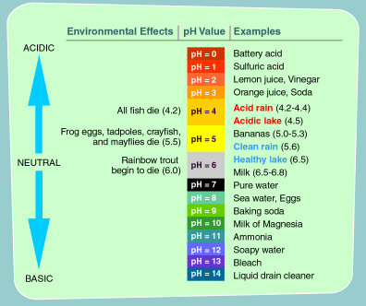

Slide 5
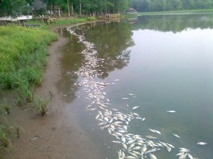
Dissolved Oxygen (DO)
Amount of oxygen dissolved in water and is essential to healthy streams and lakes
Measured in parts per million (ppm)
Comes form photosynthesis
All living organisms need oxygen,
Which they get from water, so the
Water systems are healthier when
They have more DO.

Slide 6
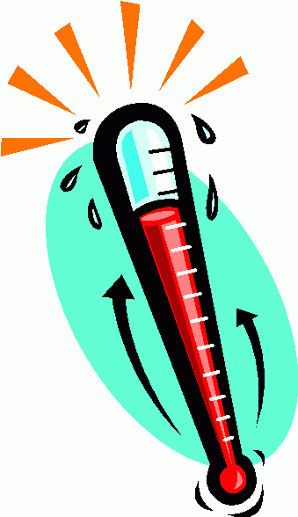
Temperature
The colder the water the more dissolved oxygen water can hold
The warmer the water, the lesser amount of DO
Very warm water can kill fish
A healthy range is when water stays below 29*C

Slide 7
Nitrate and phosphate levels
Needed by living plants and animals to build protein
Nitrates Comes from things such as fertilizer, sewage, and leaking septic tanks
Phosphates usually enter waterways from human and animal waste, laundry, cleaning and industrial waste
Eutrophication: (Greek word meaning development)
Over fertilization of water with nutrients. This occurs when water comes from runoff from farmlands, lawns, sewage, detergents, animal waste, and leaking septic tanks

Slide 8
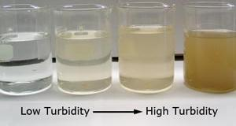
Turbidity
Turbidity measures how cloudy the water is
It can be caused by suspended solids such soil, sewage, and algae
Particles in the water can prevent plants from getting enough sunlight to complete photosynthesis
Water is more turbid = more cloudy
less turbid = less cloudy

Slide 9
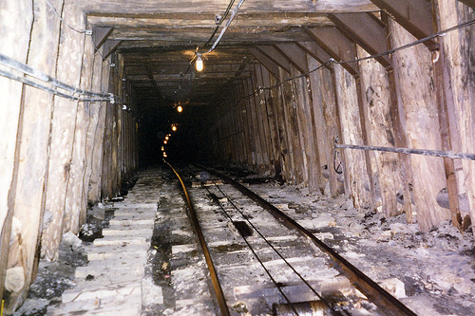
Let’s say: YOU WORK IN A GOLD MINE.
$$$$$$$
Deep underground.

Slide 10
And the mine EXPLODES!

Slide 11
SOME LUCKY ESCAPE!

Slide 12
Many miners are trapped underground!

Slide 13
How do you know if it’s safe to go down in the mine?

Slide 14
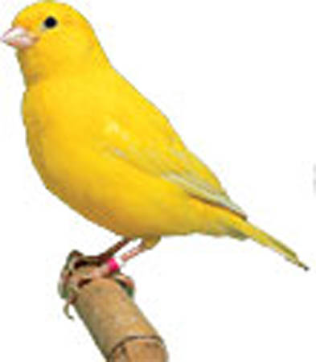
A BIO-INDICATOR!!!

Slide 15
Take a little canary for instance…
Canary as a bio-indicator
lower one down the mine.

Slide 16
Take a little canary for instance…
Canary as a bio-indicator
lower one down the mine.

Slide 17
When the canary flies into the mine,
If the canary survives, it’s safe to go into the mine!

Slide 18
The canary is lowered into the mine,
If the canary survives, it’s safe to go into the mine!
The canary (BIOlogical life) INDICATES it’s SAFE!!!!!!

Slide 19
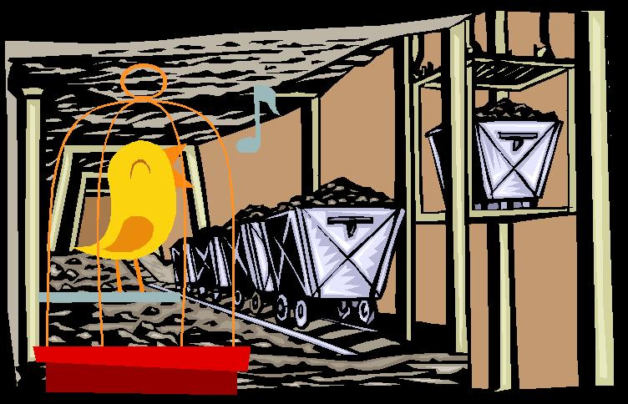
A live canary is a BIO-INDICATOR that it’s safe to enter a damaged mine.

Slide 20
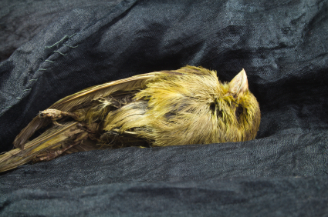
If a bio-indicator doesn’t survive, it isn’t safe!
Canary doesn’t make it.

Slide 21
If a bio-indicator doesn’t survive, it isn’t safe!
Canary doesn’t make it.
Neither did the miners!

Slide 22
Bio-indicators
Organisms used to assess ecosystems health
Looking at the health of the organisms that are living in the water, can help determine the health of the water system
Water that is healthy helps keep its organisms healthy. Diseased fish shows that the water system is unhealthy

Slide 23
Good vs. Bad Bioindicators
A good bio-indicator does not easily adapt to a changing environment. These organisms stay within a small range and if you no longer see them in the body of water, this indicates a change in water quality
A bad bio-indicator can live in a wide range of water quality and can change with its environment.

Slide 24
Which is the best bioindicator? Why?
pH | 7 | 6.5 | 6 | 5.5 | 5
Trout | X | X | X
Bass | X | X | X
Snail | X
Perch | X | X | X | X
Salamander | X | X

Slide 25
Nutrients added to waterways through runoff, too many of these leads to Eutrophication
Animals in this area must be able to adapt to wet and dry conditions, temperature, & salinity
Organisms used to assess ecosystems health
Increase in turbidity, increase temp, increase DO
Colder water can hold more DO
The amount of particles suspended within water
In this zone you can see where the continent ends
This zone receives no sunlight, has most phytoplankton
The higher amount of this, the better the water quality
Increase in pressure, decrease in temperature, life is supported from nutrients in vents
The measure of how basic water is
DO
Neritic Zone
Temperature
pH
Benthic Zone
Nitrates and Phosphates
Turbidity
Bioindicators
Intertidal Zone

