Slide 1
#30 Water Quality Indicators

Slide 2
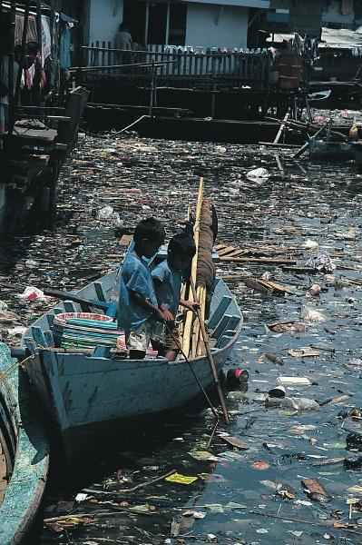
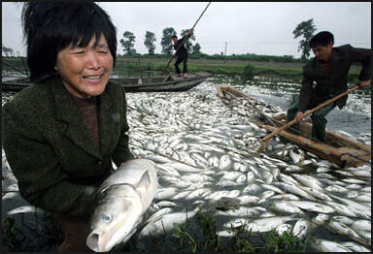
What’s wrong with the water? Explain any methods scientist use to determine healthy water

Slide 3
pH (potential of hydrogen)
pH is the measurement of how acidic or basic a substance is
The pH scale ranges from 0 to14
The closer the number is to 0 the more acidic, the closer it is to 14 the more basic
A substance with the pH of 7 is considered neutral, meaning its neither acidic nor basic
Any substance that has a pH less than 7 is acidic, and substances with a pH greater than 7 are basic

Slide 4
Pure water is 7 – very healthy, but we don’t find pure water naturally on our planet.
Since we don’t find pure water naturally on our planet, what is the range for healthy water for marine life?
Waters ranging in pH between 6.5 – 8.5 are considered healthy waters
pH is important to living things because:
Living things grow and survive in a particular pH environment

Slide 5
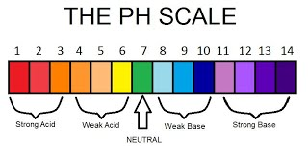
Strong acid
Weak acid
Strong acid
Weak base
Strong base
Strong acid
Strong acid
Neutral

Slide 6
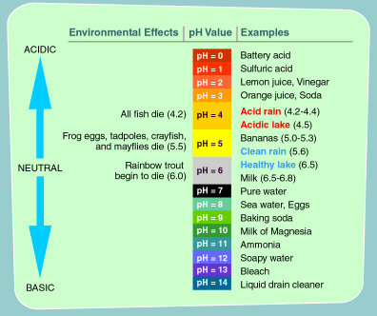

Slide 7
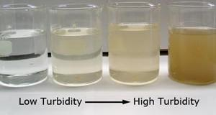
Turbidity
Turbidity is the cloudiness of water
Water can become turbid if suspended pieces of soil, sewage, and algae are in the water.
Turbidity in the water can prevent plants from getting enough sunlight to complete photosynthesis
Water is more turbid = more cloudy
less turbid = less cloudy

Slide 8
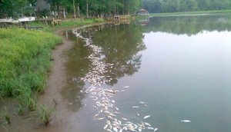
Dissolved Oxygen (DO)
All living organisms need oxygen, which they get from water, so the water systems are healthier when they have more DO.
Photosynthesizing plants and moving water adds D.O. within the water. The amount of oxygen within a body of water is called dissolved oxygen
Areas that have higher salinities, have lower amounts of DO

Slide 9
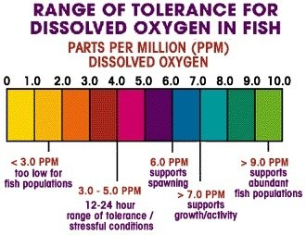
What do you think will happen to marine life if DO is too low?
More DO = More oxygen available for marine life
Less DO = Less available DO for marine life

Slide 10
Fill in the blank on ws

Slide 11
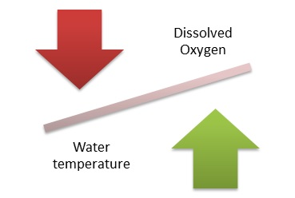
Temperature
The measure of how hot or cold a substance is.
The colder the water the more dissolved oxygen water can hold
The warmer the water, the less DO in the water
Very warm water can kill fish

Slide 12
Fill in the blank on ws

Slide 13
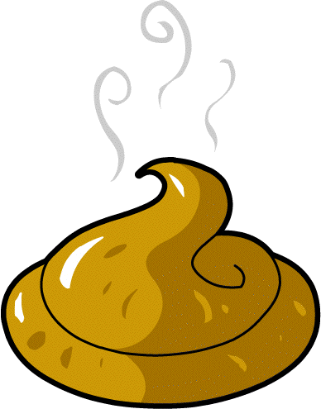
Nitrate and phosphate levels
Nitrates and phosphates are needed by living plants and animals to build protein. Nitrates and phosphates are found naturally in plant nutrients however, excess amounts can be added to bodies of water due to runoff.
Nitrates Comes from things such as fertilizer, sewage, and leaking septic tanks
Phosphates usually enter waterways from human and animal waste, laundry, cleaning and industrial waste

Slide 14
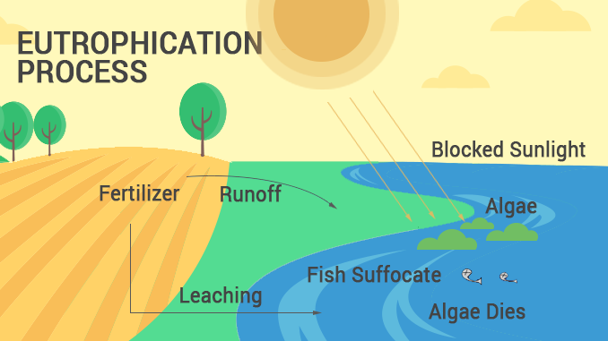
eutrophication
Eutrophication: (Greek word meaning development)Over fertilization of water with nutrients.
This occurs when water comes from runoff from farmlands, lawns, sewage, detergents, animal waste, and leaking septic tanks getting into a body of water. These excess nutrients helps algae to grow rapidly, eventually covering the surface of water. All plants under water are no longer going to be able to photosynthesize, which will reduce the amount of DO and cause marine life to die.

Slide 15
In addition to the DO deficiency, decomposing bacteria will take any remaining oxygen in the body of water and use it to break down the plant matter.
The process of algal blooms taking over and killing life in a body of water is EUTROPHICATION
https://www.youtube.com/watch?v=mLbDbmmV6Qc

Slide 16
Fill in the blank on ws
Summarize the previous slides and fill in blanks on your notes explaining eutrophication. Use the link on the following page to help

Slide 17
salinity
Salinity is the amount of dissolved salts in water. The solubility of oxygen decreases as the temperature and salinity ____________
increases

Slide 18
Bio-indicators
Organisms used to assess ecosystems health
Looking at the health of the organisms that are living in the water, can help determine the health of the water system
Water that is healthy helps keep its organisms healthy. Diseased fish shows that the water system is unhealthy

Slide 19
Good vs. Bad Bioindicators
A good bio-indicator does not easily adapt to a changing environment. These organisms stay within a small range and if you no longer see them in the body of water, this indicates a change in water quality
A bad bio-indicator can live in a wide range of water quality and can change with its environment.

