Slide 1
Update TOC
#61 Amoeba Sisters – Mitosis WS
#62 Amoeba Sisters – Meiosis WS
#63 Cellular Division, Osmosis and Diffusion Notes

Slide 2
#65 Cells, Diffusion, and Biotech notes

Slide 3
Cellular Division
A cell must divide in order to multiply
To produce more cells, DNA must be copied first

Slide 4
Cellular Division
Mitosis is the process in which the nucleus divides to form two new nuclei.
* The reasons cells reproduce:
Growth
Repair
Replacement

Slide 5
*Mitosis
The self-division of cells into two identical (genetically alike) cells.
Occurs in the nucleus. Applies to all cell types except reproductive cells.
*Meiosis
A special cell division process necessary for sexual reproduction cells.
Applies only to reproductive cells.

Slide 6
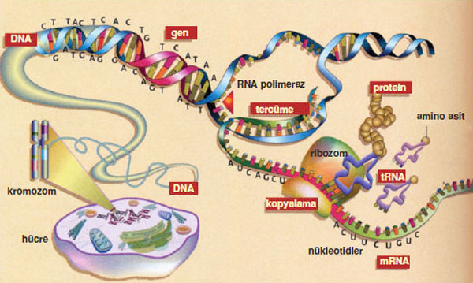
*What if you need to replace organelles?
Protein synthesis is the process in ribosomes where proteins create different organelles.

Slide 7
Diffusion

Slide 8
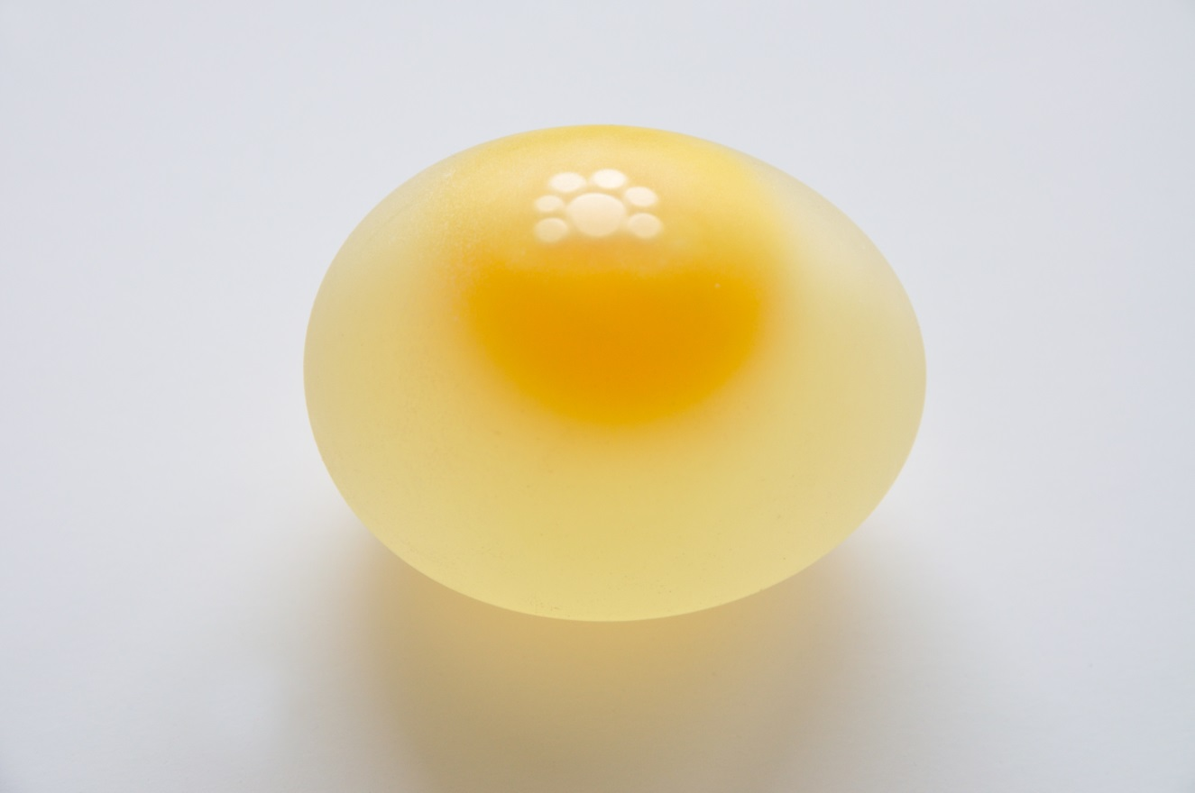
Dissolving an Egg Shell
CaCO₃+ 2H → Ca + H₂O + CO₂

Slide 9
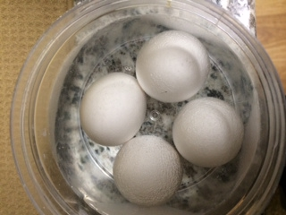
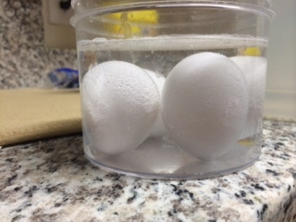
the process of dissolving a shell

Slide 10
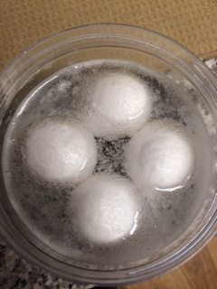
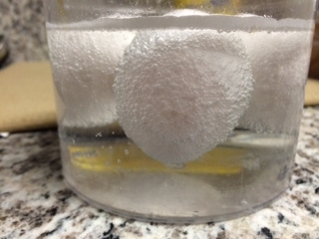

Slide 11
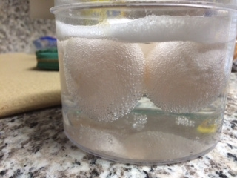
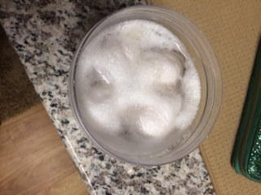

Slide 12
*Diffusion
The spreading of molecules from areas of high concentration to areas of low concentration to reach equilibrium (balance).

Slide 13
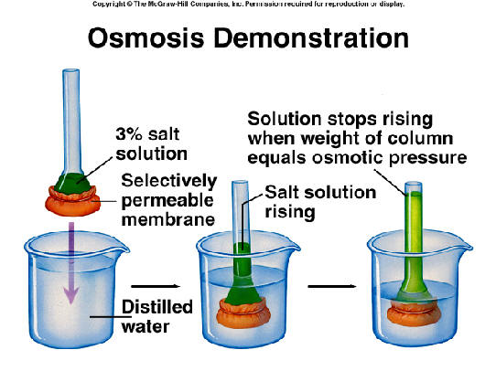
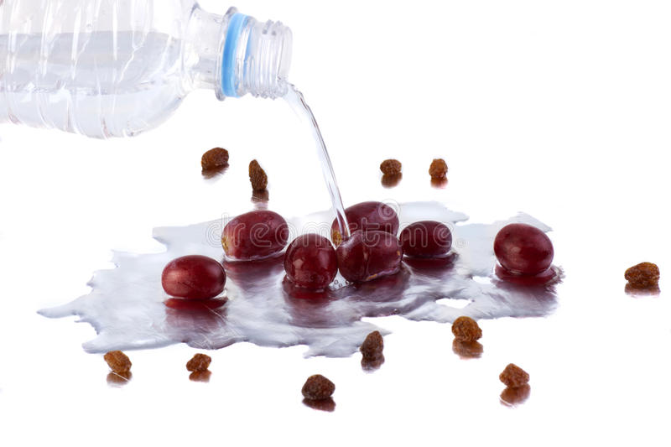
*Osmosis
The diffusion of water molecules across a membrane.

Slide 14
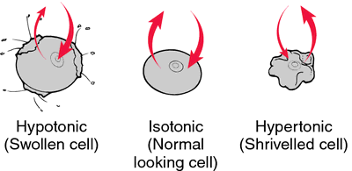
Dissolving an Egg Shell, Final Day
CaCO₃+ 2H → Ca + H₂O + CO₂
Let’s Pull the Eggs form the Vinegar!

Slide 15
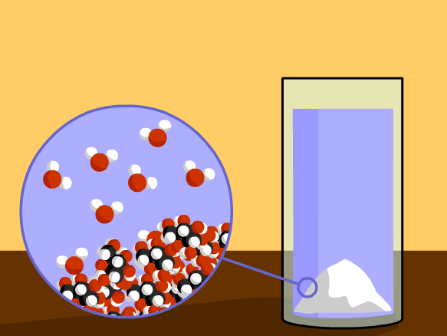
Brain Pop - Diffusion

Slide 16
Biotechnology botes

Slide 17
textbook pages NC28-30 (back of book)
Answer the following questions:
What is biotechnology?
How does biotechnology positively impact medicine
What is the difference between genetically engineering a plant or animal by crossbreeding vs gene replacement
Why do you think people are more comfortable with crossbreeding over gene replacement?
Identify the benefits and the risks of biotechnology. Try to find 5 of each

