Slide 1
Watch video
https://www.youtube.com/watch?v=_xeYNnzwpSE

Slide 2
*Photosynthesis
Photosynthesis is the process in which water, carbon dioxide, and light energy (sun) undergo a chemical reaction to produce glucose energy and oxygen.
Occurs in the chloroplast.
Chloroplast contain chlorophyll, a green pigment that captures the suns energy for photosynthesis
H₂O + CO₂ + sun energy → C₆H₁₂O₆ + O₂
(this equation needs to be memorized)

Slide 3
Balance the equation and answer the following:
H₂O + CO₂ + sun energy → C₆H₁₂O₆ + O₂

Slide 4
Balance the equation and answer the following:
H₂O + CO₂ + sun energy → C₆H₁₂O₆ + O₂
Where in the plant cell would you expect to find this reaction occurring?
Name another organelle in all plant cells that it needs for structure & support.
How many carbon dioxide molecules are in the reactant side of the equation?
If you start with 12 oz. of carbon dioxide & 16 oz. of water, and you end up with 6 oz. of oxygen, how much sugar is produced?

Slide 5
Balance the equation and answer the following:
H₂O + CO₂ + sun energy → C₆H₁₂O₆ + O₂
If you start with 12 oz. of carbon dioxide & 16 oz. of water, and you end up with 6 oz. of oxygen, how much sugar is produced?

Slide 6
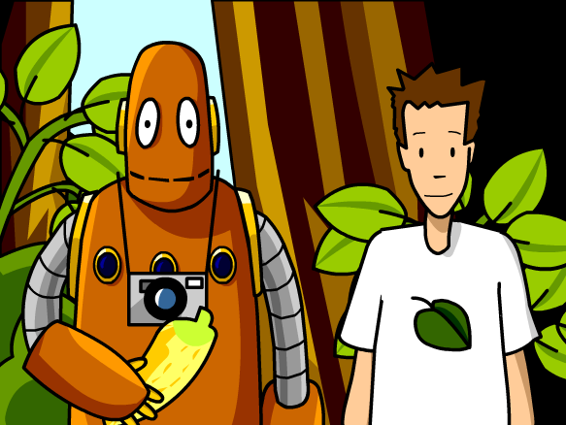
Time for some BrainPop on Photosynthesis!
Notes:
https://www.brainpop.com/science/cellularlifeandgenetics/photosynthesis/

Slide 7
Knowledge Check
Explain how do all plant cells capture and store energy?
Where does photosynthesis take place?
Explain how photosynthesis is important to life of earth?

Slide 9
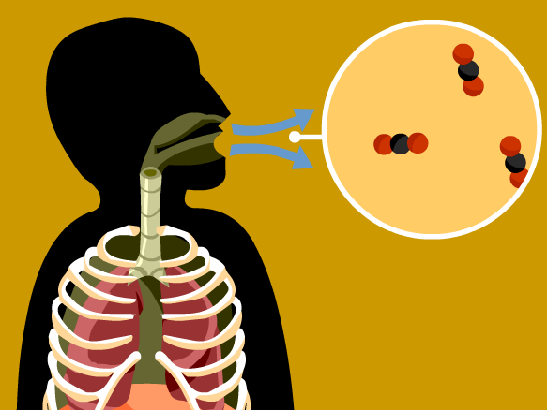
# 63 Cellular Respiration Notes

Slide 10
So what about animals? Do they photosynthesize?
*Animal cells do not photosynthesize but they do undergo a process known as cellular respiration

Slide 11
Cellular respiration is the process through which our cells get the energy to perform their functions.
Since all living things are made of cells, and cells need energy to perform life's functions, cellular respiration is necessary for all living things
*There are 2 types of cellular respiration:
Aerobic and anaerobic

Slide 12
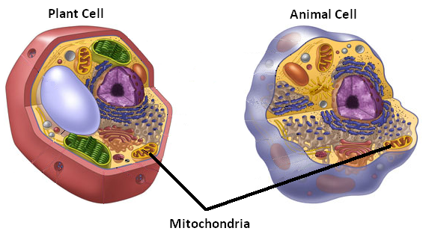
*Respiration occurs in ALL cells and can take place either with or without oxygen present.

Slide 13
*Cellular Respiration
Cellular respiration is the process in which glucose and oxygen undergo a chemical reaction to produce (ATP) energy, carbon dioxide, and water.
Occurs in mitochondria.
C₆H₁₂O₆ + O₂ → Energy (ATP) + CO₂ + H₂O

Slide 14
Cellular Respiration…Lets read about it…
Turn to pages E51
Draw, color, and label a picture (aerobic)

Slide 15
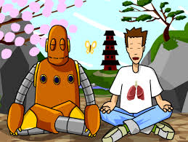
Time for a BrainPop on Cellular Respiration
Notes:
https://www.brainpop.com/science/cellularlifeandgenetics/cellularrespiration/

Slide 16
Aerobic respiration
During aerobic respiration oxygen is present
During this process food molecules and oxygen are broken down from sugar molecules (glucose) to energy known as ATP, water and waste (CO₂).
*ATP stores energy in a strong bond which can be broken down to harness the energy.

Slide 17
So what if no oxygen is present?
*Anaerobic respiration occurs when no oxygen is present. This is also called fermentation.
There are 2 main types of fermentation alcoholic or lactic acid fermentation. Depending on the reaction either ethanol (alcohol) and carbon dioxide are produced or lactic acid.
*Much less ATP is produced in anaerobic respiration. This produces 2 ATP molecules instead of the 36 produced in aerobic respiration

Slide 18
Knowledge Check
Read page E54 and explain why you breathe so hard after a long run and your muscle begin to ache (tingle).
Draw and explain the picture on the next slide

Slide 19
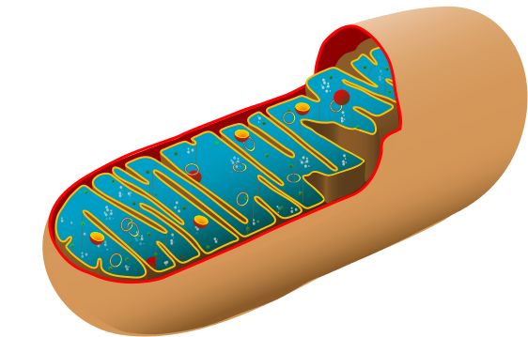
Light energy
Photosynthesis
Plant cell (chloroplast)
H₂O
+ CO₂
Glucose
+ O₂
Animal cell
(mitochondria)
ATP Energy
Cellular Respiration

