Slide 1
Write these dates in your planner
Fri 9/13 – Greek and Latin Quiz 2 flashcards
Wed 9/18 Post Quiz (formal grade)
Fri 9/20 – Earth History Pt 1 Test (formal)
Fri 9/27 – Greek and Latin Quiz 2

Slide 2
Update Your TOC
Page 7 Density Soap Lab
Page 8 Earth’s Layers Notes

Slide 3
Warm-up
How would you explain the Big Bang Theory to someone who hasn’t heard it before?
https://www.youtube.com/watch?reload=9&v=nVsHjnY-o9s

Slide 4
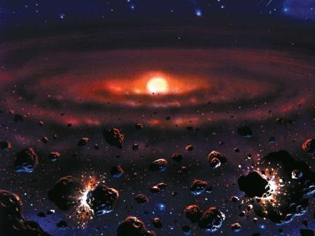
So where did it begin?
We don’t exactly know how the universe began but some scientist theorized…
Remember theories are just a HYPOTHESIS!
Notes:
Theories aren’t proven true! You do not have to believe this!!!
It is theorized that the universe was created approximately 14.4 billion years ago. According to the Big Bang Theory, in the beginning the universe was all one place. Within this small place all matter and energy was squished into this infinitely small point, then exploded! Then approximately 10 billion years later the solar system formed

Slide 5
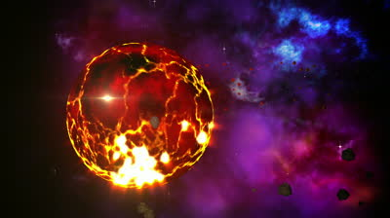
Approximately 4.6 billion years ago the Earth was formed when bits of material collided into one another creating larger pieces of gas and solid chunks
Denser materials (heavier) such as iron sank towards the center of the core
Less dense (lighter) like oxygen and silicon moved towards the surface
Notes:
As the rocks were impacting one another, this along with radioactive decay produced extreme heat which made the earth look like a fireball.

Slide 6
Earth’s Layers Notes
Inner Core* – The most dense layer made of very hot solid metals. The pressure is so great that the heat cannot turn the metals into liquid.
Outer Core* - A layer of liquid metals that surround the inner core.

Slide 7
Inner Core - A ball of hot, solid metals. The pressure is so great that the heat cannot turn the metals into liquid.
Outer Core - A layer of liquid metals that surround the inner core.
Mantle* - Earth’s thickest layer that is made up of hot rocks that are less dense than the metallic core.
Crust*- A thin, outermost layer of cooled rock that completely surrounds the Earth. There are 2 types of crust:

Slide 8
Crust*- A thin, outermost layer of cooled rock that completely surrounds the Earth. There are 2 types of crust:
Continental Crust * - makes up the landmasses
Oceanic Crust * - makes up the ocean floor

Slide 9
Lithosphere* - A rigid (rough) layer of cooler rock in the crust and top part of the upper mantle
Asthenosphere* - A layer of hotter, softer rock in the upper mantle.
Lithosphere
Crust
Asthenosphere
Mantle

Slide 10
So where is the lithosphere and asthenosphere
Lithosphere
Asthenosphere

Slide 11
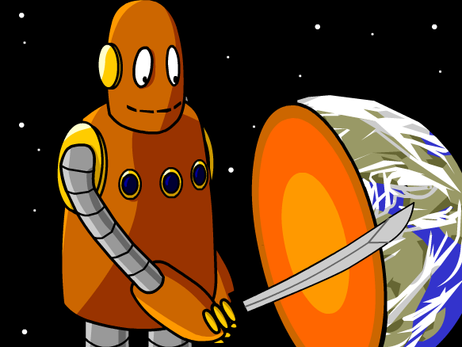
BrainPop: Earth Structure
Notes:
https://www.brainpop.com/science/earthsystem/earthsstructure/

Slide 13
Earth’s Layers Notes
Picture 1 goes here
Notes and Definitions go here!
More definitions here.
Picture 2 goes here

