Slide 1
http://goo.gl/forms/6Kv8bS0KbI
Zero
Take your HW out and have it on your desk. Make sure your name is on your paper!

Slide 2
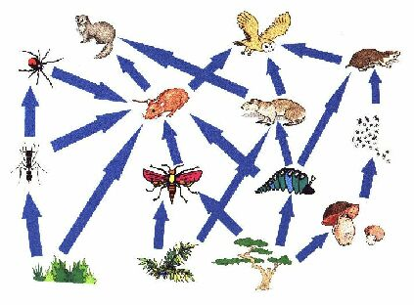
How many producers?
Primary consumers?
Secondary?
Tertiary ?
How many trophic levels are modeled?

Slide 3
Ecology Pyramid Assignment
Each box represents a triangle from the handout I gave you. Please read what I am requiring in each box and complete the ecology pyramid. All triangle MUST BE COLORED to receive full credit. When you finish cut out along the outermost edge, fold, and tape together. Congratulations you have now created a 3-D diagram.

Slide 4
Label the following parts:
Primary consumers
Producers
Tertiary consumers
Secondary consumers
Omnivores
Carnivores
Autotrophs
Heterotrophs
Herbivores
ENERGY PYRAMID
Label each trophic level.
Read the handout to help explain an energy pyramid. Also watch this video again for further clarification
https://www.youtube.com/watch?v=CReZd9OHEfs
If the sun starts with 1,000,000 kcal (a type of units) of sunlight, how much kcal will be present on each trophic level. Write the numbers on each level and the number of how much energy is lost at each level
Draw pictures and write the names of the organisms you drew on the appropriate level:
The organisms must be accurately positioned on the diagram
4 producers
3 primary
2 secondary
1 tertiary
Color the background of the autotrophs one color and the background of the heterotrophs another on this pyramid triangle only
BIOMASS PYRAMID
If you start with 1,500,000 lbs of producers, according to the “rule of 10,” theoretically how many animals can be supported on each level.
Write the numbers on each level
Draw and label an arrow showing the direction from most energy to least energy
Draw and label a n arrow in the direction of least organisms to most organisms

