Slide 1
Pg 16 – How Fossils Form Notes

Slide 2
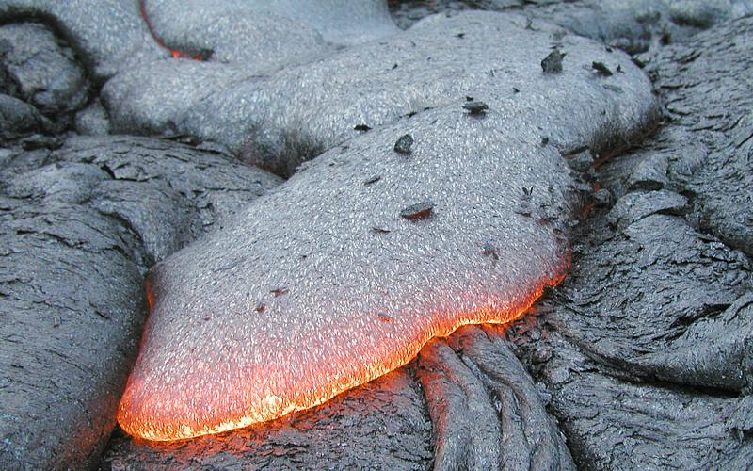
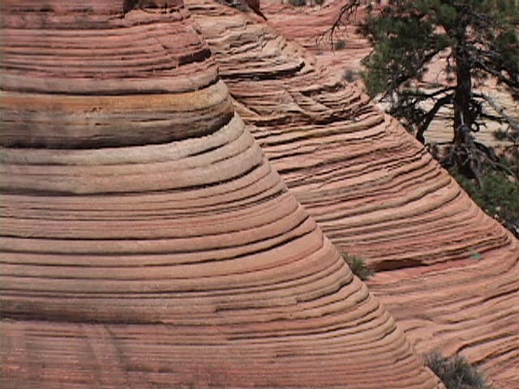
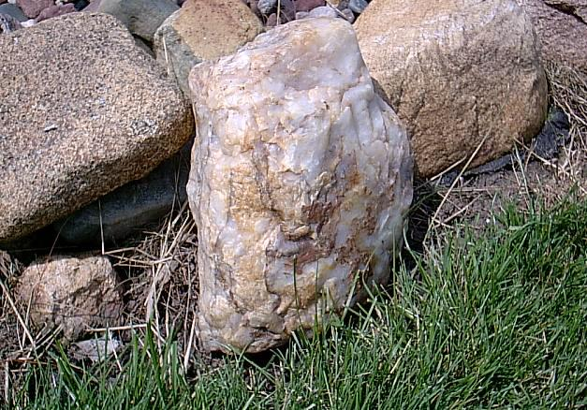
Explain what igneous, sedimentary, and metamorphic rocks are and which picture is a representation of that rock type.
C
A
B

Slide 3
Types of rock
*Igneous -
think of the word “ignites”
*Formed from solidified molten rocks
*Metamorphic –
Think of the word “change”
*Formed when other rocks are changed by heat, pressure, and chemical reactions within the Earth
*Sedimentary -
*Formed when combinations of rock fragments, seashells, and chemicals are composed in layers and hardens

Slide 4
Something to think about…
Out of the three types of rocks, which one do you think will have fossils? Explain which rock type you chose and why the others wouldn’t have any.

Slide 5
Geologist haven’t always agreed to the history of our planet
In fact there was two beliefs explaining how our planet has evolved over time…
Which one do you believe?

Slide 6
The Earth’s Story
*Uniformitarianism
*Theory: Geologic change is gradual process
Scientist: Hutton
*To help me remember:
think of uniform
(they believed the same things we experience in our lifetime such as storms, tornadoes, forest fires, etc. also existed in our past)
* Catastrophism
*Theory: Geologic change is sudden process
Scientist: Lyell
*To help me remember:
Think of catastrophe (disaster)
(Our planet has evolved due to randomized changes that happen inconsistently throughout our history)
Notes:
Hutton known as the father of Geology
Lyell went against Uniformitarianism and believed the present is the key to the future

Slide 7
*Current theory
Modern geology (current theory):
Gradual geologic change is interrupted by catastrophes
To study geologic change involves studying past life. Using fossils to study past life is called paleontology.

Slide 8
Proof the Earth is changing over time
So far we have learned that:
Tectonic plates are moving due to convection in the asthenosphere
Magnetic reversals have been recorded in the sea floor, and we’ve noticed how the “magnetic compasses” have changed directions over a course of time

Slide 9
Looking at Fossils
*The remains or traces of physical evidence of an organisms preserved by key geologic processes is called a fossil.
*Fossils are important because they give us clues about the past
Most fossils are hardened animal remains such as shells, bones, teeth, and skeletal body parts
Other fossils are impressions or preserved organisms found in rock

Slide 10
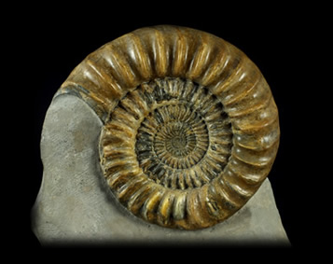
*How Are Fossils Formed
Conditions have to be just right for fossils to from in rock
Organisms must be preserved before it decomposes or disappears
Usually soft parts decays too fast, which is why fossils only really show hard parts of plants and animals
Fossils form in the layers of sedimentary rock

Slide 12
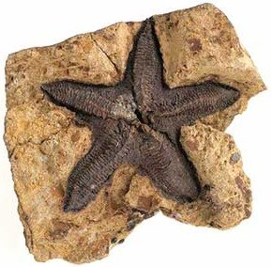
Original Remains
*Fossils that are the actual bodies or body parts of organisms are called original remains
*Original remains are found in places where conditions prevent the decomposition or breakdown to occur

Slide 13
Types of Original Remains
*Ice – best preserver of prehistoric life. Ice has preserved original remains of things such as a 10,000 year old mammoth which have been found with bones, muscles, skin, and hair still in place
*Amber – formed from the sticky substance inside trees that flows like syrup. If an insect is caught in the sap, the sap will cover the insects entire body and harden.
*Tar – thick, oily pool of liquid. Things such as saber toothed cats and other animals were trapped and preserved

Slide 14
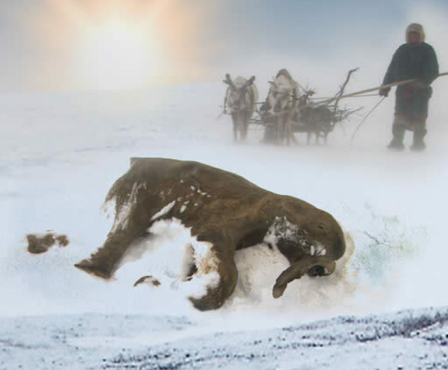
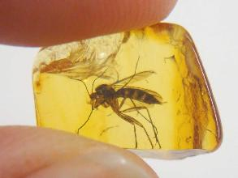
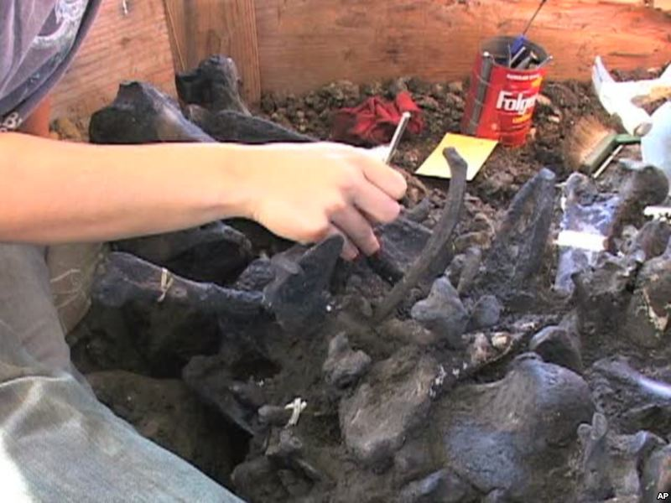

Slide 15
Page | Requirements
Cover page | Name, block, picture of fossil, title - “Type of Fossils"
Page 1 | Explain both molds and cast fossils, give an example and picture of both
Page 2 | Tell what a trace fossil is then explain the 3 types of trace fossils (1 sentence a piece). Include a picture
Page 3 | What is petrified wood? Why is this considered a fossil? What are carbon films and why are they special fossils? Include a picture
Page 4 | What do ice cores and tree rings tell us about our past? Include a picture
Page 5 | What is an original remain? Explain the 3 types of remains. Include a picture

