Slide 1
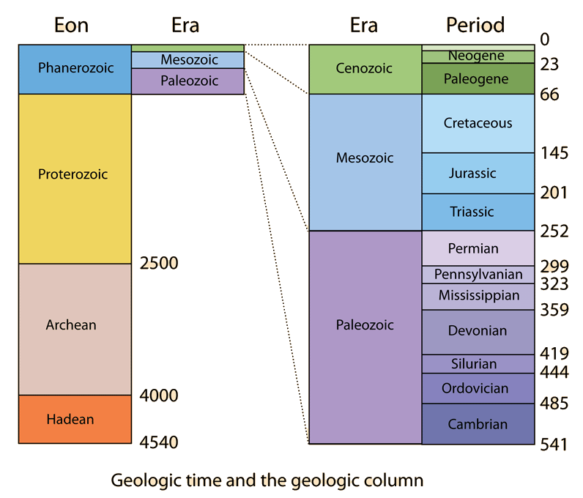
#13 Bill Nye Fossils #14 Geologic Time Scale Notes

Slide 2
The Earth is pretty old
*The Earth is approximately 4.6 billion years old
That’s 4,600,000,000 years worth if history since the Earth first came around!
So how do we group trends and history within the Earths history?
Any guesses???

Slide 3
*When dating different parts of the earth’s history, scientist group increments of time based off mass extinctions and geological events
The geologic time scale is broken down into 4 subgroups to help us get a better idea of how life was in the past.

Slide 4
Divisions of time
*Eons – Are the largest, broadest unit of geologic time. Eons are cover so much time, in order to see trends they are divided into smaller subcategories.
*Eras – smaller subdivisions of eons are called eras. Eras are the second longest unit of geological time that are often separated by mass extinctions. Ex.- Paleozoic, Mesozoic, and Cenozoic
Organizing time in large increments like this allows us to ask broad, big picture questions such as:
was there life on our planet during this time?
And if so, what did it look like?

Slide 5
Divisions of time
*Periods –Are smaller, more specific groupings of time within each era. Periods within the geologic time scale are often separated by trends found within rock layers
*Epoch – most recent, short period subdivisions. Starts in the Cenozoic Era.

Slide 6
Precambrian Time
*Consists of the Earth's first 3 eons of time.
It began with the creation of the Earth around 4.6 billion years ago.
*Makes up about 90% of the Earth’s History (the first 4 billion years!!!)
*The fossils mostly had soft bodies
which rarely formed into fossils.
*Near the end of Precambrian Time,
life appeared as small unicellular
organisms (like bacteria).

Slide 7
Precambrian Time Continued
5 major events occurred during this time:
the formation of the Sun and light
the creation of the Earth
the creation of the atmosphere through volcanic out-gassing
the creation of the oceans
the creation of life.

Slide 8
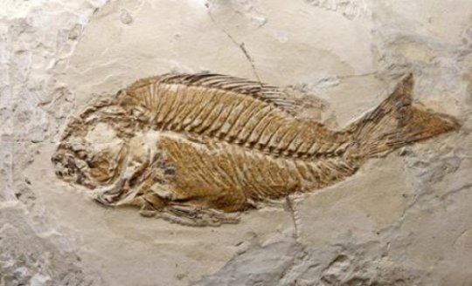
*Paleozoic Era
Life consisted mostly in the ocean
Fish were the 1st animals with backbones
Toward end of era life moved onto land.
Ex. reptiles, insects, ferns
A mass extinction ended the era and caused most ocean life and amphibians to disappear.
The cause of this extinction
is not understood

Slide 9
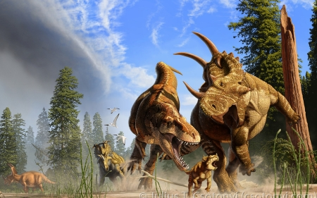
Mesozoic Era
*Reptiles were the dominant animals of this era, including the various dinosaurs.
*Small mammals and birds also appeared.
Toward the end of the era, flowering plants appeared and the different types of mammal species increased.
*A mass extinction ended this
era and caused the dinosaurs to
become extinct.
Does anyone know what was
theorized to kill the dinos?

Slide 10
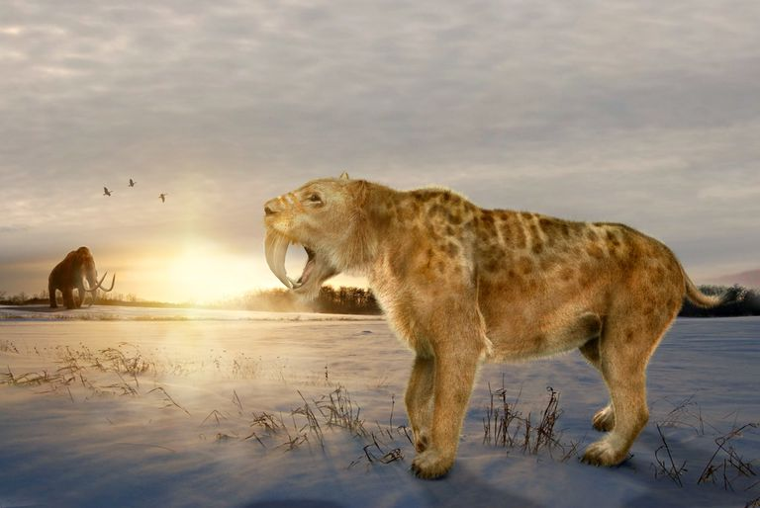
Cenozoic Era
*Most recent era. Began 65 million years ago and continues today!
*Mammals dominated this era
Diversity of life forms increased. New mammals
appeared while others became extinct.
*Humans are part of the
most recent period within
this era.

Slide 11
Earths history on the span of your arm

Slide 12
Ways to understand the earths age
https://www.youtube.com/watch?v=tkxWmh-tFGs
3:44 mins

Slide 13
Recap
Explain the structure of the geologic time scale
What is the order from largest to smallest: period, eon, epoch, era
Each era ended due to what?

Slide 14
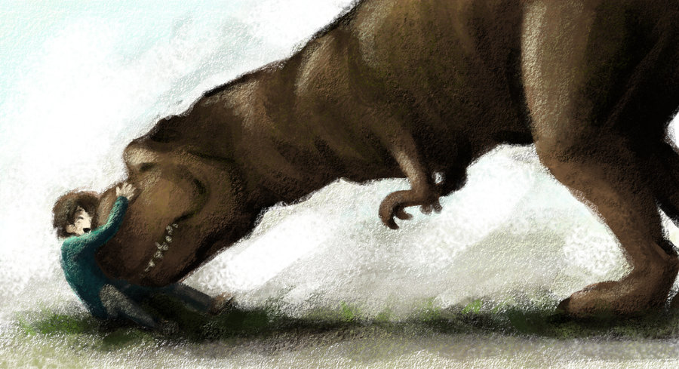
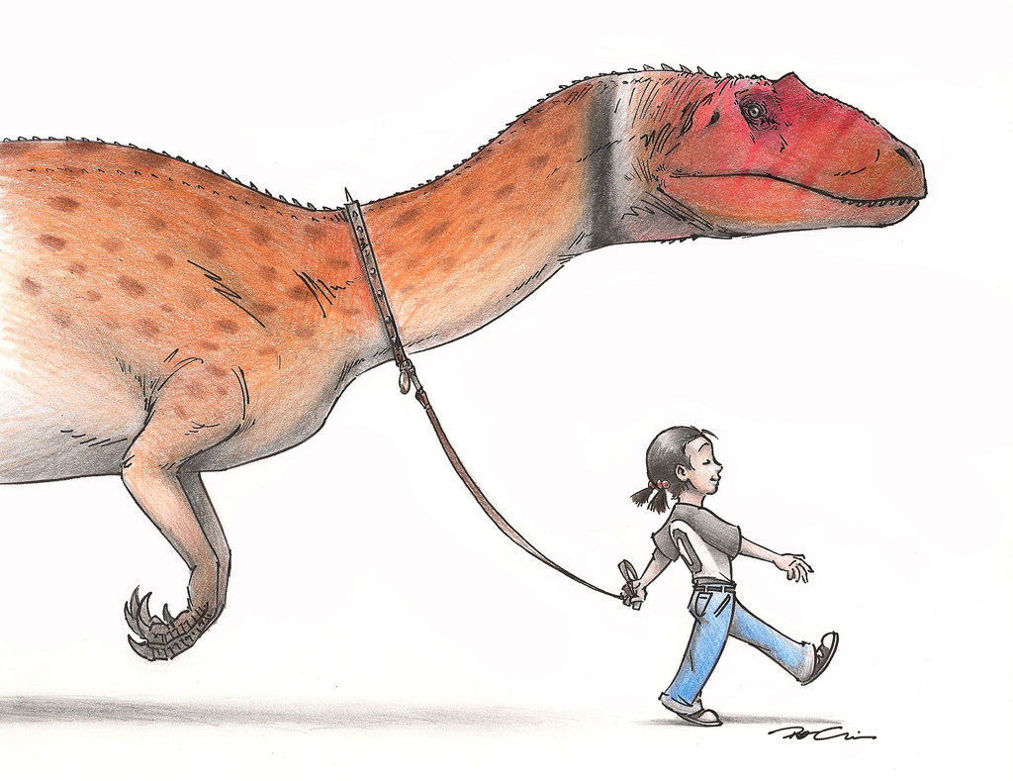
Knowing what we do about the geologic time, what’s wrong with these pictures

Slide 15
PBS – A Brief History of Geologic Time
https://www.youtube.com/watch?v=rWp5ZpJAIAE
~12 min

Slide 16
EXTRAS

Slide 17
https://clarkscience8.weebly.com/geologic-time.html

Slide 18
Warm up
When looking at the geologic time scale, explain if humans were here for a minute period of time or long period of time. Justify your answer. (look in textbook to help A64)
What are fossils and what can they tell us?
Use the following words:
Paleontologist
Index fossil
Sedimentary rock
Layer

Slide 19
Superposition Practice
With your 8 pieces of paper, arrange the pieces in order according the law of superposition.
***fossil D is younger than fossil A****

Slide 20
Match each number to corresponding letter
An animal builds an underground habitat which got preserved over time
a 3-deminsional model of organism
Minerals soaked into buried remains making them harden into rock
Trapped air bubbles tells use about past atmosphere and climate
Tilting and folding
This organism was found in various places in Africa, Asia, and South America. These fossils are only found from 278 million years - 280 million years ago
Rare fossil found shows the soft parts that usually don’t get preserved
This organism was only found in Antarctica and existed for over 100 millions of years
Impression left after dino died and decayed away
Small insects get trapped in amber which lets us see small life forms in past
Mold
Index fossil
Preserved remain/Original remain
Cast
Petrified fossil
Trace fossil
Carbonized fossil

