Slide 1
Recap
Subatomic particles
Mendeleev v. Mosely

Slide 2
How small is an atom?
https://www.ted.com/talks/just_how_small_is_an_atom?language=en

Slide 3
#33 Groups and Periods: Periodic Table Properties

Slide 4
*Period (Row) Properties
There are seven horizontal periods on a periodic table (numbered from the top down)
Atomic numbers and atomic masses increase as you move from the left to the right in a period
All atoms of the elements in the same period have the same number of shells
Example
Period 1 = 1 shell
Period 2 = 2 shells
Period 3 = 3 shells
Etc…

Slide 5
Important Features of the Periodic Table: Periods (Row)
Periods are the horizontal rows of elements on the periodic table
How many
periods (rows)
are on the
Periodic Table
Of Elements?
FROM LEFT TO RIGHT OR RIGHT TO LEFT

Slide 6
*Group (Family) Properties
There are eighteen vertical groups on the periodic table (numbered from left to right)
Atomic numbers and atomic masses increase as you move from the top down in a group (family)
Atoms of elements in the same group have the same number of valence electrons
Exceptions:
Transition elements (3-12)
Hydrogen (could be similar to groups 1 or 17)
Helium (actually has 2 valence electrons)

Slide 7
Important Features of the Periodic Table: Group (Family)
These are the columns of elements on the periodic table
How many groups (families)
are on the
Periodic Table
Of Elements?
FROM TOP TO BOTTOM OR BOTTOM TO THE TOP

Slide 8
*How can I remember this…
Periods Pull
Groups Grow

Slide 9
Group properties textbook notes
Turn to page D26-32 in textbook and read about the different groups on the periodic table
Color your small periodic table based off the colors mentioned and take notes on the groups mentioned on the next slide.

Slide 10
#34 – Group properties notes D26-32
Color hydrogen –red
Group 1 –yellow
Group 2 - orange
Groups 3-12 – light brown
Group 17 – green
Group 18 – blue
Bottom two rows - purple

Slide 11
#37 – Group properties notes D26-32
Color hydrogen –red
Group 1 –yellow
Group 2 - orange
Groups 3-12 – light brown
Group 17 – green
Group 18 – blue
Bottom two rows - purple
Notes need to be organized like so:
Carbon family (Group 14)
Information about this group written here.
Nitrogen family (Group 15)
Information about this group written here.

Slide 13
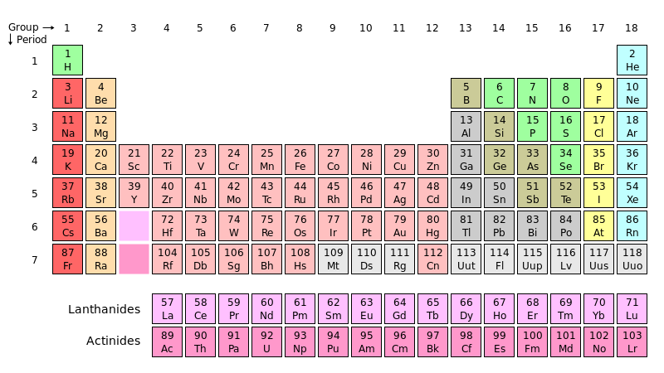
Period
A horizontal row in the Periodic Table.

Slide 14
Group
A vertical column in the Periodic Table.

