Slide 1
#36 Metals, nonmetals, and metalloids notes
Color your small periodic table as shown on next slide and create a key

Slide 2
nonmetals
metals
metalloids

Slide 3
Read handout and answer the following:
Define physical and chemical property.
How can physical and chemical properties be helpful in determining differences between elements on the periodic table?
What are the properties of metals? Nonmetals? Metalloids?
Notes:
Blue coach book pages 16-17

Slide 4
Flip your notebook sideways and create a double T chart like this one. It should take up your entire page
Metals
Non-metals
Metalloids

Slide 5
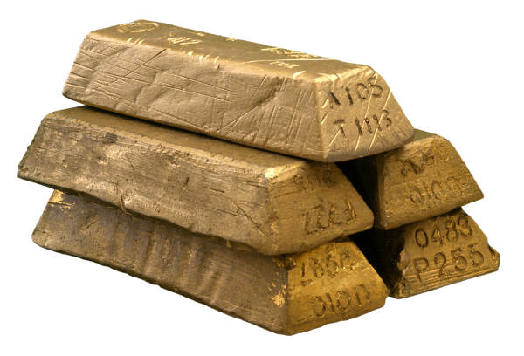
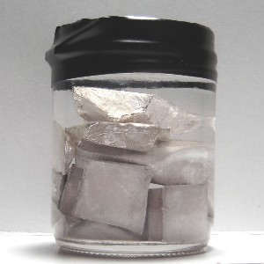
*Metals
Location
Found on the left of the zigzag line/staircase on the periodic table (exception → Hydrogen is a nonmetal)
Chemical Properties
Have few electrons in their outer energy shell, thus lose electrons easily
Physical Properties
Ductile (can be rolled into wire)
good conductor of heat and electricity
malleable (can be hammered into thin sheets)
shiny
most are solid @ room temperature
79 Au 196.967
11 Na 22.990
What metal is not a solid
@ room temperature?

Slide 6
Atoms with Few Electrons in their Outer Energy Level
Notice: only 1 electron in outer level
11 Na 22.990
-
+
-
+
+
-
-
+
-
-
-
-
+
+
+
+
+
-
+
+
+
-
+
-
4 Be 9.012
+
+
Notice: only 2 electrons in outer level
-
-
-
-

Slide 7
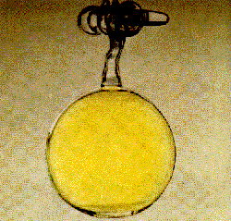
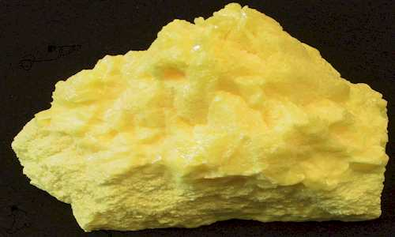
*Non-Metals
Location
Most found to the right of the zigzag line/staircase on the periodic table
Chemical Properties
Most have almost full outer shell, thus they tend to gain electrons; some have completely full outer level
Physical Properties
not ductile, not malleable, dull in appearance, poor conductors of heat and electricity, most are gas at room temperature
17 Cl 35.453
16 S 32.066

Slide 8
Atoms with Full or Almost Full Outer Energy Level
8 O 15.999
-
-
Notice: 2 electrons in outer level – FULL
-
-
+
+
+
-
+
+
+
+
+
-
-
+
+
-
-
2 He 4.003
-
-
-
-
Notice: 6 electrons in outer level – almost full
-
+
+
+
+
+
+
+
-
Notice: 7 electrons in outer level – almost full
+
+
-
9 F 18.998
-
-
-

Slide 9
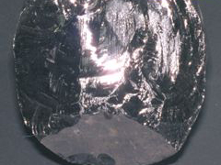
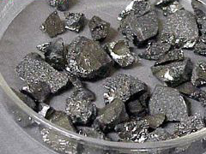
*Metalloids
Location
Border the zigzag line/staircase on the periodic table
Chemical Properties
Most atoms have ½ (≈) complete set of electrons in outer level
Physical Properties
Metalloids have properties of both metals and non-metals
They are semi conductors, which means they conduct heat and electricity better than nonmetals, but not as good as metals
14 Si 28.086
5 B 10.811

Slide 10
Atoms with ½ (≈) Complete Outer Energy Level
-
Notice: only 4 electrons in outer level
5 B 10.811
-
+
+
-
+
+
-
+
-
-
-
-
-
-
+
+
+
+
+
+
+
Notice: only 3 electrons in outer level
+
+
+
-
-
-
-
+
+
+
+
-
14 Si 28.086
-
-
-
-

Slide 11
Determine the atomic mass and atomic # without using a periodic table
Atoms | Protons | Neutrons | Electrons
Carbon | 6 | 6 | 6
Beryllium | 4 | 5 | 4
Oxygen | 8 | 8 | 8
Lithium | 3 | 4 | 3
Sodium | 11 | 12 | 11

