Slide 1
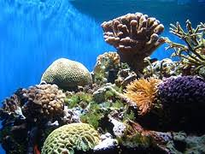
Neritic Zone
R
Kieran Velez, Robby Frye, Davis Jorgensen, and Lilliam Urquilla

Slide 2
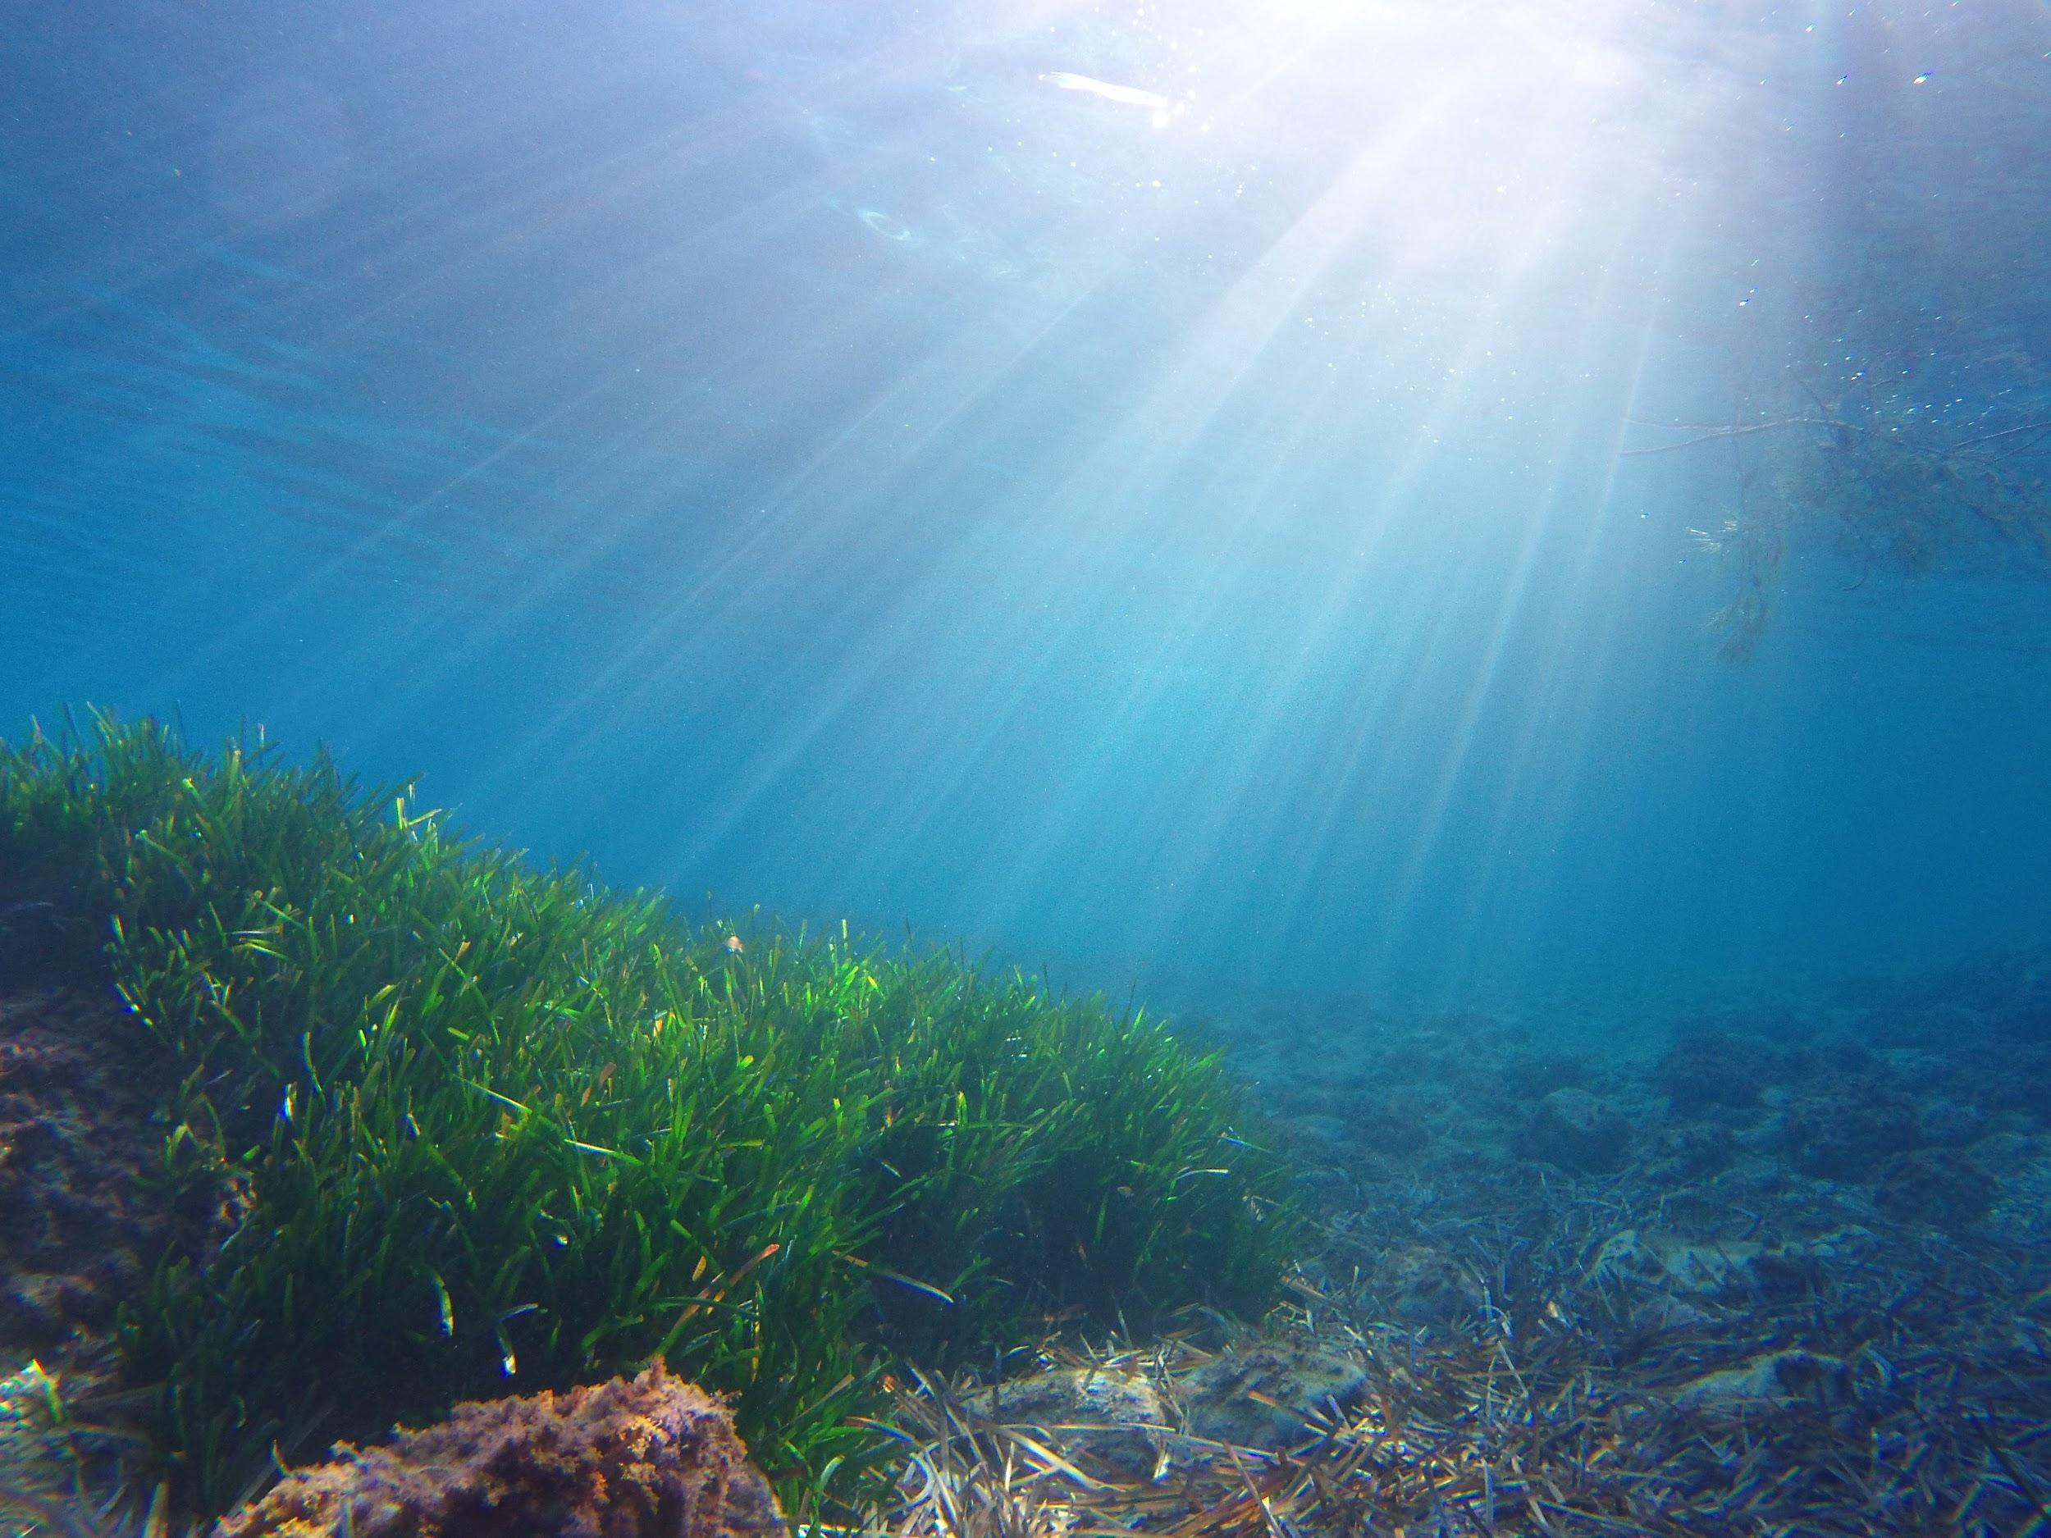
Motto
D
We are the place where the sun does shine!
Notes:
https://www.britannica.com/science/neritic-zone

Slide 3
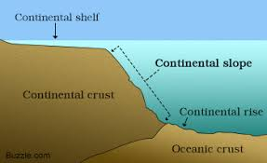
What is the Neritic Zone?
L
The neritic zone of the ocean is the top 660 feet (200 meters) of the ocean completely lit by the sun. This sunlight allows many organisms to photosynthesize.
This zone sits on the continental shelf, which is the relatively shallow part of the ocean compared to the depths of the open ocean. The zone goes all the way up to the continental slope, where the land drops off from the edge of the shelf into the deep sea. We will go into more description in a later slide.
Notes:
https://www.britannica.com/science/neritic-zone
https://www.dictionary.com/browse/continental-shelf

Slide 4
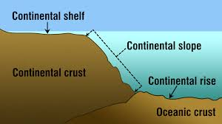
Continental Shelf and Continental Slope
R
Our zone is located on the continental shelf. The Continental Shelf is the portion of the continent that is gradually sloping into the ocean water. The continental shelf extends from the coast to about 330 to 660 feet out before you see a rapid drop of land. The steep descent of land into the ocean is called the continental slope.
The continental slope is the area between the end of the continental shelf and the beginning of the deep sea. The continental slope starts at about 330 feet out and goes to about 10, 500 feet.
There is such a steep drop-off because continental crust is much thicker than the oceanic crust. This creates a great difference where they meet which is the continental slope.
Notes:
https://www.nationalgeographic.org/encyclopedia/continental-shelf/ ,

Slide 5
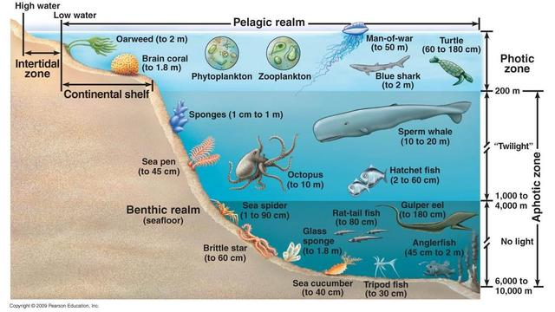
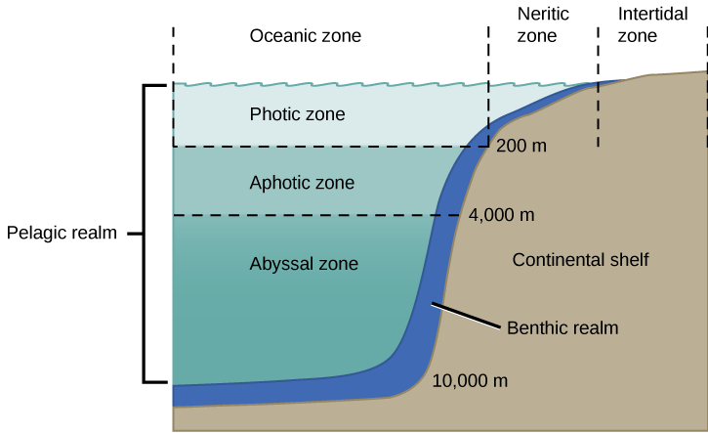
Depth of the Neritic Zone
D
Depth
The Neritic Zone is approximately 200 meters (660 feet) in depth.
Considering the fact that the ocean can reach a depth of 36,069 feet , this is a relatively very shallow layer of the ocean in comparison to the ocean as a whole

Slide 6
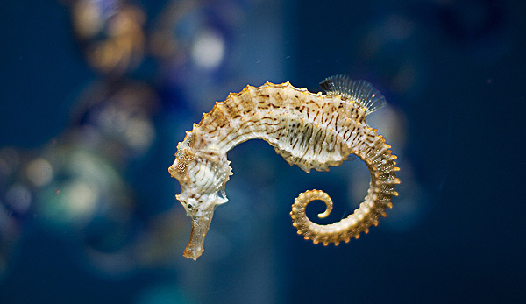
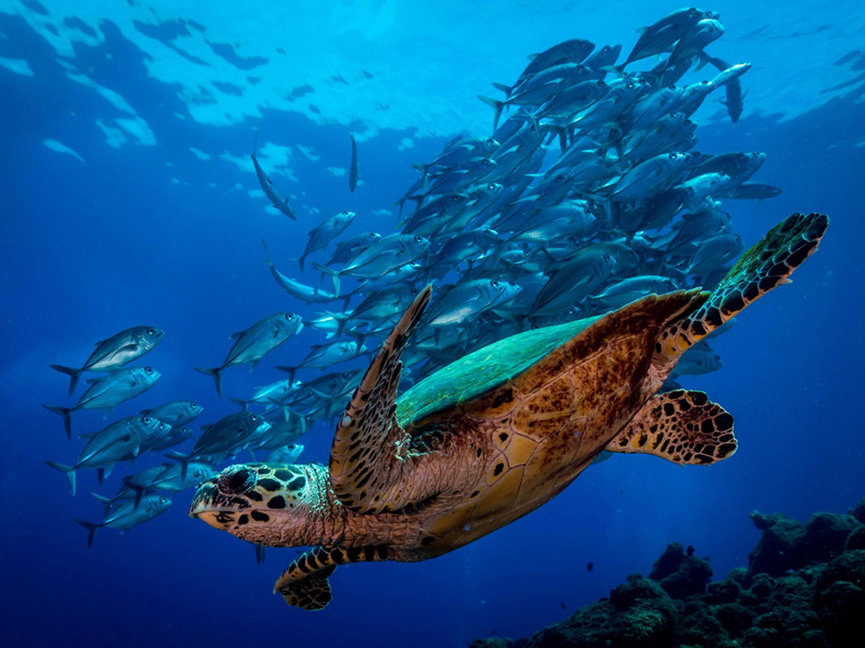
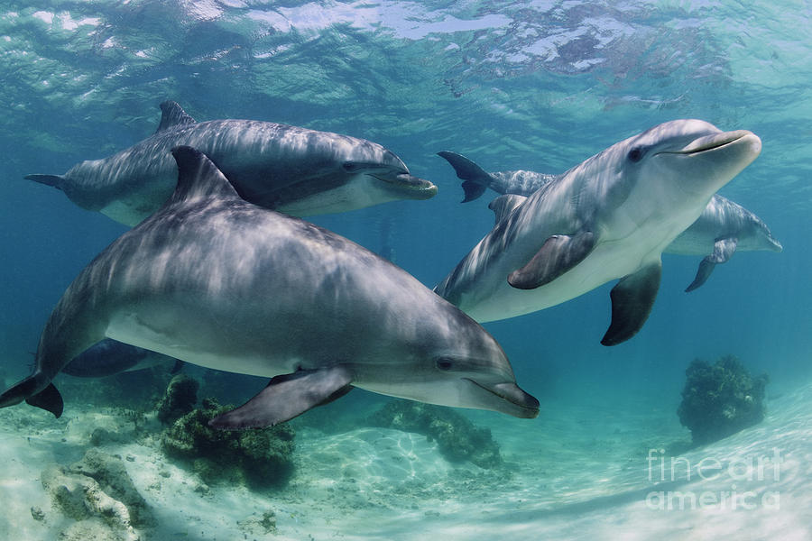
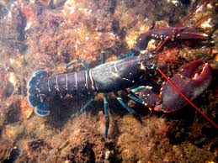
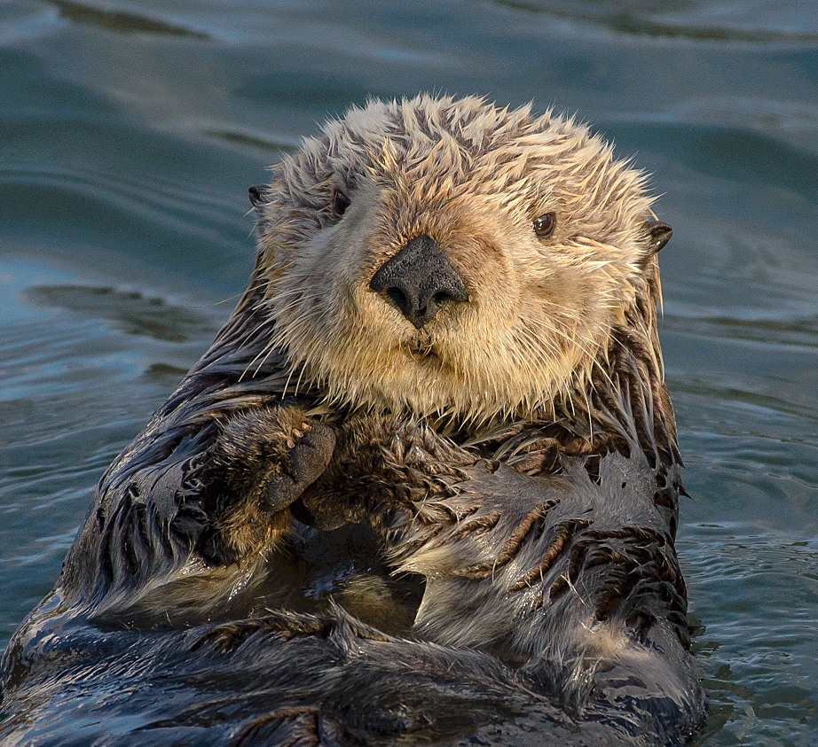
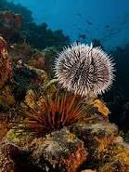
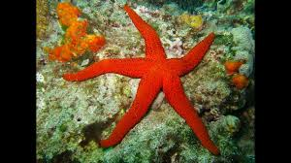
Animal Life
K
Sea turtles
Lobsters
Dolphins
Marine Otters
Sea Stars
Sea Urchin
Seahorses

Slide 7
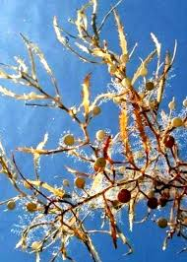
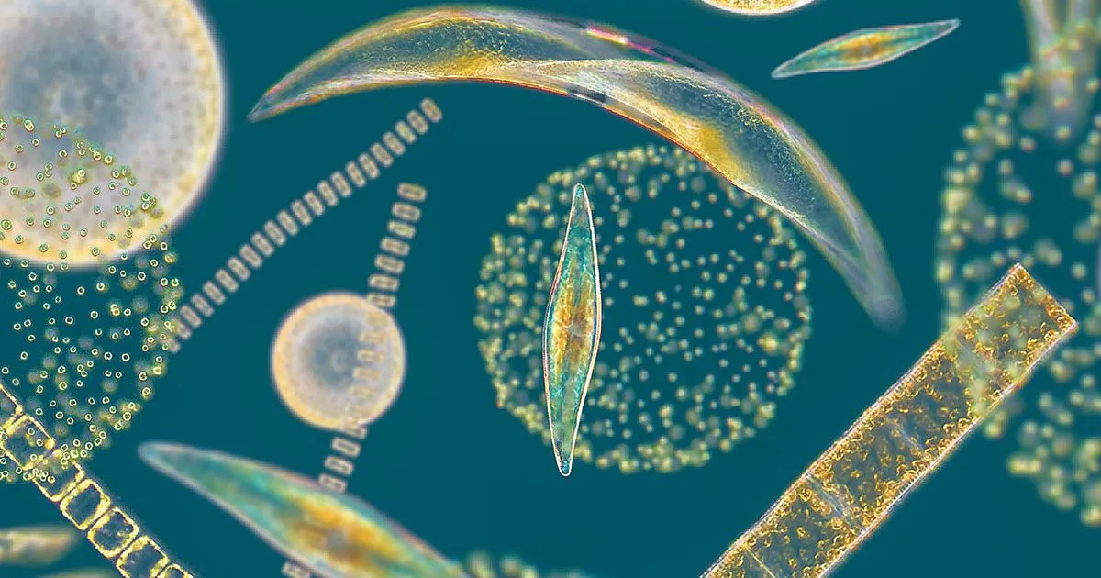
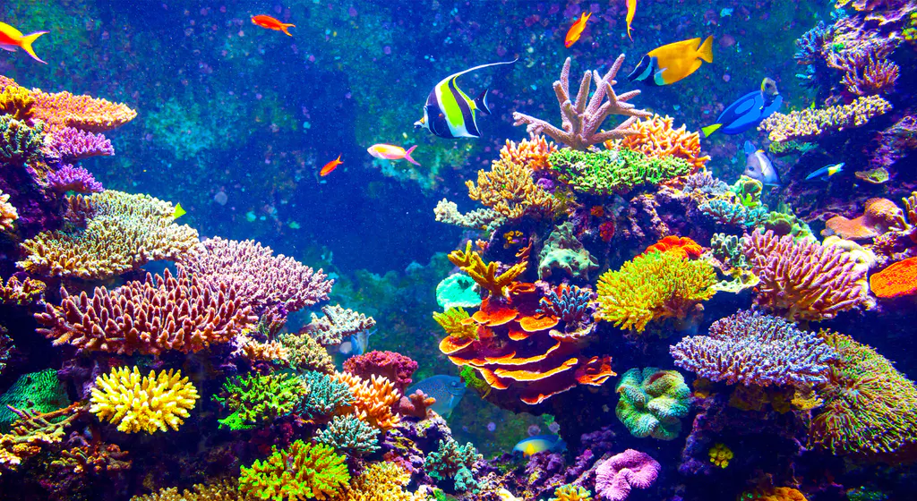
Plant Life
L
Plant life in the neritic zone is important to the ecosystem, both within this zone and globally. The Neritic Zone is important because it's one of the largest homes of plants in the world.
Plankton
Seaweed
Coral reefs

Slide 8
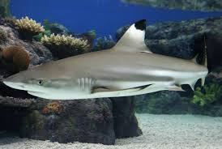
Facts Worth Noting
R
Sharks are known to be the main predators in the zone.
There is a high number of fish and dolphins in this area
The Neritic zone only takes up about eight percent of the ocean.
The neritic zone is home to the largest variety of life in the world with thousands of different species of sea life, such as coral and sea snakes that are found nowhere else in the world.
Notes:
https://sciencestruck.com/interesting-facts-about-neritic-zone

Slide 9
Questions
D
How does the continental shelf differ from the continental slope?
2. Why are plankton and other bottom dwelling organisms able to go through the process of photosynthesis in this layer?
3. What is the maximum depth in the neritic zone?
65 Feet C. 660 Feet
200 Feet D. 1312 Feet
Notes:
Correct answer for #3: C

Slide 10
Answers:
K
The continental shelf differs from the continental slope by the shelf is the relatively shallow part of the ocean that we can walk on and slowly slopes down until it reaches the continental slope. The slope is the part of the seafloor that drops off very drastically into the deep ocean
The reason that plankton and other bottom dwelling organisms are able to go through the process of photosynthesis is because of the amount of sunlight that is constantly penetrating through this layer.
The maximum depth of the neritic zone is C , 660 feet.

