Slide 1
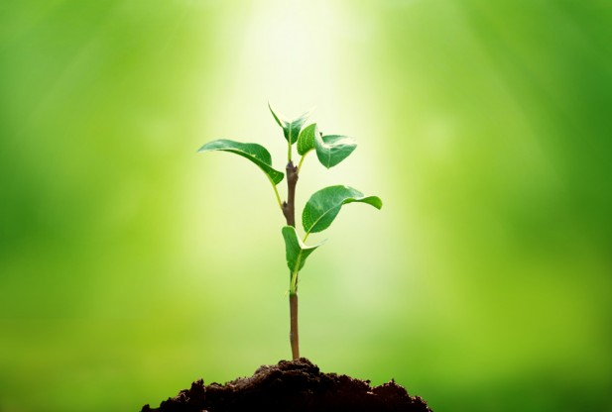
# 61 photosynthesis notes

Slide 2
Upcoming dates
Mon 2/25 – Cells and Biotechnology Post Quiz
Wed 2/27 – Cells and Biotechnology test

Slide 3
Things you need to accomplish by tomorrow
Warm-up
Notes with colored diagram
Webquest
The balancing equations slide will roll over to tomorrow if not finished.

Slide 4
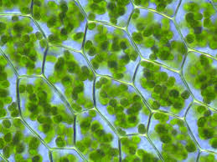
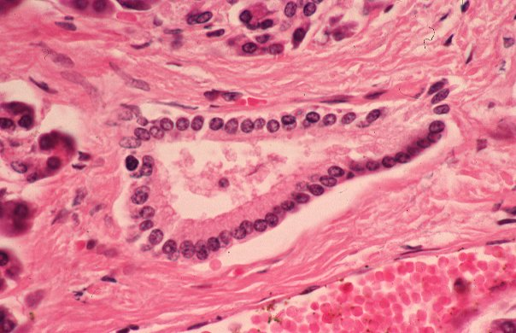
Warm-up
Create a Venn diagram to compare and contrast a plant with an animal cell.
Find as many similarities and differences as possible

Slide 5
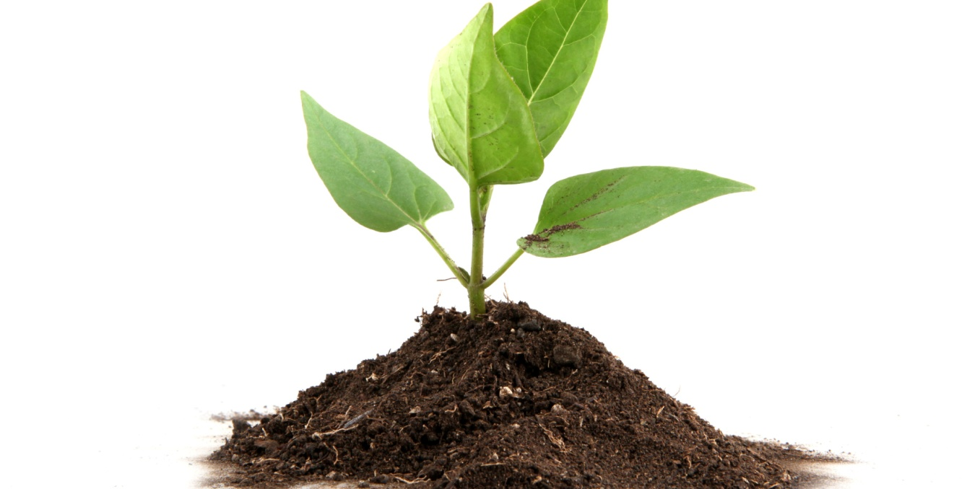
Cell Theory Recap
Every living thing is made up of cells
Cells carry out the functions needed to support life
Cells come only from other living things

Slide 6
*Why is this important?
All living things are made up of cells, which uses chemical energy to carry out functions.
The energy used by almost all forms of life on Earth comes from the _____. Some organisms capture this directly while others use food as a source of energy. Do you have an example of organisms that captures energy directly from the sun?
Sun

Slide 7
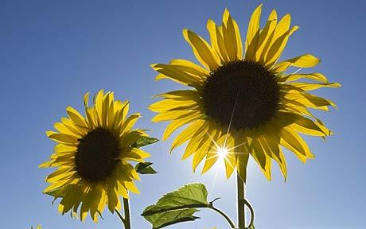
So let's look inside a plant cell...
In order to stay alive all cells need a constant supply of energy from the sun.
Do you know the process in which plants make food (energy)?
Notes:
https://www.youtube.com/watch?v=_xeYNnzwpSE

Slide 8
Watch video
https://www.youtube.com/watch?v=_xeYNnzwpSE

Slide 9
*Photosynthesis
Photosynthesis is the process in which water, carbon dioxide, and light energy (sun) undergo a chemical reaction to produce glucose energy and oxygen.
Occurs in the chloroplast.
Chloroplast contain chlorophyll, a green pigment that captures the suns energy for photosynthesis
H₂O + CO₂ + sun energy → C₆H₁₂O₆ + O₂
(this equation needs to be memorized)

Slide 10
*Photosynthesis
Occurs in the chloroplast.
Chloroplast contain chlorophyll, a green pigment that captures the suns energy for photosynthesis
H₂O + CO₂ + sun energy → C₆H₁₂O₆ + O₂
(this equation needs to be memorized)

Slide 11
Add to notes: Photosynthesis Diagram
turn to page E49 in textbook.
Draw and color the diagram
Label the picture

Slide 12
#62 Photosynthesis WebQuest worksheet
Answer the following questions on the webquest sheet
If you do not finish, it will be homework

Slide 13
Balance the equation and answer the following:
H₂O + CO₂ + sun energy → C₆H₁₂O₆ + O₂
Where in the plant cell would you expect to find this reaction occurring?
Name another organelle in all plant cells that it needs for structure & support.
How many carbon dioxide molecules are in the reactant side of the equation?
If you start with 12 oz. of carbon dioxide & 16 oz. of water, and you end up with 6 oz. of oxygen, how much sugar is produced?

Slide 14
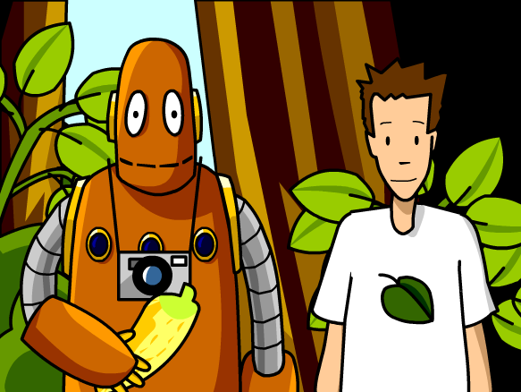
Time for some BrainPop!
Notes:
https://www.brainpop.com/science/cellularlifeandgenetics/photosynthesis/

